Slide 1
Module 2:
Ethanol and Ethanol-Blended Fuels
Notes:
Module Time: 30 minutes/ 40 minutes
Materials:
Emergency Response Considerations video – (Show the video segment from 0:00 to 4:31)
Responding to Ethanol Incidents video – (Total time 19:20)

Slide 2
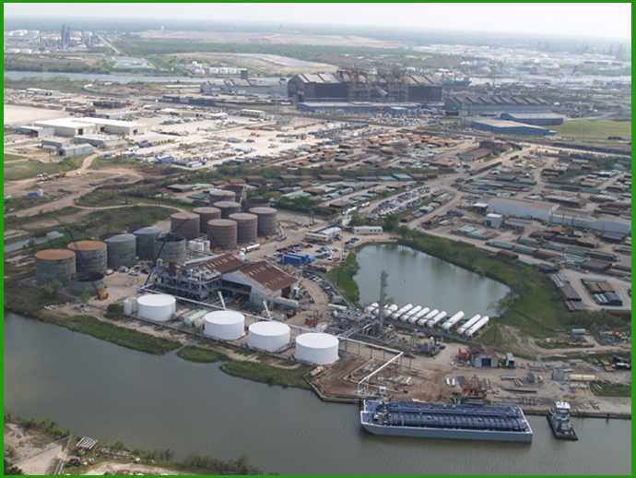
Objective
Upon completion of this module, participants should be able to describe the use of ethanol & ethanol-blended fuels in the United States.
Notes:
Enabling Objectives
1. Describe the differences between gasoline and ethanol-blended gasoline as fuels.
2. List the four most common ethanol-blends.
Denatured Fuel Ethanol, 95-98% volume/ 2-5% natural gasoline
Ethanol Flex-Fuel, 51-85% volume ethanol
E10, 10% volume ethanol/ 90% gasoline
E15, 15% volume ethanol/ 85% gasoline

Slide 3
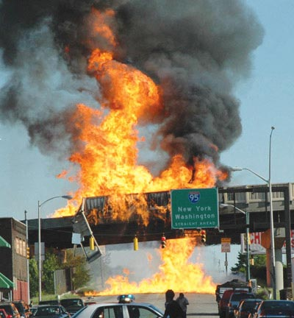
Introduction
May 14, 2007:
Cargo tank truck overturned & burned
8,000 gallons released
Driver killed
Sent burning stream of ethanol onto the road below
Baltimore, MD
Notes:
Show the video Emergency Response Considerations (0:00 to 4:31).
Ethanol, what is the worry?
On May 14, 2007, a cargo tank truck carrying 8,000 gallons of ethanol overturned and burst into flames on an interstate in Baltimore, Maryland, killing the driver and sending a burning stream of ethanol into the street below, igniting a row of parked vehicles.
The following videos in public domain may enhance the presentation of this slide:
https://www.youtube.com/watch?v=F17e1Vjgjr8&feature=youtu.be
https://www.youtube.com/watch?v=LCD_rg3r518&t=41s

Slide 4
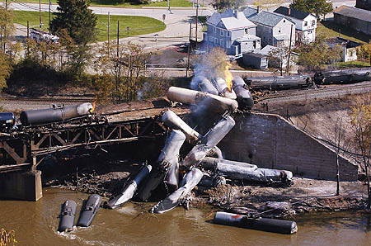
Introduction
October 20, 2006:
Train carrying 86 rail tank cars of denatured fuel ethanol
Train derailed while crossing the Beaver River railroad bridge
Rail tank cars ignited & caught on fire
Some of the unburned denatured fuel ethanol was released into the river & the surrounding soil
New Brighton, PA
Notes:
Ethanol, what is the worry?
On October 20, 2006, a train carrying eighty-six-cars of ethanol derailed in New Brighton, Pennsylvania. Twenty-three cars derailed and approximately twenty of those cars released product. Some of the rail tank cars went into a river while others burst into flames.
On March 3, 2004, an ethanol bulk storage tank containing approximately 1.85 million gallons exploded and burned in Port Kembla, New South Wales, Australia. The explosion blew the roof of the tank 100 feet in the air and landed next to the tank, damaging firefighting equipment for the whole facility.
*See DOT PHMSA Report of Incidents.
Group Discussion:
Ask the participants if they think those will be isolated incidents or if they think the occurrence of such incidents is likely to increase? In other words what is the urgency to learn more about ethanol?
Answer: Domestic consumer use of ethanol is likely to increase each year.
If you have a large ethanol or ethanol-blended fuel fire in your jurisdiction, do you know the best extinguishing agent and the most effective application techniques?
That is what this course is designed to cover. We want to give you an awareness of the use, transport, storages, and extinguishment of ethanol and ethanol-blended fuel fires.
The addition of ethanol to gasoline presents some unique firefighting challenges. Traditional methods of firefighting against hydrocarbon (i.e., gasoline) fires have been found to be ineffective against these polar solvent-type (i.e., ethanol-blended) fuels. While gasoline will tend to float on top of water, ethanol-blended fuels are water miscible and blend readily with the water. For this reason, the use of Alcohol-Resistant Aqueous Film-Forming Foam (AR-AFFF) is recommended as a means of extinguishing an ethanol fire.
Show the video Responding to Ethanol Incidents (total time 19:20).
Group Discussion:
Tell participants that the video focuses on the storage of ethanol and ethanol-blended fuels and the effectiveness of foam on ethanol fires. After the video, ask and discuss the following:
Are traditional suppression methods for gasoline emergencies effective for ethanol and ethanol-blended fuels?
Answer: No
Based on the studies, which foam was the most effective on E10, ethanol flex-fuels and denatured fuel ethanol (E95/ E98)?
Answer: Alcohol-Resistant Aqueous Film-Forming Foam (AR-AFFF)

Slide 5
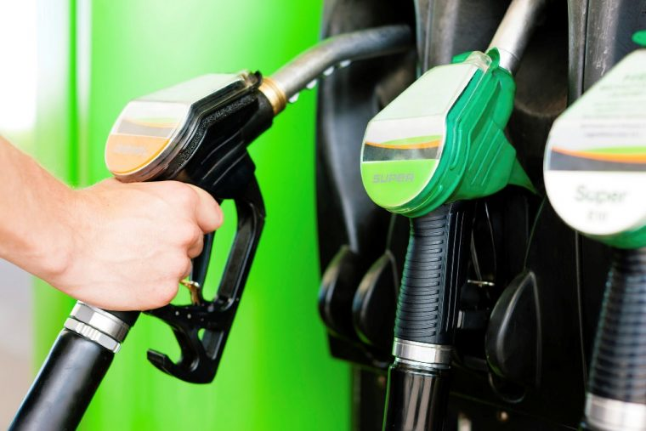
Introduction
Primary automotive fuels are gasoline & diesel
U.S. automobile industry predominantly produced gasoline-powered vehicles
Gasoline & diesel are hydrocarbons derived from crude oil
Notes:
Since the beginning of the twentieth century, the U.S. and the world have become a motorized society. Most families either own an automobile or rely on motorized transportation on a daily basis. For the past 100 years, the primary automotive fuel has been a byproduct of crude oil. Opposite from the European community, which focused on diesel engines for light-duty and passenger vehicles, the U.S. automobile industry has predominantly utilized gasoline-powered light-duty vehicles while heavy-duty or off-road larger vehicles and equipment generally use diesel. Both gasoline and diesel are hydrocarbons (composed of hydrogen and carbon) that are derived from crude oil.

Slide 6
Introduction
Ethanol-blended fuels are a substantial component of U.S. motor fuel market:
Ethanol blended into nearly all unleaded gasoline
Available throughout the U.S. & in all octane grades of gasoline
Bio-refineries, ethanol production facilities, exist in multiple states
Expected increase in transportation needs to bring product to market
Notes:
The nature and characteristics of hydrocarbon fuels are familiar to virtually everyone involved in fire protection today since gasoline and diesel are so widely used and incidents are common occurrences. Notably, ethanol-blended fuels are a substantial component of the U.S. motor fuel market. Today, ethanol is blended into nearly all unleaded gasoline and is sold year-round from coast-to-coast and border-to-border. Ethanol accounts for more than 10 percent of the U.S. gasoline pool and its use is expected to continue growing.
Over 200 ethanol production facilities can be found across the country, with most located in the Midwest. The ethanol production facilities primarily use rail to bring their products to market. The transport of ethanol via rail tank cars has increased significantly over the past decade and is expected to continue to grow.

Slide 7
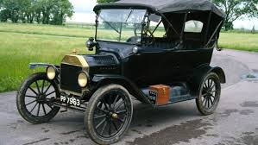
History of Ethanol-Blended Fuels
Ethanol was used to power original Model-T Ford!
Ethanol has been a gasoline additive since the 1980s
Primary role was air quality improvement
Replace lead, MTBE & other harmful chemicals
Secondary role was octane improvement
Current role is octane, air quality, & increase domestic energy production
Notes:
Ethanol for use as a transportation fuel has been steadily growing since the 1980s. As production grew, ethanol was added to gasoline supplies to replace octane enhancers like lead and MTBE as they were being removed from the gasoline supply due to toxicity concerns. The Clean Air Act of 1990 further increased the market share for ethanol-blended fuel due to mandated usage of oxygenated fuels in reformulated gasoline (RFG) in certain areas of the U.S. to help reduce carbon monoxide emissions. RFG refers to extensive changes in gasoline properties that reduce emissions of volatile and toxic organic compounds in ozone non-attainment areas. Fuel oxygenates such as ethanol add chemical oxygen to the fuel, which promotes more complete combustion and thereby lowers carbon monoxide emissions. Hydrocarbon exhaust emissions are also often reduced. Today, ethanol is the most widely used oxygenate for RFG.
Ethanol has a blending octane of 114 and is widely used by refiners to create regular octane gasoline from sub-octane base stocks or to raise regular octane fuels to the mid-octane level. This addition of ethanol to gasoline to boost octane is an alternative to more energy-intensive refining operations, making ethanol one of the most cost-effective octane enhancers available to the refiner and blender today. Mid-level ethanol blends like E20 and E40 can improve engine efficiency and reduce greenhouse gas emissions when used in new internal combustion engines so demand for high octane ethanol will continue to grow.

Slide 8
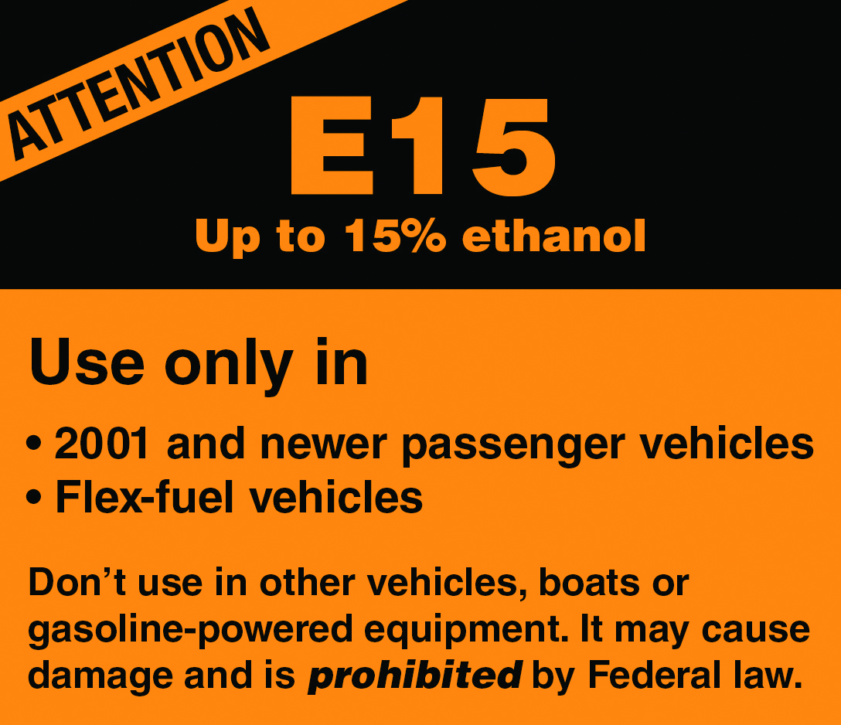
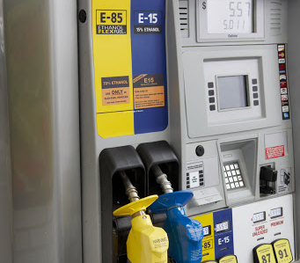
History of Ethanol-Blended Fuels
In 2010s:
EPA approval is up to 15% by volume ethanol (E15) allowed in gasoline
Ethanol flex fuels becoming more available
Notes:
In 2011, the Environmental Protection Agency (EPA) approved E15 (15% ethanol/ 85% gasoline) for use in model year 2001 or newer light-duty cars, trucks and SUVs and in all flexible fuel vehicles (FFVs). Vehicles older than 2001 as well as small engines, boats, and motorcycles are not approved to use E15.
Higher ethanol-blended fuels are growing in use. A common example of this type of fuel is ethanol flex fuel, which is 51-85% ethanol by volume.

Slide 9
Common Ethanol Blends & Ethanol-Blended Fuels
Common Name | Ethanol Concentration | Acronyms/ Synonyms
Ethanol | 100% Volume | Ethyl Alcohol, Distilled Spirits, Beverage Alcohol, Neat
Denatured Fuel Ethanol | 95-98% Volume | E95-E98, Fuel Alcohol
E85* | 51-85% Volume | Ethanol Flex-Fuel, E85
E15* | 15% Volume | E15, Unleaded Gasoline
E10* | 10% Volume | E10, Unleaded Gasoline
* “EXX” is commonly used to indicate the ethanol concentration in volume %.
Notes:
“Exx” is commonly used to indicate the ethanol concentration. The “xx” is the percentage by volume of the ethanol in the fuel.
E100 is produced and marketed as undenatured or neat beverage alcohol.
Denatured fuel ethanol is ethanol that has been denatured with 2-5% of approved hydrocarbon, typically natural gasoline. This blend is also known as E95-E98 or fuel alcohol. Denatured fuel ethanol is one of the top hazardous materials shipped by rail in the U.S.
Ethanol-blended fuels may include blends of gasoline and ethanol in any ratio. Presently there are three common ethanol-blended fuels, with E10 the most common. This is a blend of 10% ethanol and 90% gasoline and is found at all retail fueling stations. E15, a blend of 15% ethanol and 85% gasoline can be sold year-round and its availability and use is expanding. You will also find Ethanol Flex Fuels in the marketplace, which range from E51-E85. This fuel is sold for use in FFVs only.

Slide 10
Summary
Ethanol has been a gasoline additive since the 1980s
Ethanol use has expanded dramatically in the U.S. since the mid-2000s
Ethanol production & use continues to increase
Expected increase in transportation needs to bring product to market
Notes:
Ethanol has been a gasoline additive since the 1980s; however, its use has dramatically expanded since the mid-2000s. U.S. ethanol production and use will continue to increase and there will be an increase in transportation needs to bring this product to market.
Group Discussion:
Ask the participants:
With ethanol-blended fuel use increasing, you can expect to encounter them just about anywhere. What aspect of the use of ethanol-blended fuels might have the most impact on your private life or professional career (i.e., increased production, spill and fire risk, price at the pump, vehicle efficiency, etc.)?
What impacts does increasing ethanol production and use have on transportation?

