Slide 1
Ethanol
Emergency Response
Module 4: Transportation and Transfer
Notes:
Module Time: 30 minutes/ 40 minutes
Materials:
Emergency Response Considerations video – (Show the video segment from 0:00 to 4:31)
Responding to Ethanol Incidents video – (Total time 19:20)

Slide 2




Objective
Upon completion of this module, participants should be able to describe how ethanol-blended fuels are transported & transferred as well as where the most likely points for error in these actions exist.
List common modes of transportation for ethanol-blended fuels.
Describe the
UN/ DOT placards and markings that will allow responders to identify ethanol-blended fuel transports.
Identify national resources available to provide product and mitigation information.
Discuss the likelihood and potential locations of incidents involving ethanol-blended fuels.
Methods of identifying and confirming presence in transport vehicles will also be discussed.
Notes:
Enabling Objectives
1. List common modes of transportation for ethanol-blended fuels.
2. Describe the United Nations/ Department of Transportation (UN/ DOT) placards and markings that will allow responders to identify ethanol and ethanol-blended fuel transports.
3. Identify national resources available to provide product and mitigation information.
4. Discuss the likelihood and potential locations of incidents involving ethanol-blended fuels.
5. Methods of identifying and confirming presence in transport vehicles will also be discussed.

Slide 3
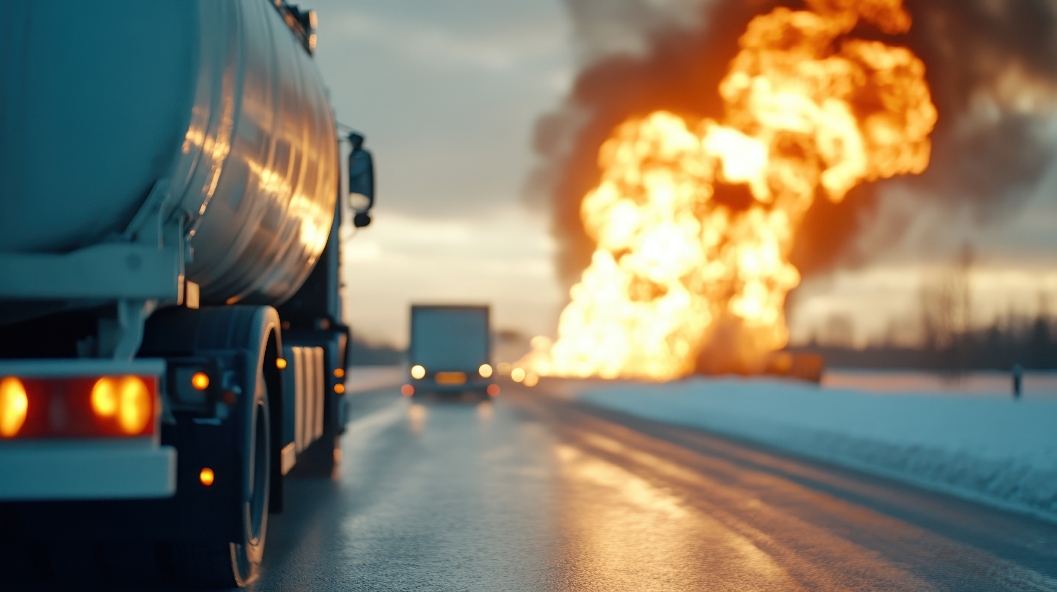

Introduction
Essential to quickly & effectively identify presence of ethanol/ ethanol-blended fuels at scene of incident
Important to recognize proper placarding & marking of ethanol-blended fuels
Steps taken to ensure incidents managed effectively
Notes:
Show the video Emergency Response Considerations (6:48 to 9:30).
Given the increased use of ethanol and ethanol-blended fuel, it is essential that emergency responders be able to quickly and effectively identify their presence at the scene of an incident. It is important to recognize the proper placarding and marking of ethanol-blended fuels. Proper identification of ethanol and ethanol-blended fuels can ensure proper steps are taken so incidents are managed effectively.
Group Discussion:
Ask participants, in their jurisdiction where is the greatest likelihood of an emergency involving Ethanol Flex-Fuels or ethanol transportation?

Slide 4
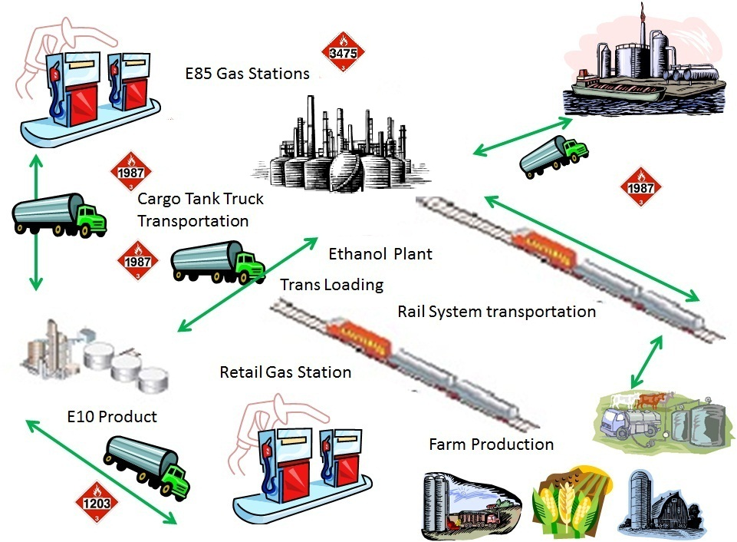
From Field to Your Vehicle
Notes:
Most ethanol transported from an ethanol production facility is denatured fuel ethanol with 2-5% hydrocarbon (like natural gasoline). A smaller quantity of ethanol leaves the production facility undenatured (also known as neat ethanol), for industrial use or export. Less than 1% of gallons shipped from an ethanol production facility are shipped as ethanol flex fuel (51-85% ethanol by volume).
The ultimate destination determines the mode of transport leaving a production facility. Denatured fuel ethanol is delivered to a liquid products terminal, an oil refinery, or directly to a retail fueling station. When shipping to a liquid products terminal or oil refinery, transportation by rail is the most common. However, cargo tank truck transport may be used for short shipping distances. Cargo tank truck transport is used to move product from liquid product terminals to retail fueling stations and, to a lesser extent, from an oil refinery to deliver to retail fueling station.

Slide 5

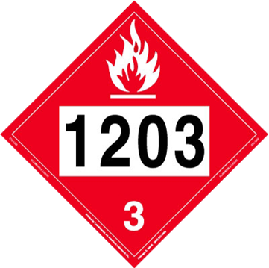
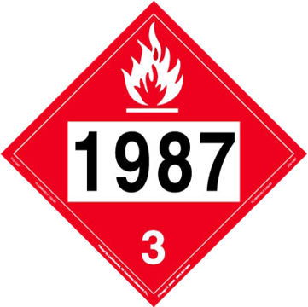
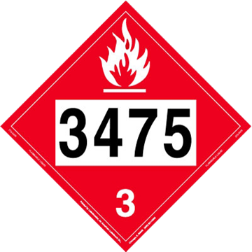
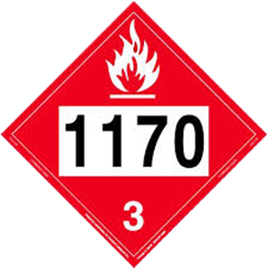
Transport Placards
& Markings
Identify the product through use of DOT placards
Ethanol-blended fuels & gasoline transported in various types of containers
  Cargo tanks
  Rail tank cars
  Freighter ships/ barges
  Pipelines
Notes:
Ethanol and ethanol-blended fuels are identified using DOT placards and markings.
The U.S. Department of Transportation (DOT) requires that vehicles transporting hazardous materials (also known as dangerous goods) must display the appropriate DOT hazard class placard. These placards must be displayed on all sides of the transporting vehicle.
Ethanol-blended fuels and gasoline are transported in various types of containers including cargo tank trucks, rail tank cars, freighter ships or barges, and pipelines.

Slide 6
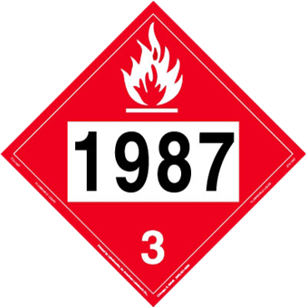
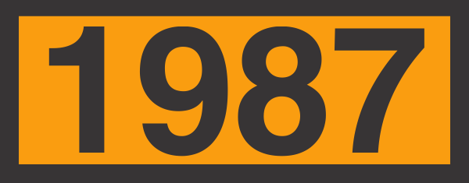
Transport Placards & Markings
DOT:
  Classifies according to primary hazard
  Assigns standardized symbols to identify hazard classes
Ethanol & ethanol-blended fuels are flammable liquids
Notes:
DOT has classified hazardous materials according to their primary hazard and has assigned standardized symbols to identify the classes. Materials are grouped by their major hazardous characteristics; however, many materials will have other hazards as well. Ethanol and ethanol-blended fuels are in the flammable liquids category or DOT Class 3 hazardous materials. Placards for flammable liquids have a red background with a white flame and a “3” at the bottom on them along with their corresponding identification number. The same placarding and marking protocols are used for highway and rail shipments.
Group Discussion:
Explain that the identification number is a four-digit identification number on the placard or orange panel. By looking up the identification number in the Emergency Response Guidebook (ERG), you can find hazard response information about the material.

Slide 7
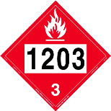
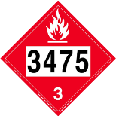
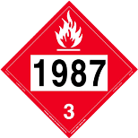
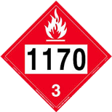
Hazardous Material Description
Ethanol Shipping Information
Identification Number | Ethanol Concentration | Preferred Proper Shipping Name | Common Ethanol Blends
UN 1203 | 1% - 10% | Gasoline | E10
UN 3475 | 11% - 94% | Ethanol & gasoline mixture | E15-E85
UN 1987 | 95% - 99% | Alcohols n.o.s. | Denatured Fuel Ethanol, E95 - E98
UN 1170 | 100% | Ethanol or ethyl alcohol | E100
Notes:
Ethanol-blended fuels up to and including E10 will display an identification 1203 flammable placard.
Ethanol blends of E15 to E85 are included under the 3475 identification. The 3475 placard covers ethanol blends from E11 to E94.
Denatured fuel ethanol (E95 to E99 blends) will display a 1987 flammable placard.
The 1170 placard is for undenatured or neat ethanol (E100).

Slide 8
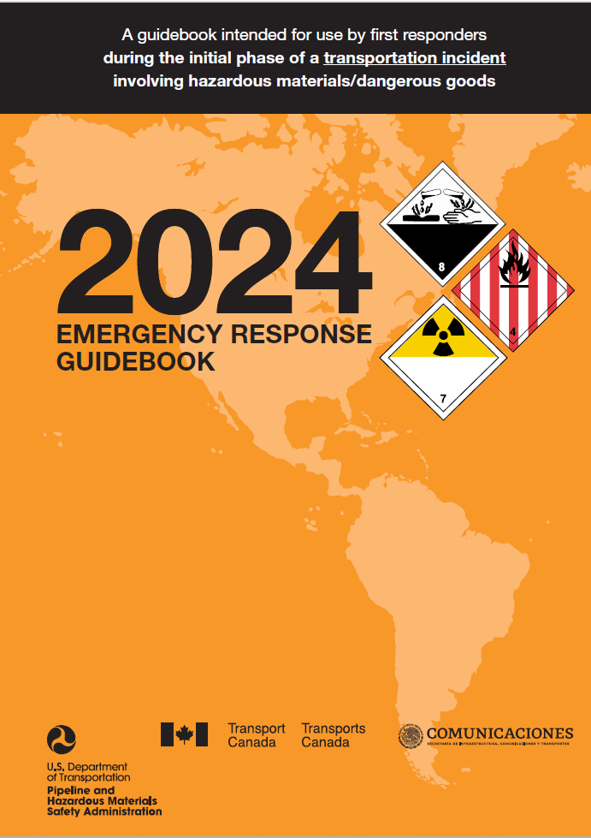
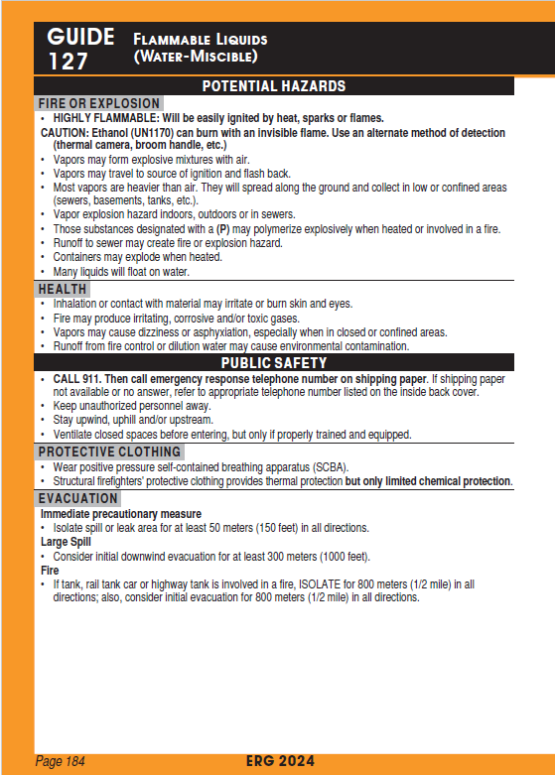
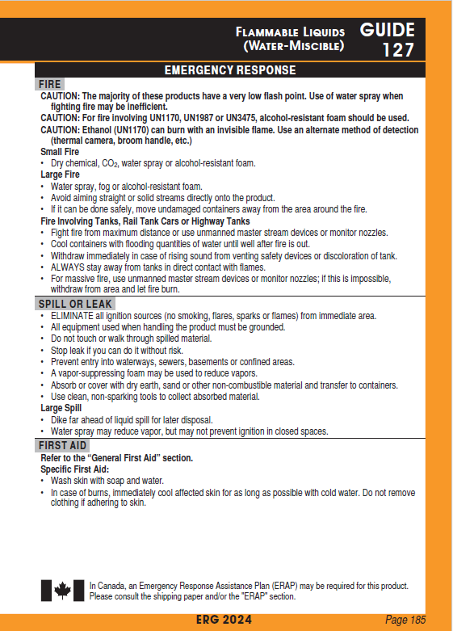
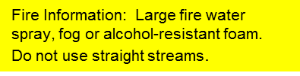

Emergency Response Information
Notes:
The DOT Emergency Response Guidebook (ERG), which includes this placarding information, is used as a resource for emergency responders when attending to an incident involving hazardous materials and dangerous goods. A safety data sheet (SDS) will also provide key safety information and product characteristics.

Slide 9


NFPA 704 for Ethanol
NFPA 704 marking system (known as the Fire Diamond) uses, colors, numbers (0-4, ascending hazard), special symbols
NFPA 704 Rating for Ethanol
  Health - 2
  Flammability - 3
  Instability - 0
Notes:
The National Fire Protection Association (NFPA) 704 marking system used for identifying hazardous materials found within facilities is based on the “704 diamond.” First "tentatively adopted as a guide" in 1960, this system is revised regularly and has been adopted by NFPA as a standard.
The NFPA 704 system uses colors, numbers (from 0-4), and special symbols to indicate the presence of hazardous materials. Each colored square indicates the type of hazard and the higher the number, the greater the hazard. For example, the number 4 in the blue health square indicates that a very short exposure could cause death or major residual injury (See figures 4.3 in Participant Guide).
Health: Blue
Flammability: Red
Instability: Yellow
Special: White (special notice)
Ethanol is represented by a 2 in the blue health square, indicating slight-to-moderate irritation. It is also represented by a 0 for instability (yellow) and a 3 for flammability (red), indicating high flammability with ignition likely under most conditions. There is no commonly accepted special character (white) for ethanol, though one may be appropriate.

Slide 10
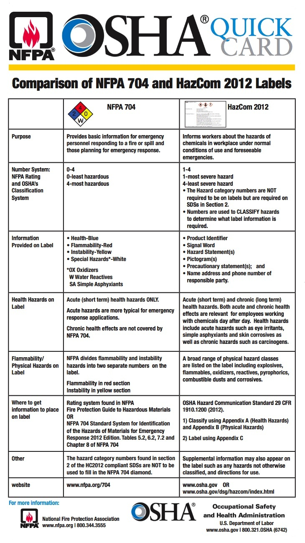
Hazard Rating
Number Systems
  NFPA Rating 0-4
    0-least hazardous
    4-most hazardous
  OSHA’s Classification System 1-4
    1-most severe hazard
    4-least severe hazard
      The Hazard category numbers are NOT required to be on labels but are required on SDSs in Section 2
      Numbers are used to CLASSIFY hazards to determine what label information is require
Notes:
The U.S. Department of Labor Occupational Safety and Health Administration (OSHA) has adopted hazardous chemical labeling requirements as a part of its revision of the Hazard Communication Standard, 29 CFR 1910.1200, bringing it into alignment with the United Nations Globally Harmonized System of Classification and Labeling of Chemicals (GHS). Implementation affects chemical manufacturers, importers, distributors, and employers.
NFPA’s rating goes from 0, which is least hazardous, to 4, which is most hazardous. The OSHA classification system, on the other hand, is numbered 1-4 with 1 being the most severe hazard and 4 being the least severe hazard relating to emergency responder and community exposure.
DOT has not adopted GHS, so current DOT placard requirements for packaging and packages remain in effect.
Emergency responders need to be aware that the OSHA non-harmonized numerical marking system is exactly opposite of the NFPA 704 standard marking system, which may cause confusion on an incident scene. Emergency responders arriving on any hazardous materials incident must visually survey the scene from a safe distance, determine what type of hazardous material identification system is visible, properly interpret the marking system, and initiate the appropriate action plan.

Slide 11
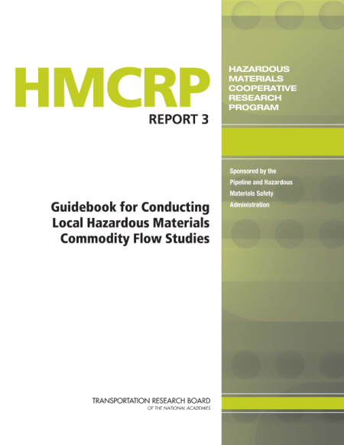
Transportation Patterns
Most hazardous materials incidents occur during transportation & transfer operations
  Denatured fuel ethanol is classified as a hazardous material
Be aware of areas/ routes where large number of shipments of ethanol & ethanol-blended fuels routinely pass
Conducting a hazardous material flow study for your area would provide critical information to help with response needs
Notes:
Emergency responders should be aware of areas or routes where shipments of ethanol and ethanol-blended fuels routinely pass. To aid in familiarization of commodity patterns, railroads provide traffic flow information to bona fide emergency response agencies.
The U.S. DOT Pipeline and Hazardous Material Safety Administration (PHMSA) publishes the Guidebook for Conducting Local Hazardous Materials Commodity Flow Studies. This Guidebook is designed to support risk assessment, emergency response preparedness, resource allocation and analyses of hazardous commodity flows across jurisdictions.

Slide 12
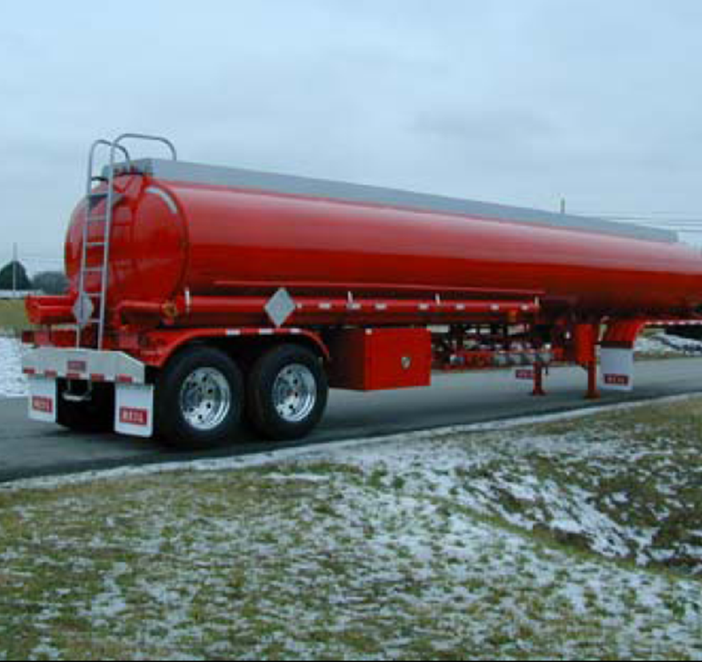
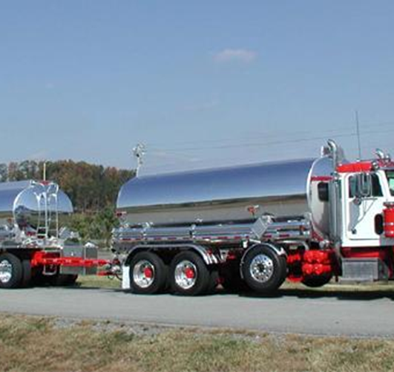
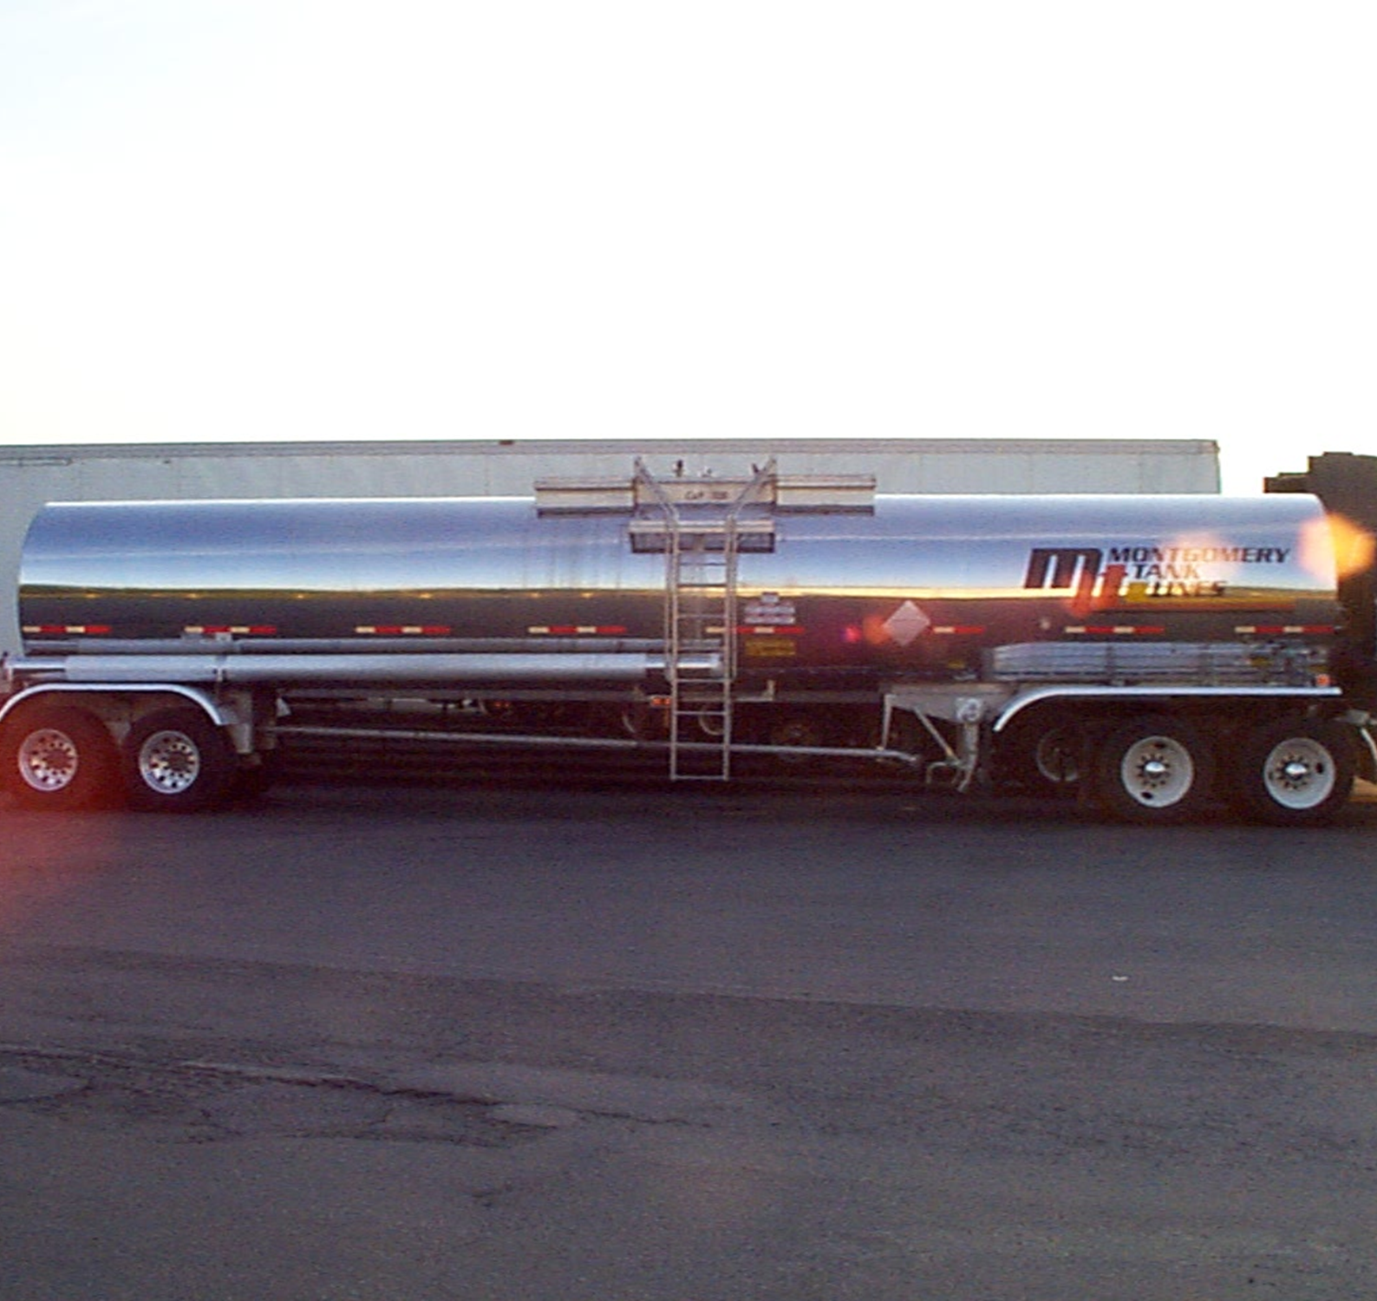
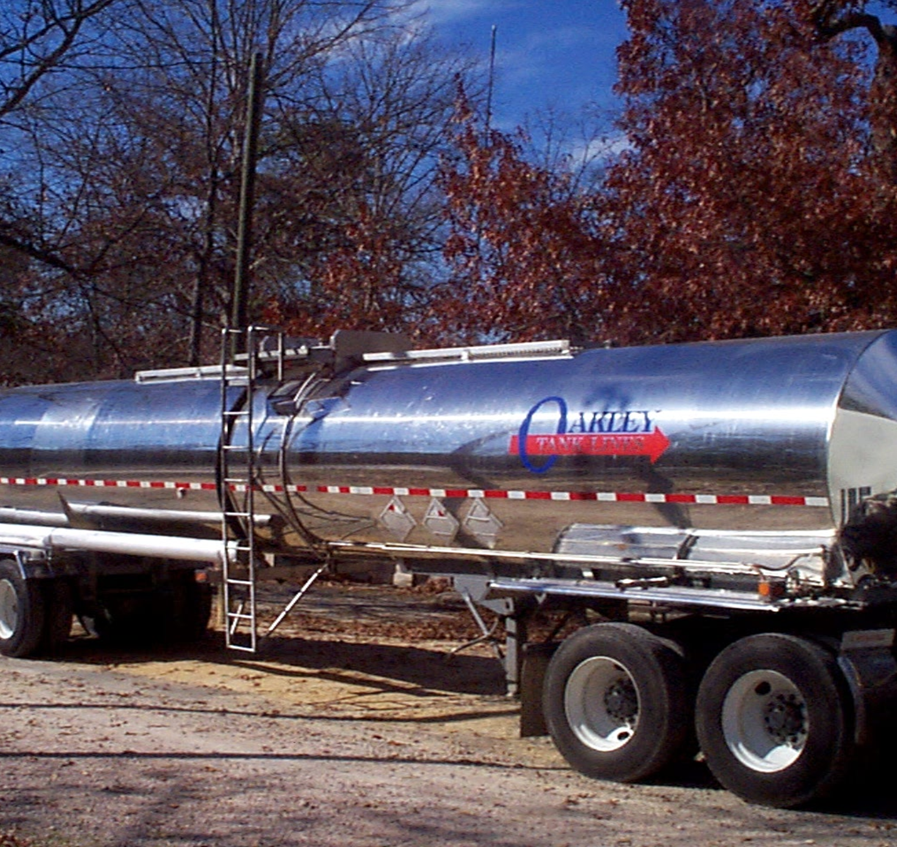
Transportation via Highway
MC306/DOT406
6,000 – 9,500 gallons
MC306/DOT406
9,500 – 12,000 gallons
MC306/ DOT406
  Capacity > 5,000
  Aluminum shell
  Multiple compartments
MC307/ DOT407
  Capacity > 5,000
  Steel shell
  Multiple compartments
MC307/DOT407
5,000 – 7,000 gallons
MC307/DOT407
5,000 – 7,000 gallons
Notes:
Since both gasoline and ethanol-blended fuels have very similar physical and chemical characteristics, they will be transported in the same general types of containers and tanks. The most prevalent style of highway transport of the blended fuels that emergency responders will encounter will be by the MC306/ DOT406 or MC407/ DOT407 cargo tanks (see Figures 4.4 and 4.5 in the Participant Guide).
The MC306/DOT406 style cargo tank is the second most common mode for ethanol leaving a production facility.
These non-pressure bulk liquid tanks come in a variety of sizes and configurations. The most common models have a capacity between 6,000 and 9,500 gallons, depending on regional factors. Each tank can have up to seven compartments and is typically constructed out of aluminum.
New single-tank chassis supporting triple axles may have an increased capacity of up to 12,000 gallons of ethanol-blended fuel
The MC307/DOT407 cargo tanks are low-pressure bulk liquid tanks that come in a variety of sizes and configurations and typically hold between 5,000 and 7,000 gallons. They may be insulated or uninsulated and usually contain 1–4 compartments, though some have up to six. These tanks are typically constructed out of steel.
A few additional items to note regarding cargo tank trucks. Many states within the U.S. have also allowed the use of tandem trailers carrying up to 24,000 gallons of ethanol-blended fuels. Recently the U.S. is experiencing the use of “Road Trains” which are triple tankers with triple axles transporting up to 36,000 gallons of ethanol-blended fuels.
Group Discussion:
On the drawing, Figure 4.4 in the Participant Guide, there are outlets on the underside of the tank for on- and off-loading the product. Depending on the types of product being carried, the MC-306 is divided into compartments.
In addition to the outlets and piping on the bottom, you can see vents and caps on the top side of the tank which can fail or leak as a result of rollover accidents. Placards should be visible on all four sides making identification of the product easier.

Slide 13
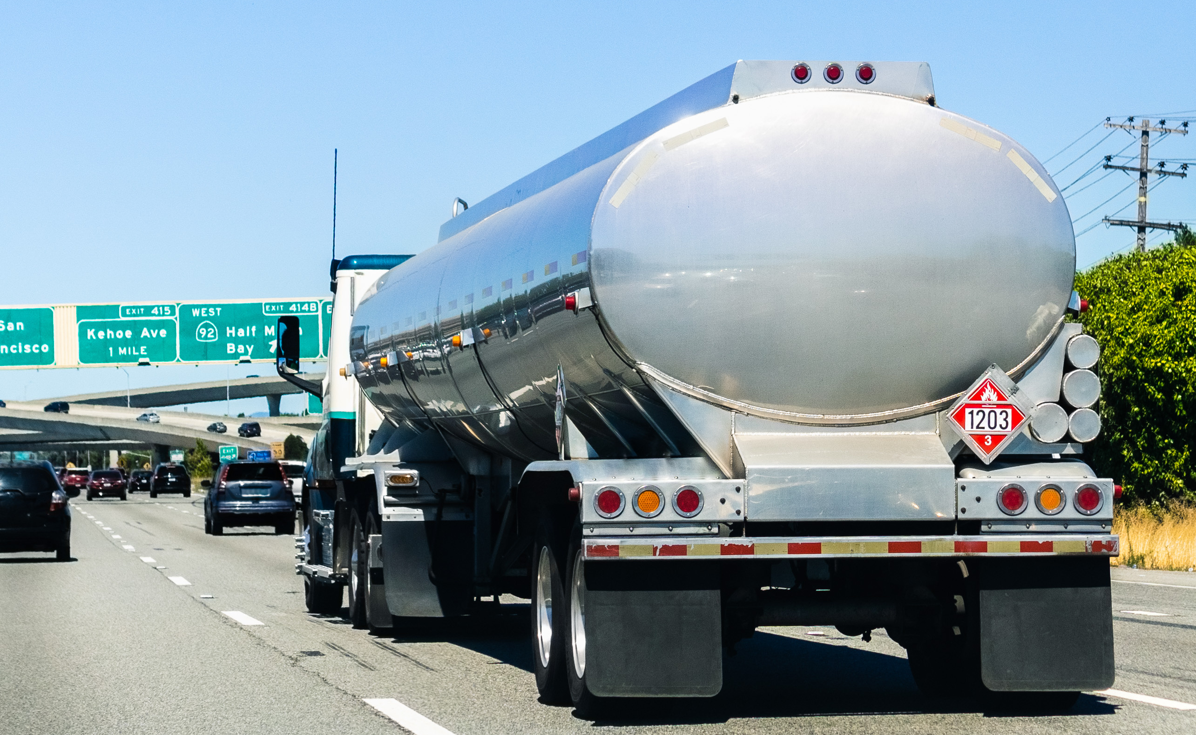
Transportation via Highway
Ethanol cargo tank trucks placarded & marked in the same manner as all other hazardous materials
Pressure & vacuum relief devices function the same as currently found on gasoline specification cargo tank trucks
Bottom loaded & unloaded
Vapor recovery system equipped
Notes:
Ethanol transported in cargo tank trucks are placarded and marked in the same manner as all other hazardous materials. To permit commodity identification, placards must be visible on both sides and both ends of a transport vehicle.
Other key characteristics of cargo tank trucks are pressure and vacuum relief devices. They are typically bottom loaded and unloaded and equipped with a vapor recovery system.

Slide 14
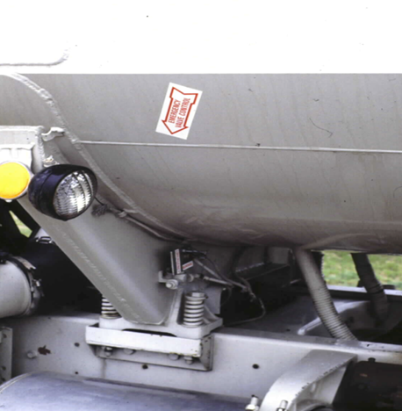
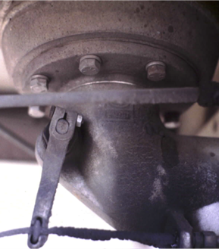
Transportation via Highway
Safety devices:
Emergency shutoffs
Break away valves
  Sheer protection
Pressure relief devices
Overfill protection
Collision protection
Notes:
Safety devices on these cargo tank trucks consist of emergency shutoffs, breakaway valves for sheer protection, pressure relief devices as well as overfill and collision protection. It is strongly encouraged that emergency response organizations review these devices and engage in hands-on and functional exercises to refresh and/or enhance their technical knowledge of these transportation vehicles.

Slide 15
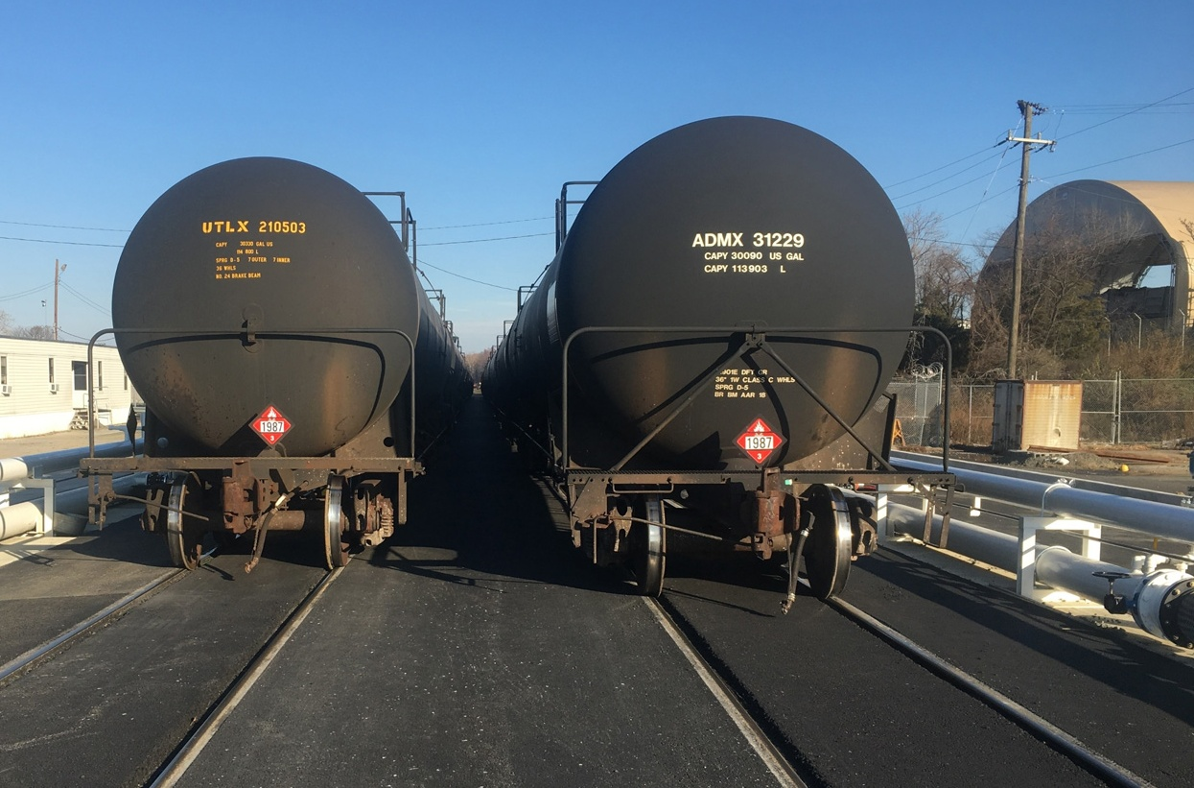
Transportation via Rail
Denatured fuel ethanol is regularly transported safely every day by rail
Transportation occurs in multiple phases from production sites to transload facilities
  Rail transport to fixed facility (terminal)
  Rail transport directly to cargo tank truck
  Rail transport directly to pipeline
Notes:
Denatured fuel ethanol (E95–E98) is a leading hazardous material shipped by rail and is transported safely on a daily basis. In the transportation of ethanol and ethanol-blended fuels, various routes are utilized: rail to fixed facility, rail directly to cargo tank truck, and rail directly to pipeline.

Slide 16
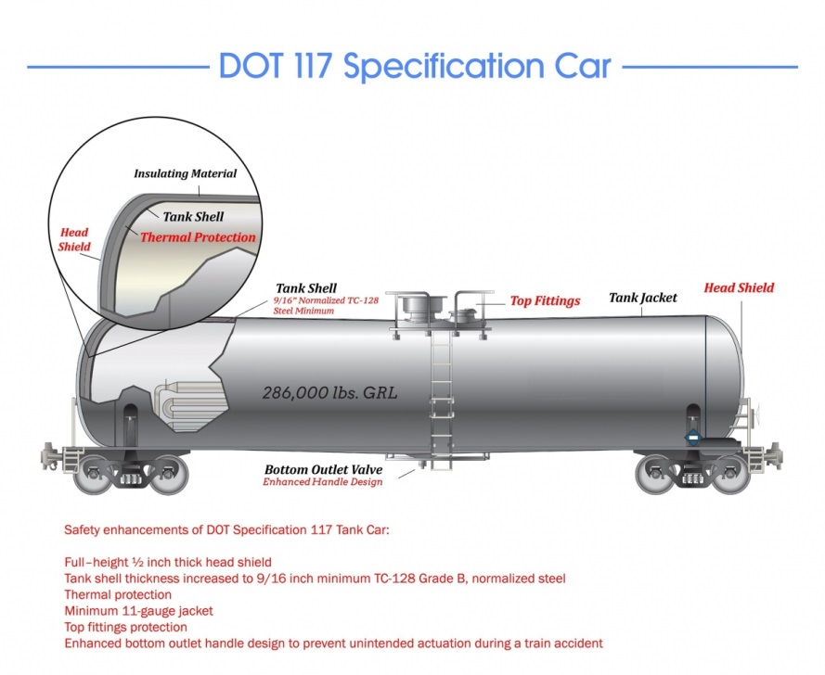
Transportation via Rail
Rail tank car: DOT117
1/2 inch thick head shield
9/16 inch tank shell thickness
Thermal protection
Minimum 11-gauge jacket
Top fittings protection
Enhanced bottom outlet handle design
Approximately 30,000 - 34,000 gallon capacity
Notes:
The most common mode of transport for denatured fuel ethanol leaving a production facility is rail transport that displays a 1987 flammable placard. Rail transportation of ethanol and ethanol-blended fuels is used to move product to fixed facilities, cargo tank truck transfer terminals or pipeline facilities.
Safety enhancements of DOT Specification 117 rail tank car:
Full-height 1/2 inch thick head shield
Tank shell thickness increased to 9/16 inch minimum TC-128 Grade B, normalized steel
Thermal protection
Minimum 11-gauge jacket
Top fittings protection
Enhanced bottom outlet handle design to prevent unintended actuation during a train accident
These rail tank cars have a capacity of approximately 30,000-34,000 gallons. Unlike tractor trailer cargo tanks that contain multiple compartments, rail tank cars usually have only one compartment.
Rail Tank Car 101 Walk-Around Video and PPT can be downloaded and/ or viewed at www.EthanolResponse.com/resources/.

Slide 17

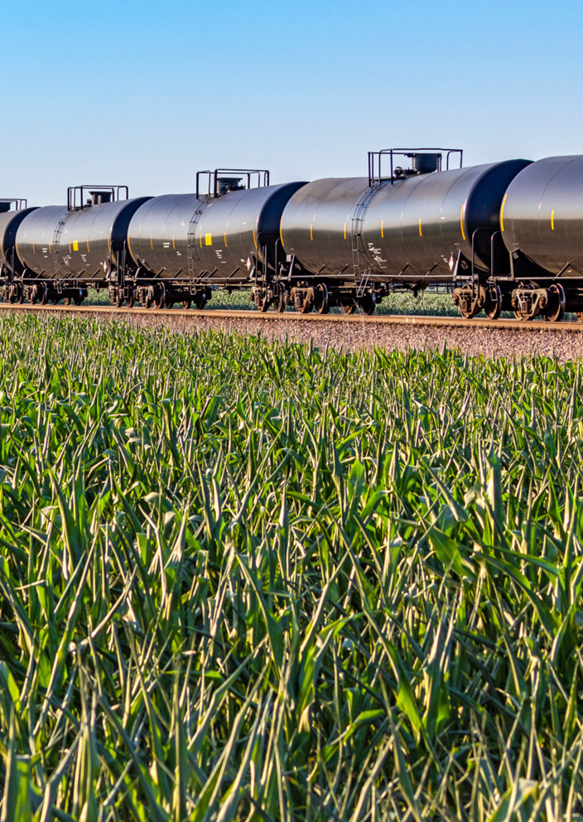
Transportation via Rail
Unit train
  Consists of 80 - 100 rail tank cars
  Single destination point
Rail tank cars placarded & marked
same as highway transport
  Both sides & both ends
Pressure relief devices
Vacuum relief device (optional)
Rail tank cars can be both top & bottom loaded & unloaded
Notes:
The most common mode of transportation for denatured fuel ethanol leaving an ethanol production facility is via rail transport. It is estimated that nearly 70% of all ethanol produced today will travel by rail during the path to its ultimate destination in the retail marketplace.
Rail transport can play a significant role in the everyday operations of an ethanol production facility. For example, a 100-million-gallon plant geographically co-located next to a rail line can easily expect to receive and ship an average of 36 rail tank cars per day. That entails receiving raw materials and process aides while at the same time shipping fuel ethanol and other co-products to customers.
Ethanol and ethanol-blended fuels are commonly transported by unit train. A unit train consists of 80-100 plus rail tank cars that are all heading for a single destination and carrying the same commodity. For the sake of this training discussion, we are referring to denatured fuel ethanol displaying a DOT 1987 placard. Shippers use the same placarding and marking protocols for both highway and railway transport. They are placarded on both sides and both ends.
Rail tank car pressure relief devices prevent internal pressure build-up above a specified setting. They open to release pressure and then close once the internal pressure has reduced below the pre-engineered setting of the relief device. (See Figures 4.7 and 4.8 in the Participant Guide. Figures 4.7 and 4.8 show typical arrangements for rail tank car components. Not all components may be present on rail tank cars used for transporting ethanol-related products)

Slide 18
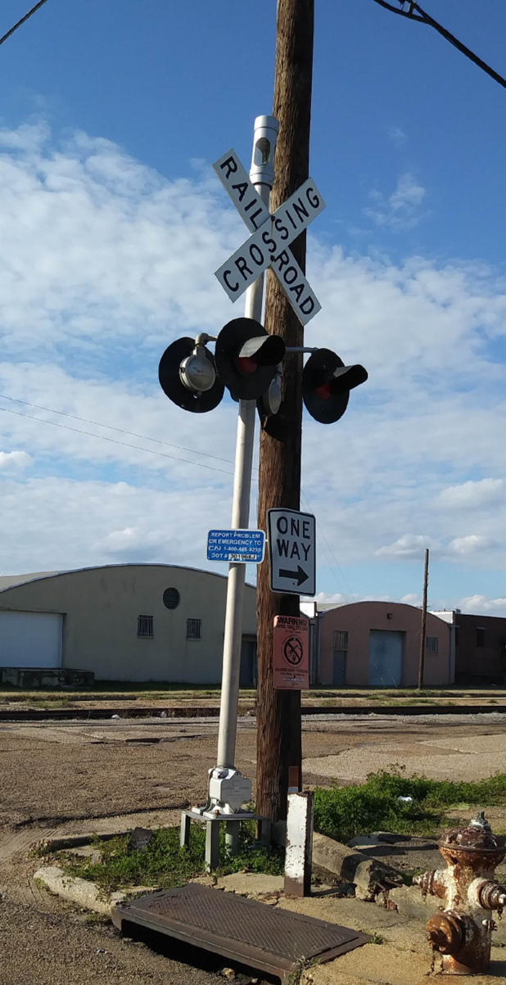
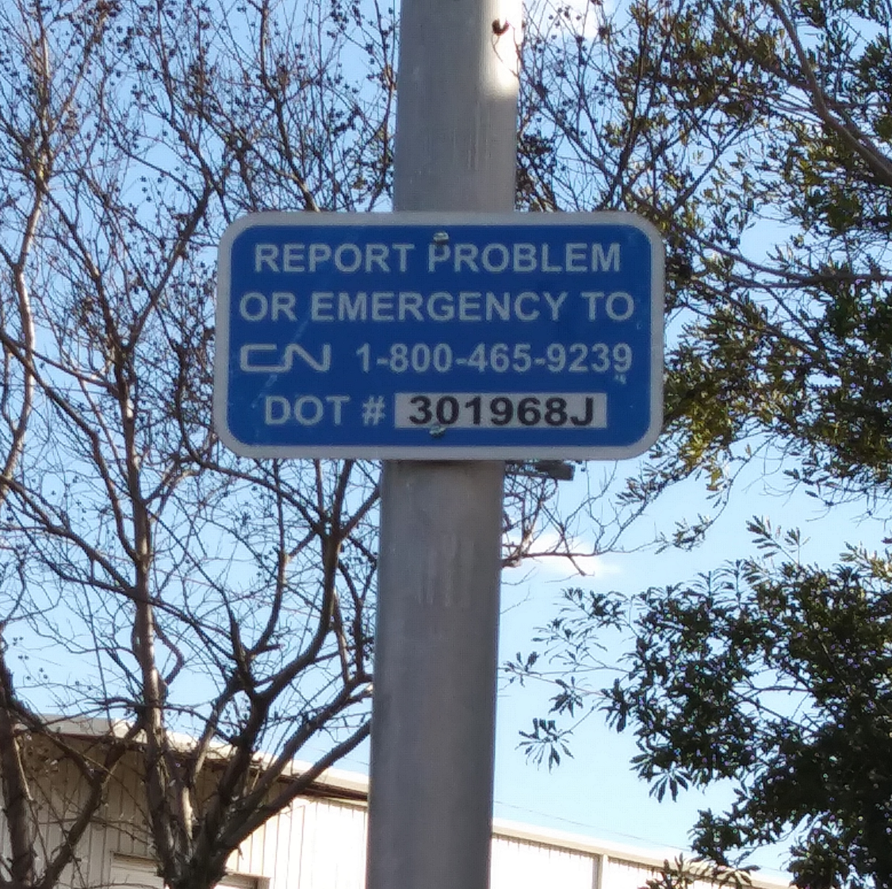

Contacts & Apps
Emergency Notification System (ENS)
  Crossing ID for a specific location
  Emergency phone number
AskRail Mobile App
  Data base in real time to determine owner, location and content of rail car based on ID number
  http://askrail.us/
Notes:
The railroad industry put into place a safety initiative called the Emergency Notification System (ENS) that marked all railroad crossings with emergency information to include to place to include ownership, emergency telephone number for the railroad and most importantly the inventory number of the crossing for quick identification of the location.
These signs are typically located within 100’ of and on both sides intersection. Each intersection is blue and white in color and has a telephone number and unique intersection identification number. The telephone number gives you direct access to the railroad dispatcher controlling that specific section of rail.
The AskRail mobile app (downloadable at http://askrail.us/) is a collaborative effort among the emergency response community and all North American Class I railroads. The app provides emergency responders with immediate access to accurate, timely data about what type of hazardous materials a rail car is carrying so they can make an informed decision about how to respond to a rail emergency. AskRail is a backup resource if information from the train conductor or train consist is not available. For security reasons, only qualified emergency responders can download the app.
Some of the basic features of the program are:
Railroad emergency contacts
Links to ERG
Real time graphic map location with evacuation diameter capabilities
Data base in real time to determine owner, location and content of rail car based on ID number
Ability to re-invent the entire consist of the rail car at an incident scene
A scenario-based exercise to familiarize new users with all capabilities of the app
TRANSCAER Seconds Count video – Contacts & Apps for the Emergency Responder https://vimeo.com/403812176

Slide 19
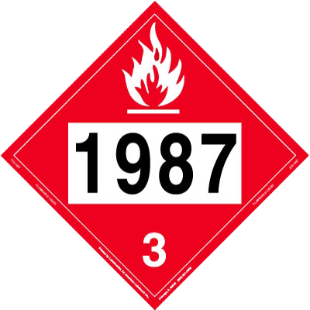
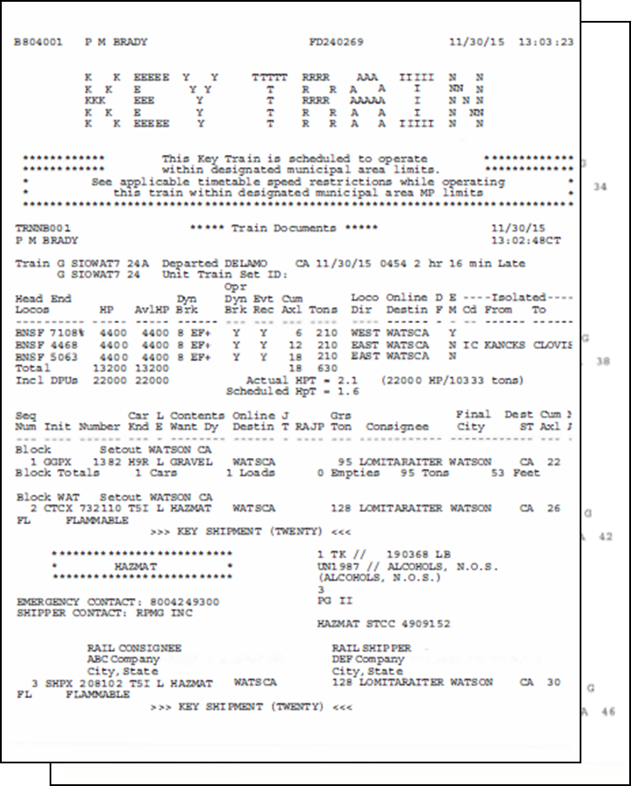
Shipping Papers
Placards & shipping papers example:
CHEMTREC 1-800-424-9300
Notes:
Shippers of hazardous materials via highway and rail must comply with U.S. Department of Transportation regulations to ensure that emergency responders have an accurate description of transported hazardous materials.
For both modes, the required shipping paper entries for ethanol-related products include the amount shipped, the identification number, the proper shipping name, the hazard class, and emergency contact name and phone number.
For highway transport, shipping papers also known as bill of lading will be in the cab near the driver. U.S. DOT now allows electronic shipping papers for tractor trailer drivers but only under specific conditions. For hazardous materials, carriers must either comply with 49 CFR Part 172 Subpart C or operate under a special permit that authorizes electronic records in place of paper copies.
For rail shipments, a Hazardous Material Response Code (HMRC), or Standard Transportation Commodity Code (STCC) number, will also be present and may aid researching emergency response information. Rail regulations require that a crew member be in possession of the shipping papers, known as Consist or Waybill. They are typically carried by the conductor, engineer, or foreman. The U.S. DOT now allows electronic Consist or Waybill documents, as long as they meet the Hazardous Materials Regulations under 49 CFR Part 172. These electronic records are available in real time to train crews, inspectors, and first responders for hazardous materials shipped by rail. Shipping papers can also be obtained directly from the railroad by calling the railroad’s emergency phone number.
Remember that the contact number will provide 24-7 access to a person knowledgeable about the commodity and detailed information about the product. One of the most frequently seen emergency response contacts is CHEMTREC® (which can be reached at 1-800-424-9300).

Slide 20
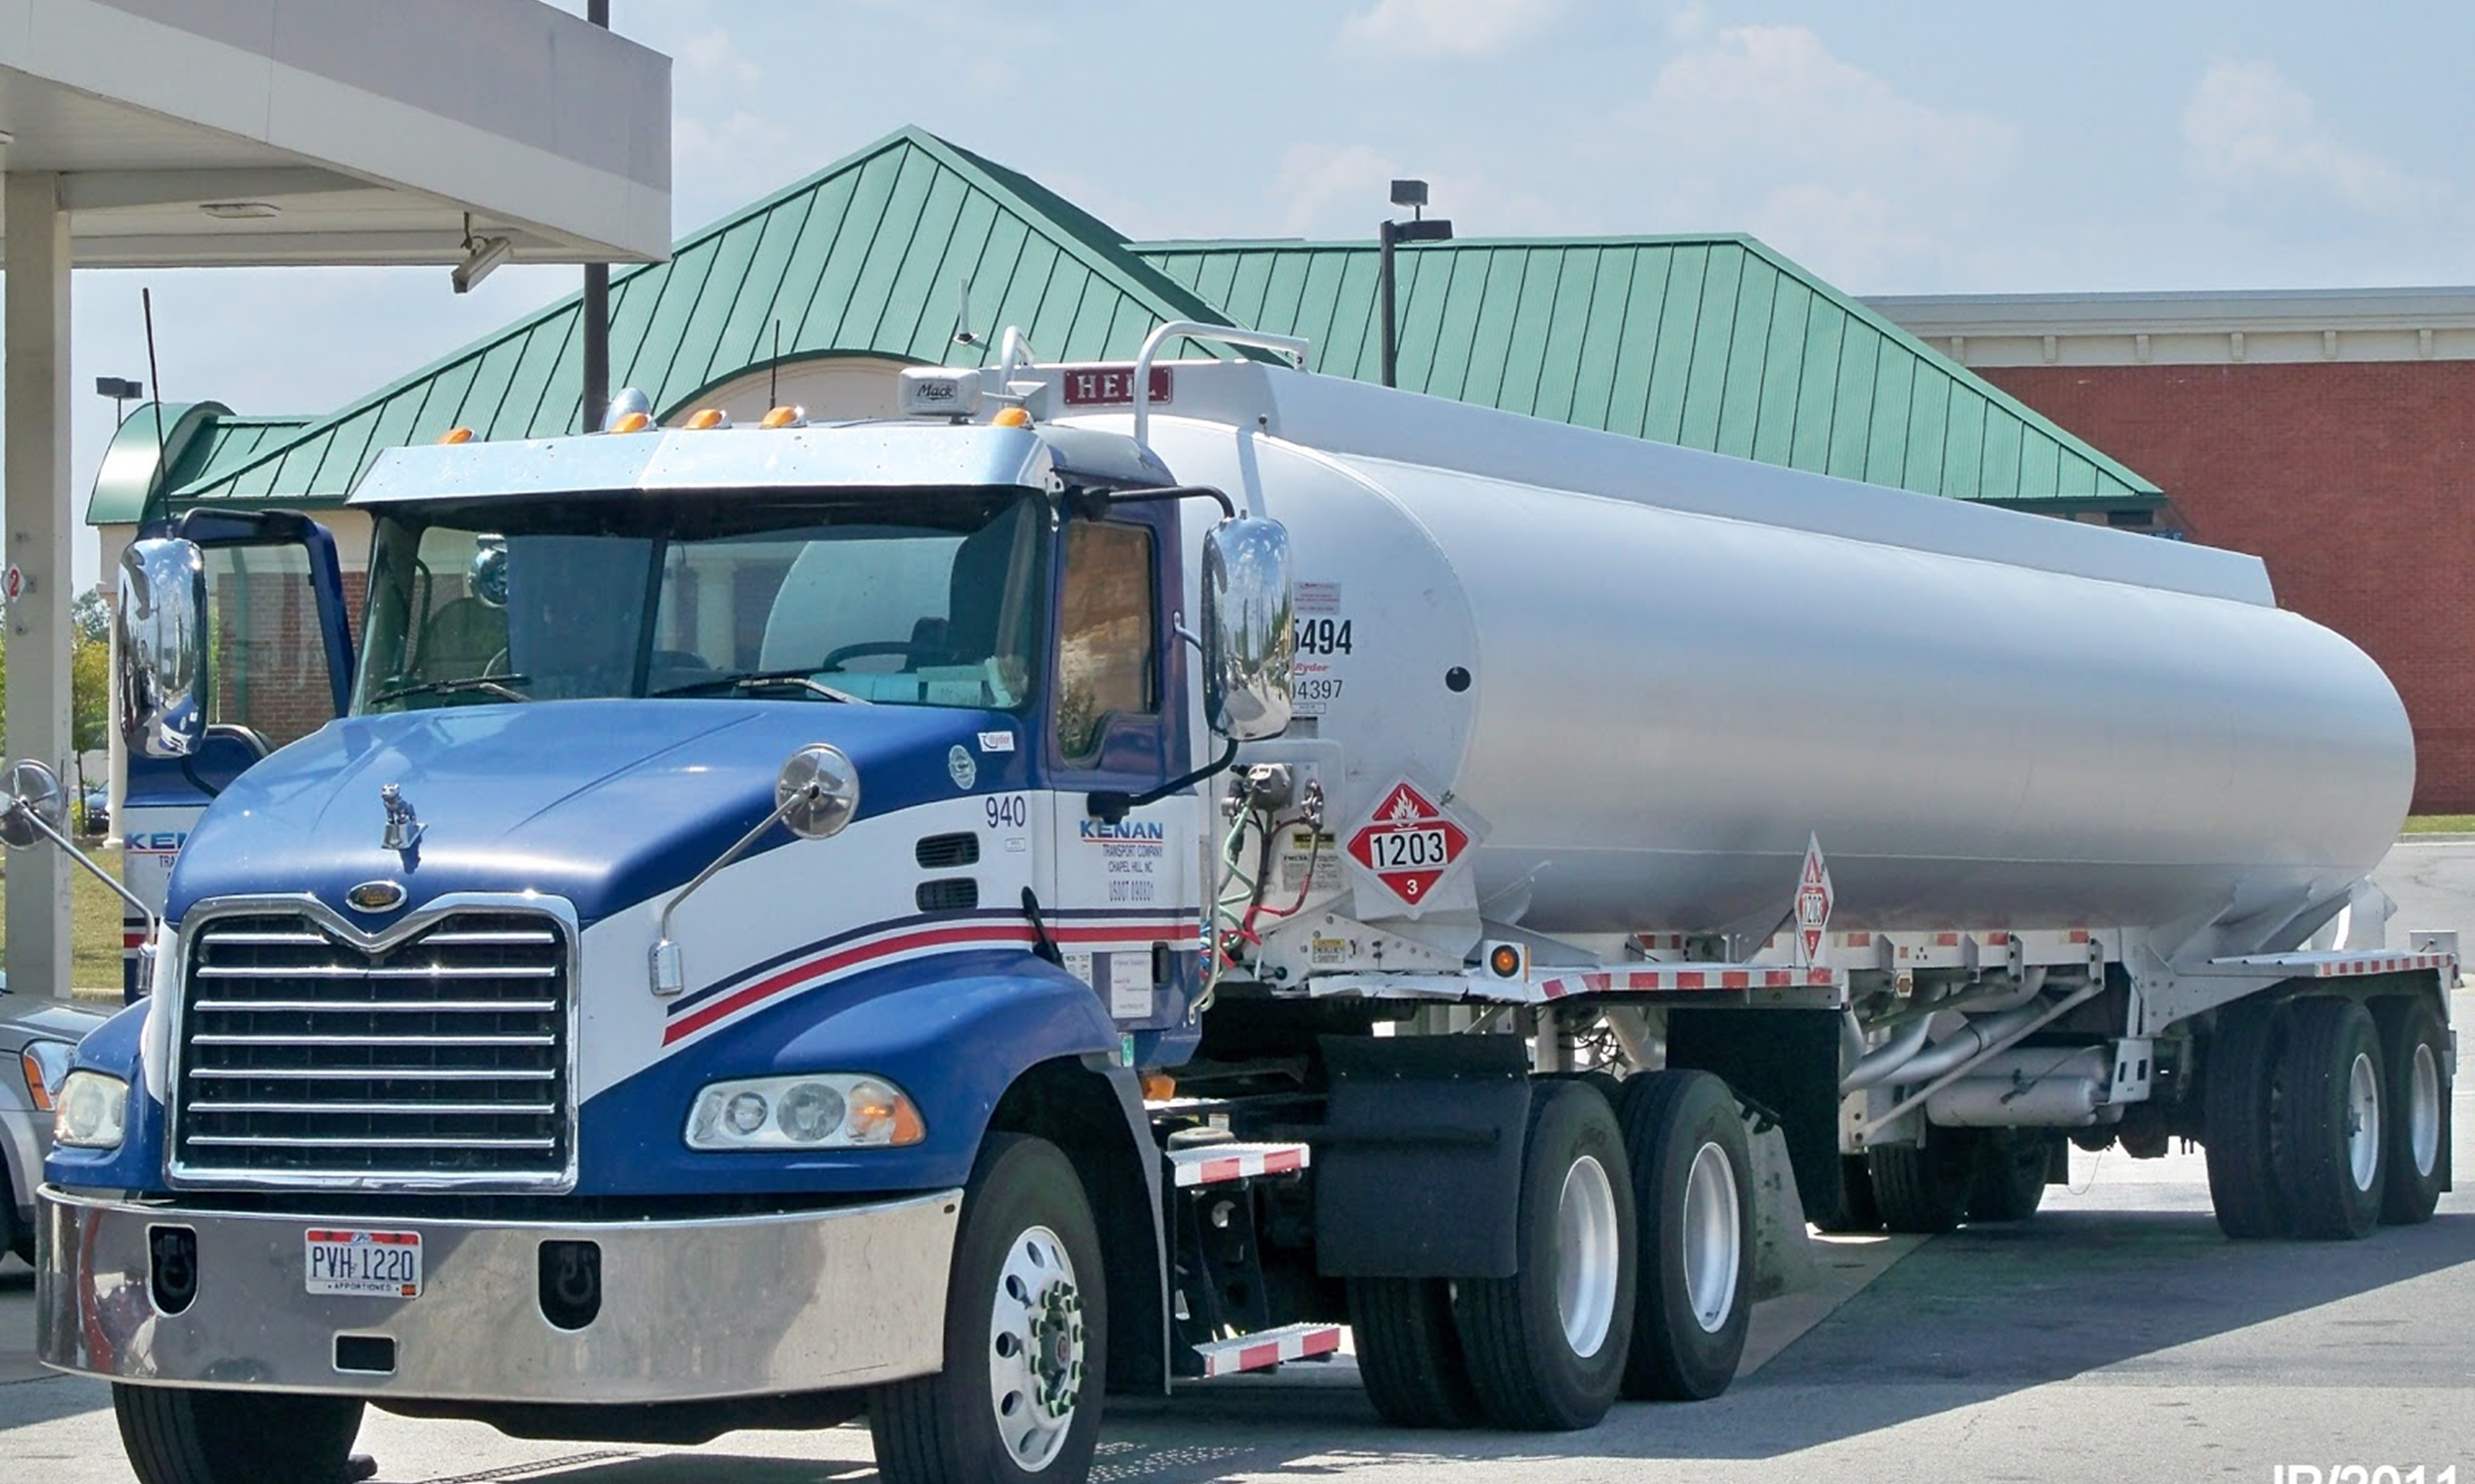
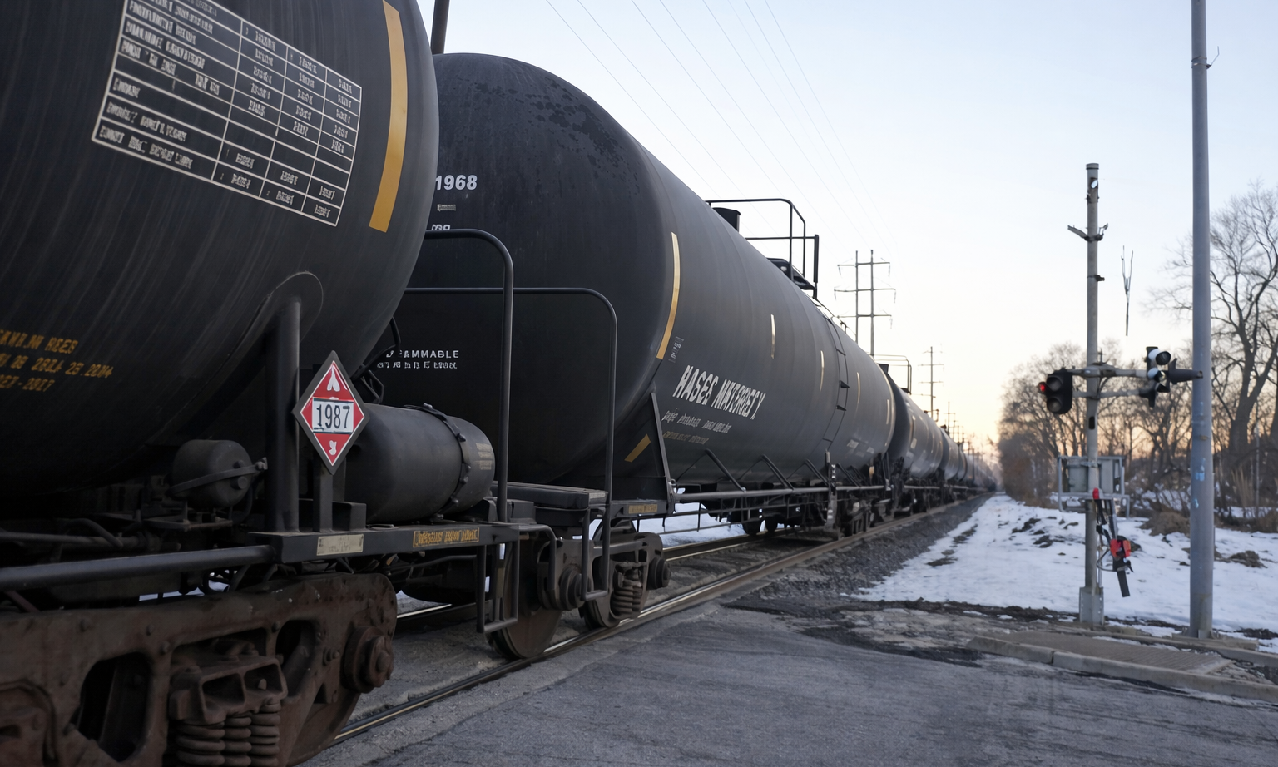

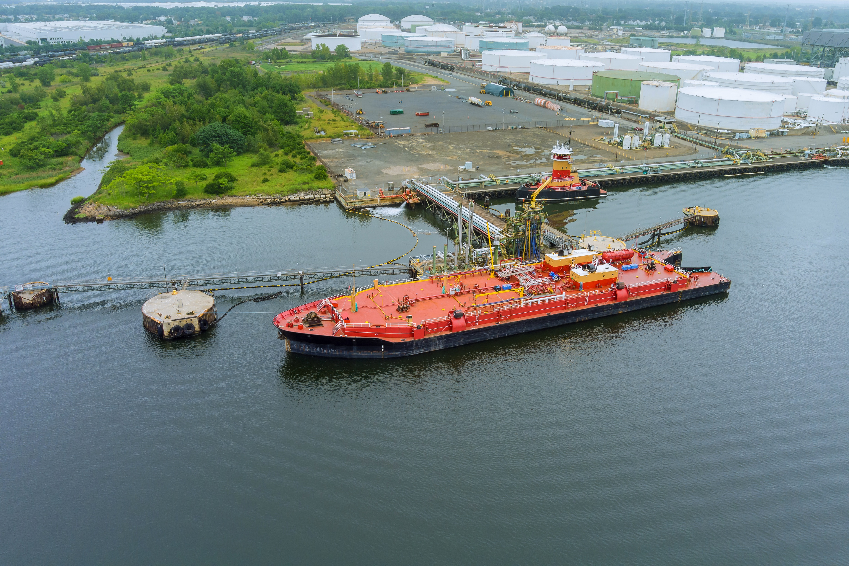
Transportation Logistics
The destination of denatured fuel ethanol determines the mode of transport
Leaving the production facility:
Largest volume transported via rail
Second is cargo tank truck and then freighter ship/ barge
Very small amounts are transported by pipeline
Arriving at storage terminals:
Storage terminals with no access to rail receive product
by cargo tank truck, freighter ship/ barge or pipeline
Cargo tank truck from rail transloading facilities
Notes:
Most of the denatured fuel ethanol placarded with identification number 1987 is transported from the production facilities to liquid product terminals by rail.
Increasingly, liquid product terminals have added rail access to their facility. Liquid product terminals that do not have rail access receive denatured fuel ethanol by cargo tank truck, freighter ship/barge or pipeline. At this time, only small amounts of denatured fuel ethanol or ethanol-blended fuel are being transported by pipeline. Ethanol shipments via pipeline may increase with greater experience.
There is some transfer of denatured fuel ethanol from rail tank cars directly to cargo tank trucks called transloading, which we’ll discuss next.
Emergency responders should be aware of the various modes of transport occurring in their areas.

Slide 21
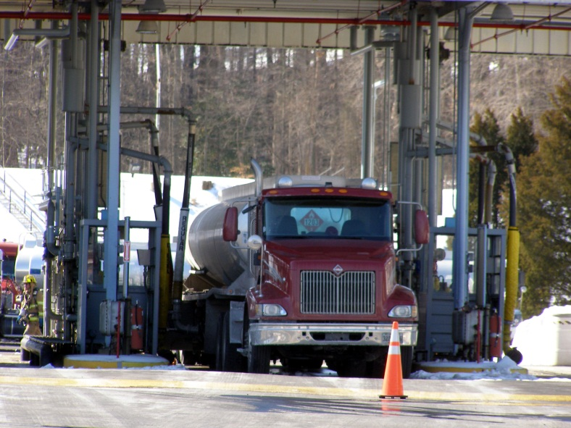
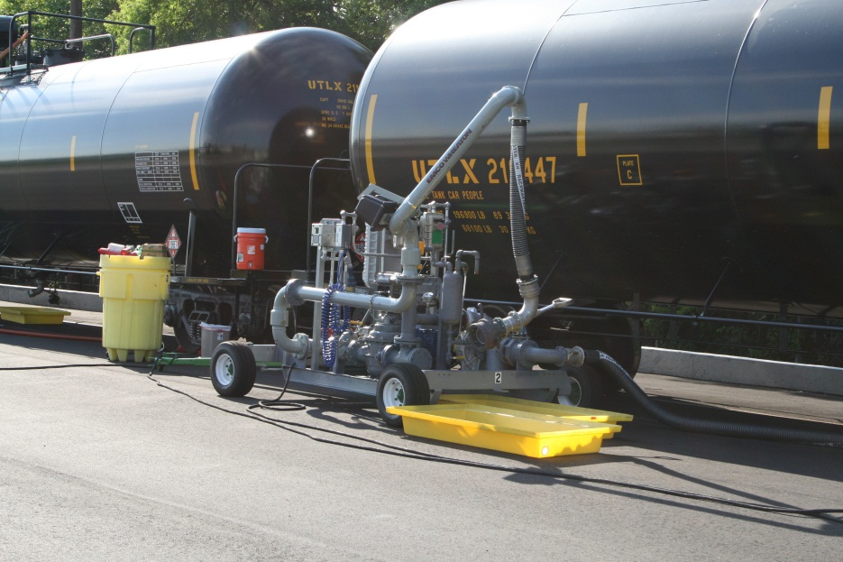
Loading/Unloading Operation
Terminal loading rack
Transloading facility
Notes:
The images show a cargo tank truck terminal loading rack and a rail transloading facility. If your responsibilities include rail tank car loading/ unloading operations, suggestions for best practice are available from the Association of American Railroads' program Recommended Methods for the Safe Loading and Unloading of Non-Pressure (General Service) and Pressure Tank Cars and Pamphlet 34. Both can be downloaded and/ or viewed at www.EthanolResponse.com/resources/.
A transload facility conducts product transfers from a mobile tank to a mobile tank. This image above titled “transloading facility” is an example of a rail tank car to cargo tank truck transload operation. As shown a portable pump system is in use. This gives the operators flexibility in the unloading process as it can occur at any location within the facility.

Slide 22
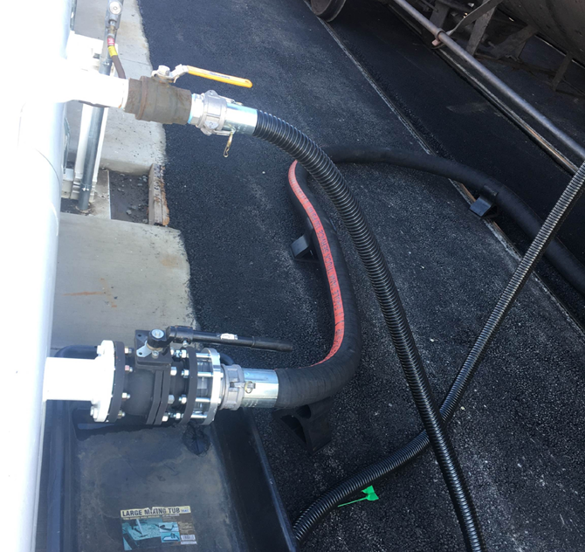
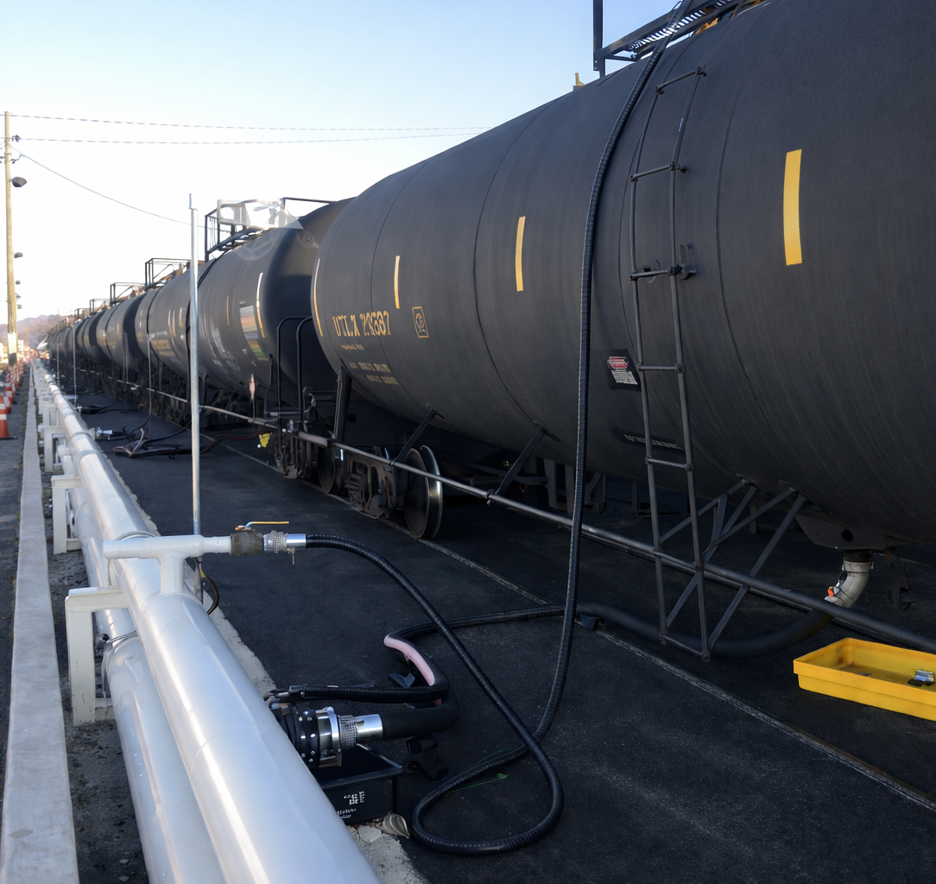
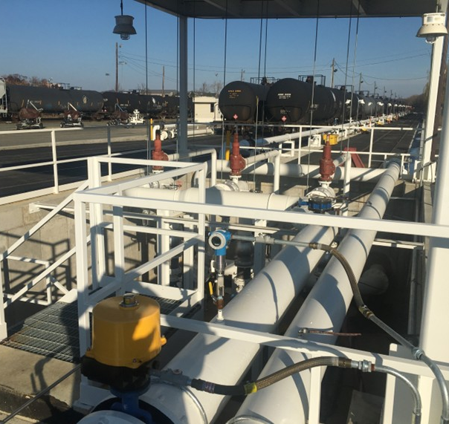
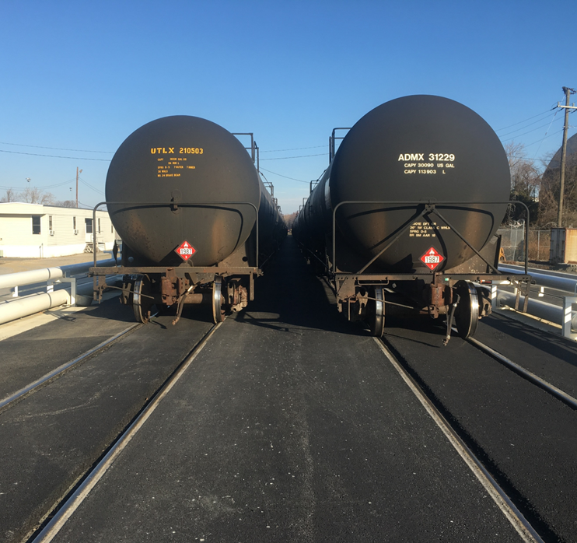
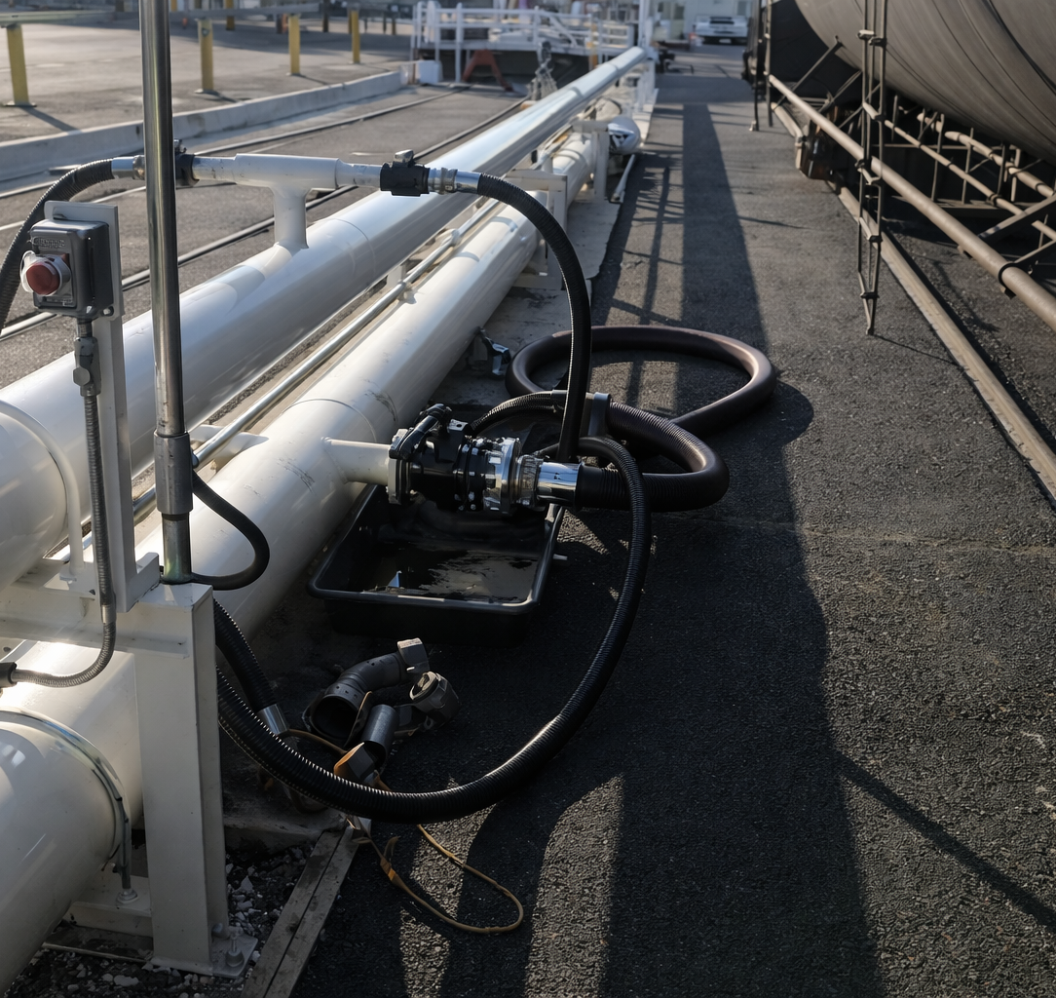
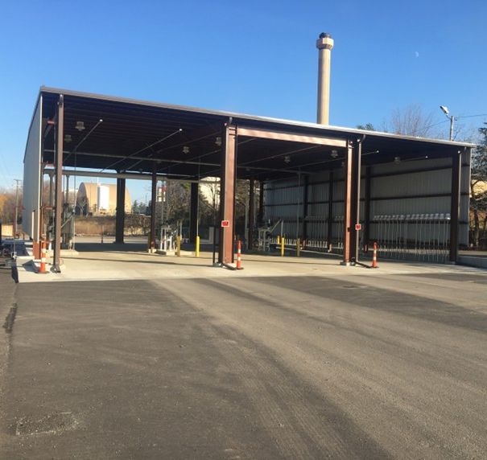
Loading/Unloading Operation
Notes:
The images show a loading racks facility with fixed fire protection. The transfer pumping system is contained within a concrete cistern to contain any product spill due to a malfunction.
The rail tank cars can be simultaneously unloaded to several cargo tank trucks positioned at the loading rack. This increases productivity and efficiency in transporting the ethanol-blended fuel to a bulk liquid storage terminal or retail market.

Slide 23

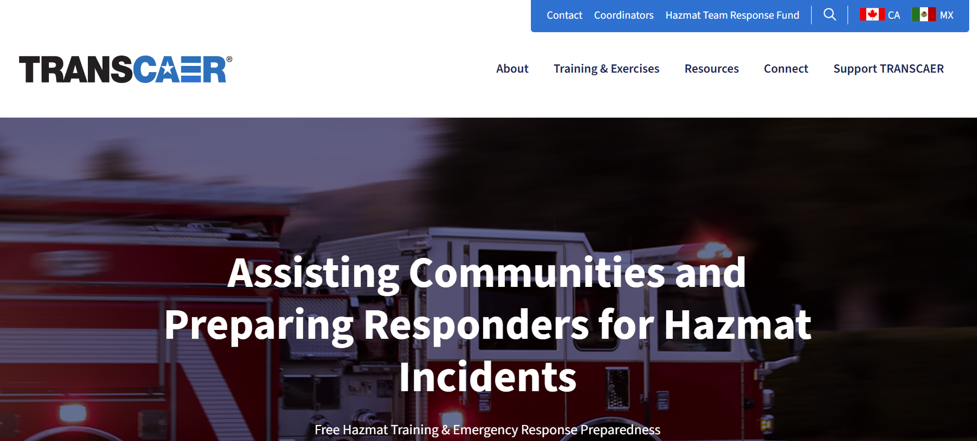
Additional Resources
Voluntary effort
Nationwide members
www.transcaer.com
Notes:
A good resource to assist in preparing for potential transportation-related hazardous materials incidents is the Transportation Community Awareness and Emergency Response (TRANSCAER) website, http://www.transcaer.com.
TRANSCAER is a voluntary national outreach organization that focuses on assisting communities to prepare for and respond to a possible hazardous materials transportation incident.
TRANSCAER members consist of representatives from chemical manufacturing, transportation, distribution, emergency response agencies, and government agencies.

Slide 24
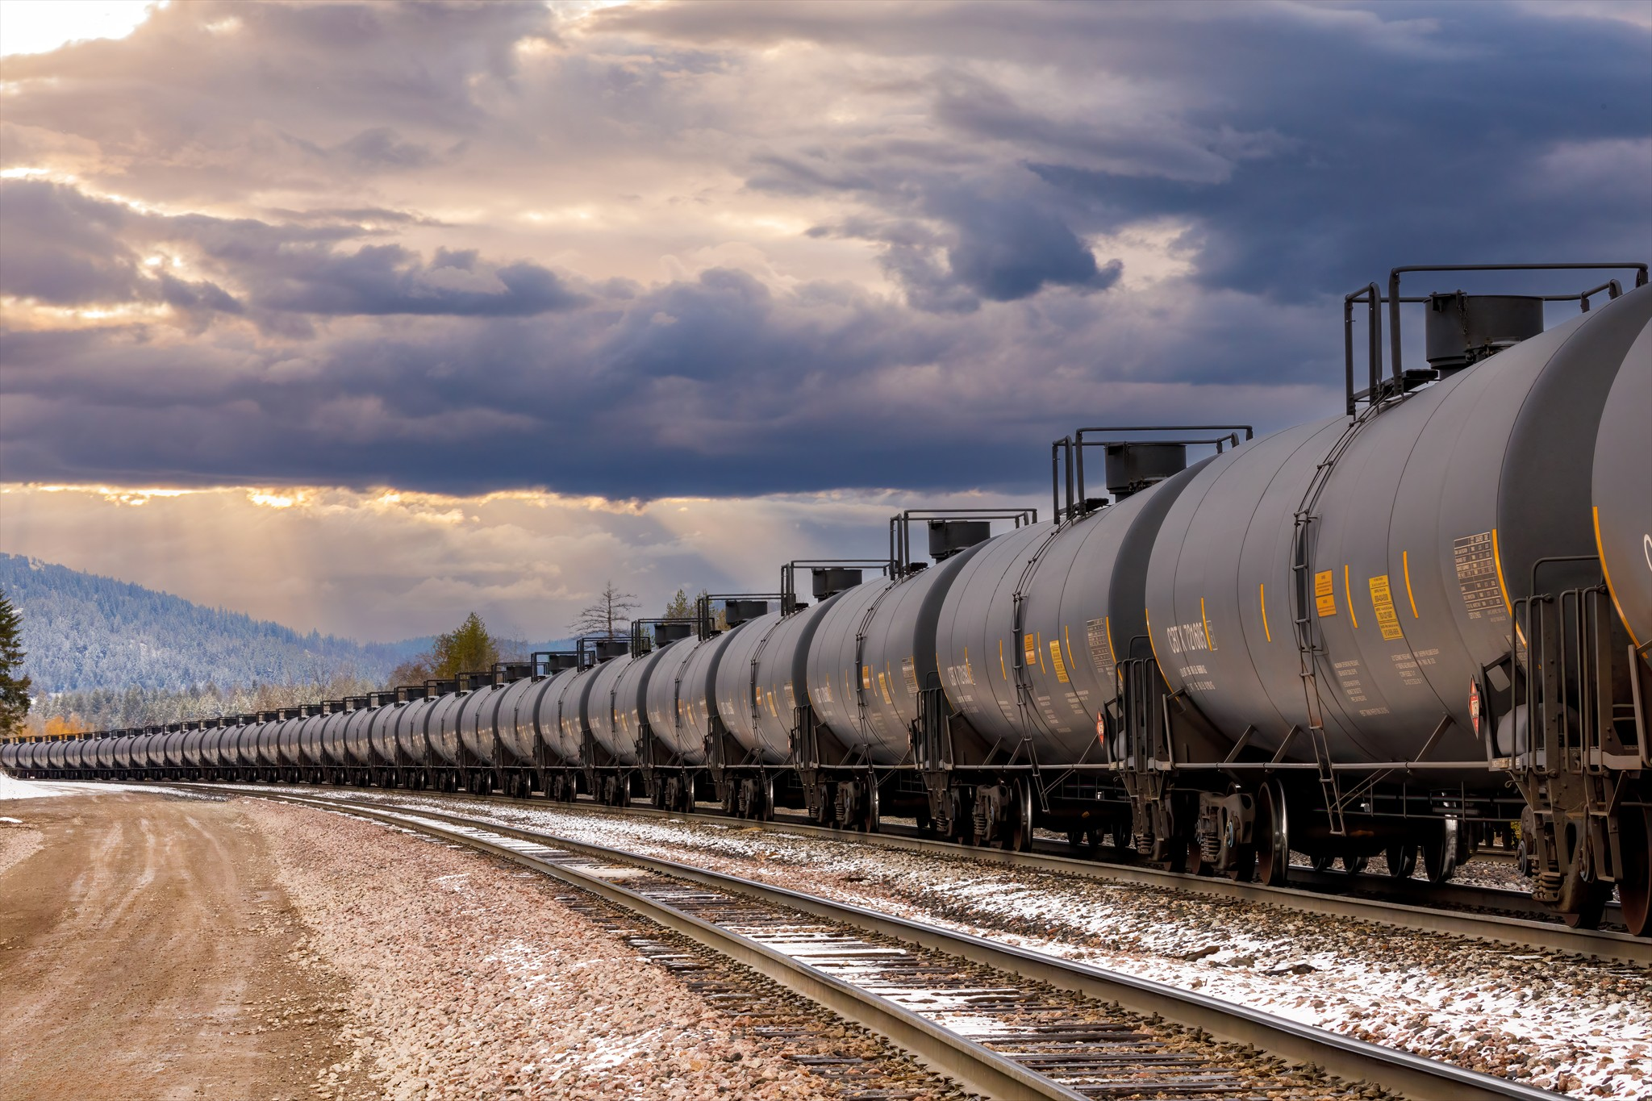

Summary
Variety of sources for information available for identifying ethanol:
SDS
DOT placards & markings
NFPA 704 labeling system
Shipping papers
Denatured fuel ethanol will be found in:
Highway cargo tank trucks
Railroad tank cars
Freighter ships/ barges
Pipelines
Notes:
There are a variety of sources from which an emergency responder can gather information about chemicals involved in spill or fire incidents.
Among them are Safety Data Sheets (SDS), DOT identification numbers and placards, the NFPA 704 labeling system, and shipping papers.
Denatured fuel ethanol (E95-E98) is one of the leading hazardous materials shipped by rail. Transportation of this fuel commonly occurs via highways as well.
Group Discussion:
Ask participants:
What are the most likely types of ethanol emergencies you can see occurring in your jurisdiction (retail fueling station incidents, production incidents, rail incidents, truck transportation incidents, etc.)?
Have there been recent ethanol emergencies in your jurisdiction?
What occurred and what were the actions and impact to the community?

Slide 25

Activity 4.1: Ethanol Product Identification
Purpose:
To allow participants to determine the hazards associated with an ethanol emergency.
Notes:
Time: 15 minutes
Materials: Figure 4.10
Scenario
A cargo tank truck (see Figure 4.10) delivering fuel to the Gas ‘N Matches retail site is involved in a hit and run accident. The driver advises you that the cargo tank truck is carrying 3,000 gallons of fuel. There is a leak in one of the large pipes on the bottom of the trailer. Fuel is leaking onto the ground and running downhill toward a small welding facility.
Instructor Directions:
Allow the participants to work in groups of two to three for this activity.
Participants should read the scenario and determine the resources available, immediate hazards, and possible actions to take.
After 10 minutes call time and randomly call on groups to provide their answers.
Participants should mention the following:
What type of vehicle is this?
Answer: MC-306/ DOT-406
List common placards that you might find on this vehicle.
Answers:
1203 placard
3475 placard
A 1987 placard for denatured fuel ethanol is not common but denatured fuel ethanol is being delivered to a small market of fuel retail stations in the Midwest.
What other resources might be helpful to responders in this incident?
Answers:
ERG
Safety Data Sheets (SDS)
Shipping papers
Information centers e.g. CHEMTREC® (1-800-424-9300)
What are the immediate concerns and hazards?
Answers:
Life safety
Evacuation of employees and customers
Incident stabilization
Control sources of ignition
Control product movement
Contain product movement
Property and environmental conservation
What possible actions might you take at this point in the situation?
Answers will vary depending on the knowledge of the class, but should include:
Initiate isolation distances for civilians
Protective action distances in the event of fire
Discuss with driver quantity and notification of owner
Request shipping papers / bill of lading
Ask if emergency shutoff has been activated
Assure that all notification have been made
This last question is to allow participants to begin thinking about mitigation techniques. Remind participants that we are operating at an awareness level. The scene will soon be operating under the National Incident Management System (NIMS) and the incident command structure.

