Slide 1
Module 3:
Chemical and Physical Characteristics of Ethanol and Hydrocarbon Fuels

Slide 2
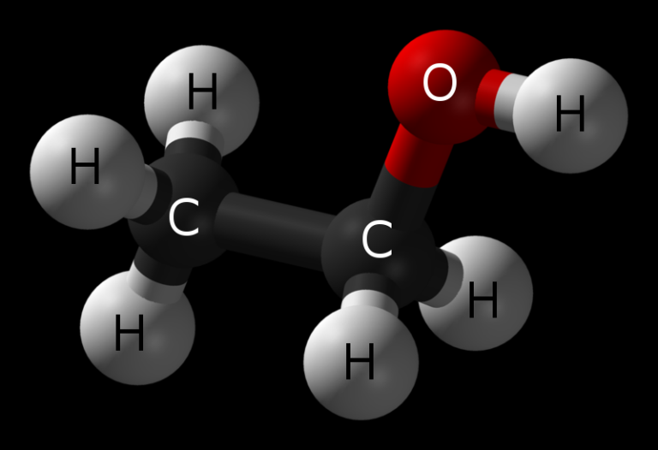
Objective
Upon the completion of this module, participants should be able to describe the chemical & physical differences between gasoline, ethanol & ethanol-blended fuels.
Notes:
Enabling Objectives
1. Compare the chemistry of gasoline, ethanol, and ethanol-blended fuels.
2. Describe the characteristics of ethanol-blended fuels.

Slide 3
Introduction
Characteristics of gasoline
Characteristics of ethanol
Conditions under which ethanol-blended fuels will retain chemical characteristics different than an all hydrocarbon fuel
Notes:
Show the video Emergency Response Considerations (4:32 to 6:47).
In order to understand the nature of ethanol-blended fuels, emergency responders will need to understand the characteristics of polar solvents and hydrocarbons, their differences, and how these types of products interact.
Ethanol is classified as a polar solvent. A polar solvent is a compound (such as alcohol, most acids, or ammonia) with a separation of charge in the chemical bonds. These have an affinity for water and will readily go into solution.
Under some conditions, ethanol-blended fuels will retain certain characteristics as a gasoline-type fuel, and under others it will exhibit polar solvent-type characteristics. Understanding these conditions and characteristics will help emergency responders mitigate their specific incident based on conditions found when arriving on the scene.

Slide 4
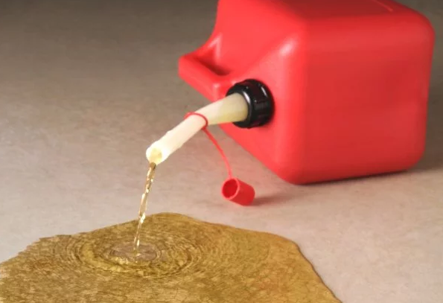
Characteristics of Gasoline
Insoluble in water
Produced from crude oil
Harmful effects after long-term & high-level exposure
Smoke from burning gasoline is black & has toxic components
Significant hazard is flammability:
Fairly narrow range of flammability
1.4% - 7.6% by volume in air
Notes:
Hydrocarbon fuels such as gasoline, diesel fuel, kerosene, jet fuel generally have similar characteristics, whether they are flammable liquids or combustible liquids. In this module we will specifically identify the characteristics of gasoline as they relate to ethanol and gasoline blends.
Gasoline is a hydrocarbon produced from crude oil. It is immiscible with water and will not mix at any concentration. Gasoline has a flash point of approximately -45°F, varying with octane rating. It changes seasonally and is blended specifically for each region of the country. An important point to note is that even in winter weather, gasoline will ignite.
Gasoline has a vapor density between 3 and 4. Therefore, as with all products with a vapor density greater than 1.0, gasoline vapors are heavier than air and will seek low levels or remain close to ground level.
Gasoline has a specific gravity of 0.72-0.76 which indicates it is lighter than water (which has a specific gravity of 1.0). Therefore, gasoline will float on top of water since it is immiscible or insoluble. Its auto-ignition temperature is greater than 530°F.
Gasoline varies in composition. It is a mixture of many hydrocarbons typically with a boiling point between 100°F and 400°F, but some portions will boil at less than room temperature.
Gasoline is not considered a poison but it does have harmful effects after long-term and high-level exposure that can lead to respiratory failure. Smoke from burning gasoline is black and has toxic components.
The toxic components found in gasoline include benzene, toluene, xylene, heptane, and hexane. Gasoline’s greatest hazard is its flammability despite a narrow flammability range (Lower Explosive Limit, or LEL, is 1.4% and the Upper Explosive Limit, or UEL, is 7.6%).

Slide 5
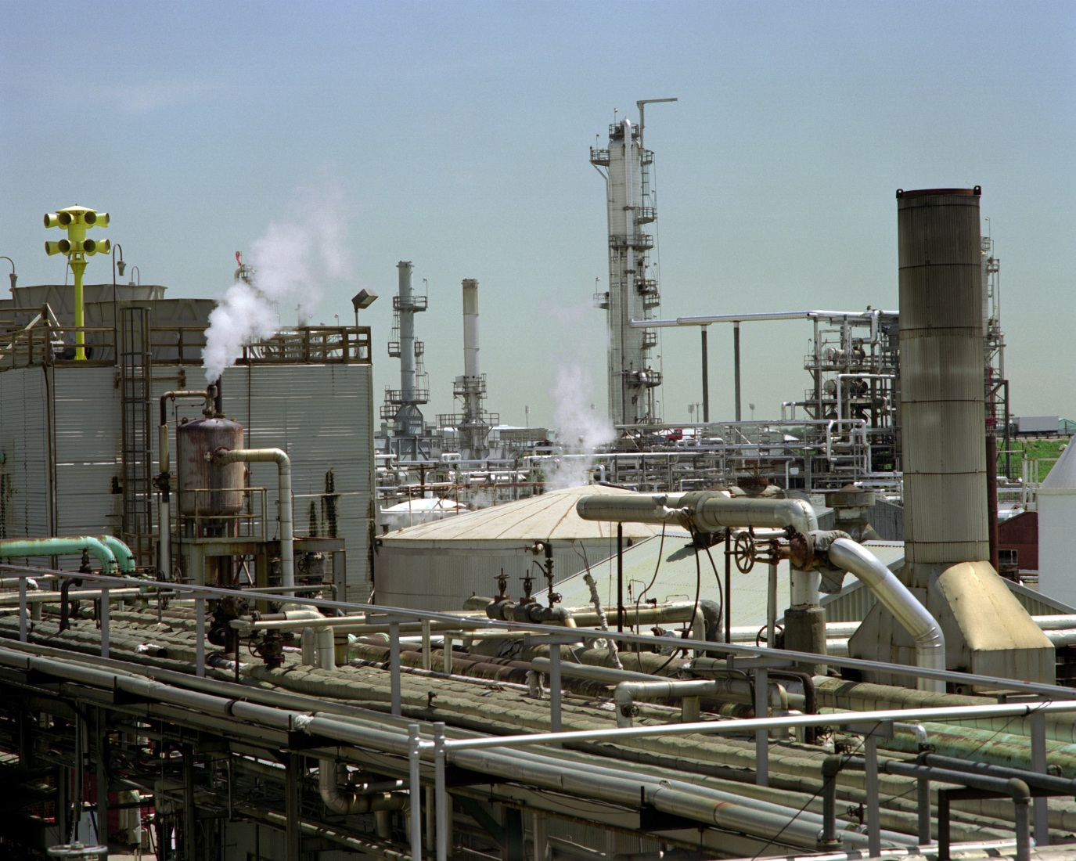
Gasoline Production
Notes:
Gasoline is produced from crude oil. Crude oil varies greatly in color and viscosity from one oil well to the next and is largely dependent upon the geographic region. Crude oil is transported via pipeline, freighter ship/barge, rail tank car and cargo tank truck to an oil refinery where it is processed into refined products like gasoline. An oil refinery uses engineering techniques such as fractional distillation and alkylation to produce gasoline.
Like crude oil, gasoline is also transported via pipeline, freighter ship/barge, rail tank car and cargo tank truck until it ultimately reaches retail fueling stations and consumers.

Slide 6
Characteristics of Ethanol
Renewable fuel source produced by fermentation & distillation processes
Most common feedstock in U.S. is corn
Other feedstock include corn cobs, corn stover, switchgrass, etc.
Ethanol used with motor fuels must be denatured with 2% - 5% natural gasoline or similar hydrocarbon before transportation to bulk storage facilities
Denaturant has minimal effects on characteristics except for flash point
The addition of denaturant further depresses the flash point
Notes:
Ethanol is a renewable fuel source produced by a fermentation and distillation process of sugars and starches found in grain like corn and sorghum, beverage and food waste, and cellulosic biomass like corn stover and switchgrass.
Like gasoline production, an ethanol biorefinery uses engineering techniques such as distillation and dehydration to produce fuel grade ethanol. Ethanol for use in motor fuel blends will generally be denatured with 2-5% gasoline or a similar hydrocarbon before being transported to bulk storage facilities.
Denaturant has minimal effects on the overall characteristics of ethanol with the exception of further depressing the flash point. This training program focuses on denatured fuel ethanol.

Slide 7
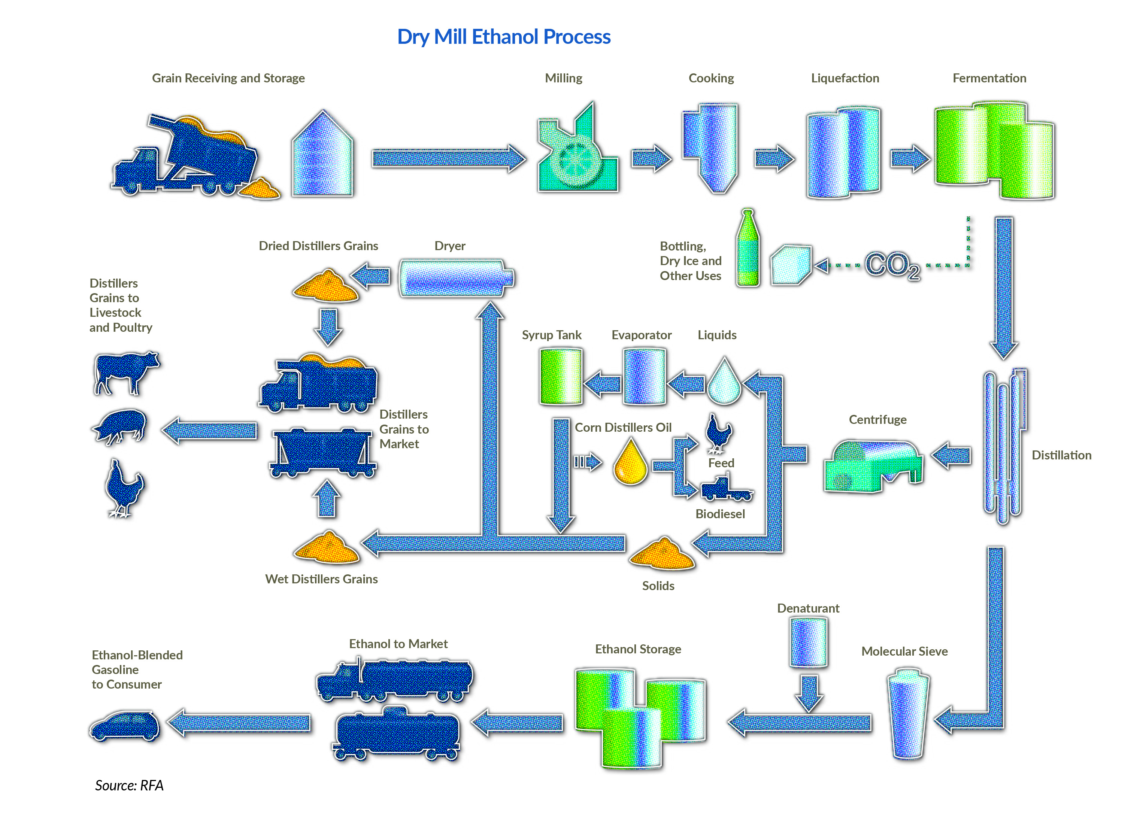
Ethanol Production
Notes:
Most ethanol is produced using the dry mill process, with the remaining processed by wet mills. The main difference between the two processes is the initial treatment of the grain.
In dry milling, the entire grain kernel is first ground into flour (or "meal”), then slurried with water to form a "mash.” Enzymes are added to the mash to convert the starch to a simple sugar. The mash is cooked then cooled and transferred to fermenters. At this point yeast is added and the conversion of sugar to alcohol and carbon dioxide (CO2) begins.
The fermentation process generally takes about 40 to 50 hours. After fermentation, the resulting "beer" is transferred to distillation columns. The ethanol is concentrated to 190 proof (95% ethanol) using conventional distillation and then is dehydrated to approximately 200 proof (100% ethanol) in a molecular sieve system.
The anhydrous ethanol is then blended with about 2-5% denaturant (such as natural gasoline) to render it undrinkable and thus not subject to beverage alcohol tax. It is then ready for shipment to gasoline terminals or retailers.
The remaining leftovers from the ethanol production process are called “co-products.” The coarse grain and syrup that are left over are then dried together to produce dried distillers grains with solubles, or DDGS, which is a high-quality, nutritious livestock feed. The high-grade, biogenic CO2 released during fermentation can also be captured and sold for use in carbonating soft drinks and beverages and the manufacture of dry ice.
7

Slide 8
Characteristics of Denatured Fuel Ethanol
Polar solvent
Miscible in water
Greatest hazard as motor fuel component is flammability
Wider flammable range than gasoline:
3% - 19% by volume in air
Notes:
Denatured fuel ethanol is a polar solvent and is water-soluble. A polar solvent is a compound such as alcohol, most acids, or ammonia with a separation of charge in the chemical bonds. These have an affinity for water and will readily go into solution.
Denatured fuel ethanol has a flash point of -5°F and a vapor density of 1.5, which indicates that it is heavier than air. Consequently, ethanol vapors like gasoline will seek lower altitudes and/or lower depressions in the surrounding terrain of an incident. Denatured fuel ethanol’s specific gravity is 0.79, which indicates it is lighter than water and it has an auto-ignition temperature of 709°F and a boiling point of 165-175°F.
Like gasoline, denatured fuel ethanol’s greatest hazard as a motor fuel component is its flammability. It has a wider flammable range than gasoline with a lower explosive limit of 3% and an upper explosive limit of 19%.

Slide 9
Chemical Properties Comparison
Property | Gasoline | Denatured Fuel Ethanol
Flash Point | -45⁰F | -5⁰F
Auto Ignition Temp | 530 - 853⁰F | 709⁰F
Specific Gravity | 0.72 – 0.76 | 0.79
Vapor Density | 3 - 4 | 1.5
Vapor Pressure | 8 - 15psi | ~3psi
Boiling Point | 100 - 400⁰F | 165 - 175⁰F
Flammable Range | 1.4% - 7.6% | 3% - 19%
Smoke Characteristics | Black | Slight
Solubility | Trace | High
Notes:
The chart displays some very similar properties between gasoline and denatured fuel ethanol. Just as important, however, are also very different inherent properties.
Gasoline is a complex mixture of over 500 compounds that may have between five and 12 carbon atoms. Denatured fuel ethanol is a two-carbon alcohol, also referred to as ethyl alcohol, that has 2-5% of a denaturant such as gasoline added to render the product undrinkable.
Both gasoline and ethanol are very flammable products; gasoline has a lower flash point of -45°F compared to -5°F for ethanol. The densities of gasoline and denatured fuel ethanol are similar; both fuels are lighter than water which has a density of 1.0.
Gasoline has a very broad boiling point range which indicates components will boil off over a broad temperature range. Ethanol, on the other hand, has a very narrow boiling point range. Ethanol has a lower vapor pressure than gasoline at 3 psi vs. 8-15 psi for gasoline.
Note the differences in the flammability ranges for these two products. It is also important to understand the great difference between the water solubility of ethanol vs. gasoline.
*Please note that the flammable range may expand depending on the actual ethanol blend. For example, E85 represents one of the most expanded flammable ranges for ethanol-blended fuel products with a flammability range of 1.4-19%.

Slide 10
Considerations for Ethanol Fires
In undenatured/ neat form, the flame & smoke are not easily visible
In denatured form, the flame is orange and there is minimal smoke but both are visible
Large amounts of water required to dilute ethanol to no longer support combustion
Will continue to burn at five parts water to one part ethanol (5:1 ratio or 500% dilution)
Notes:
The flame and smoke production from undenatured, neat ethanol fires are not easily visible. Undenatured or neat ethanol does not produce visible smoke and displays a hard-to-see blue flame. In denatured form, there is little smoke with a slight orange visible flame.
The most striking difference between ethanol and gasoline is that ethanol mixes readily with water. While it is possible to dilute ethanol to a condition where it no longer supports combustion, this may not be a practical strategy at the incident scene since it requires copious amounts of water. Even at five parts water to one-part ethanol (5:1 ratio or 500% dilution), ethanol will still burn.

Slide 11
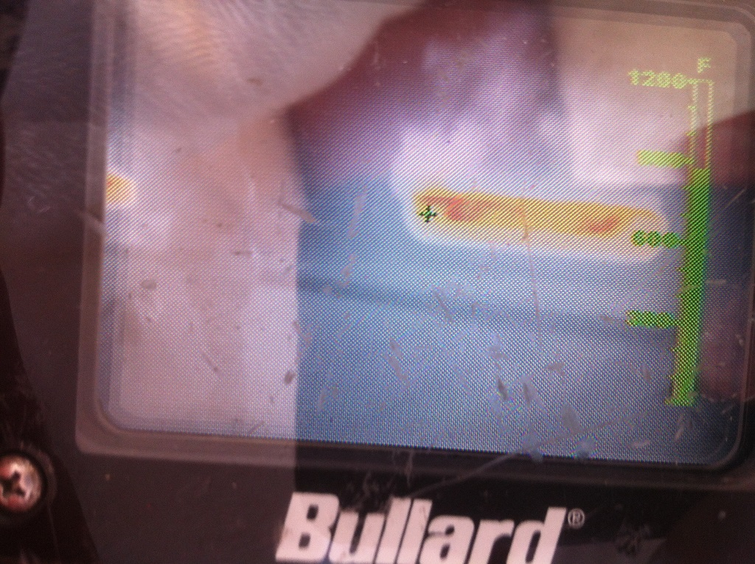
Invisible Flames - Ethanol
Thermal imaging
Fires involving a high percentage of ethanol can burn with little to no smoke generation and visible flame
The use of a thermal imaging camera is highly recommended
Notes:
Because fires involving a high percentage of ethanol can burn with little-to-no smoke generation and visible flame, the use of a thermal imaging camera is highly recommended.
This picture is of an ethanol fire as seen through a thermal imaging camera. Use caution when approaching an ethanol fire as the actual fire may be much larger than the visible flames present at the incident scene indicate.

Slide 12
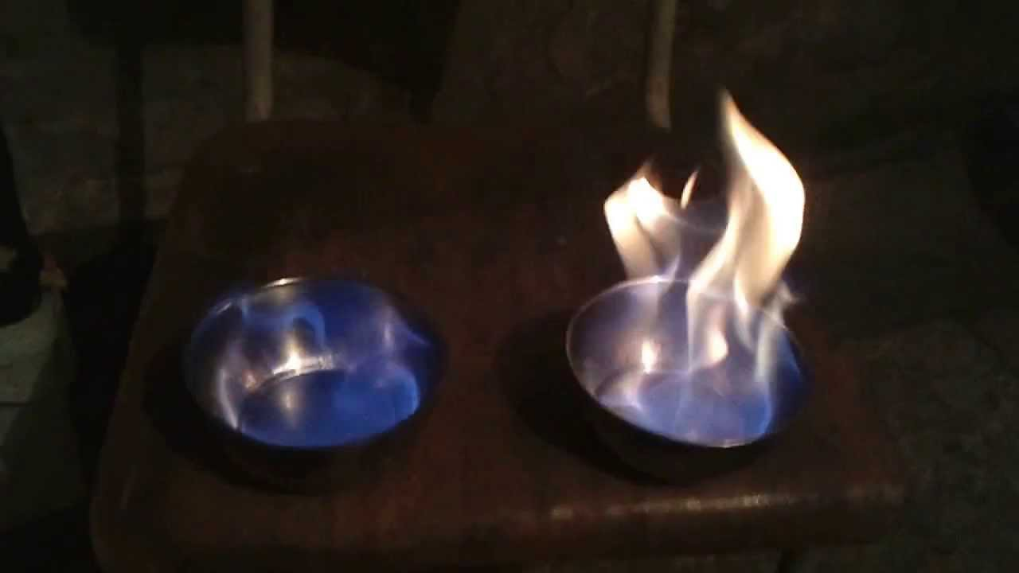
Characteristics of Ethanol-Blended Fuels
Blending fuels alters physical & chemical characteristics of original fuels:
Visual difference of smoke & flame characteristics:
Higher content of ethanol, less visible black smoke content & orange flame production
E100 E85
Notes:
Blending ethanol and gasoline produces a mixture with its own unique physical characteristics. One of the noticeable differences of an ethanol-blended fuel versus unblended gasoline is the visual difference of the smoke and flame characteristics.
The higher the content of ethanol, the less visible the black smoke content and an orange flame will be produced. These characteristics may be masked by other organic and synthetic materials that may also be burning at the incident scene such as vehicle tires, brush or grass.

Slide 13
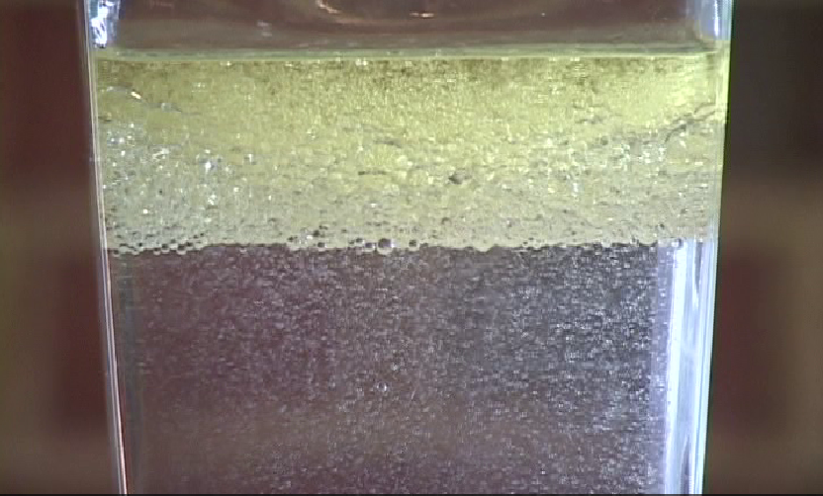
Characteristics of Ethanol-Blended Fuels
Gasoline floating on layer of ethanol/ water solution gasoline
Ethanol & gasoline are miscible, creating a homogeneous fuel blend
Water contamination of ethanol gasoline fuel blends may cause phase separation:
Phase separation will introduce a water layer in the bottom that consists of water & ethanol
All hydrocarbon gasoline will remain in the top layer
Ethanol/ water solution (still flammable)
Ethanol phasing away from hydrocarbon
Notes:
Blending ethanol with gasoline has multiple effects. The higher the concentration of ethanol, the more the fuel presents with polar solvent-type characteristics with corresponding effects on conducting fire suppression operations.
Water introduced into ethanol-gasoline fuel blends has a dramatic effect. Without water, ethanol-gasoline blends remain homogeneous or mixed.
As stated earlier, ethanol has an affinity for water. For instance, it is not necessary to add any gas line antifreeze to an ethanol-gasoline blend since the ethanol will absorb trace amounts of water and pull it through the fuel system of the vehicle.
However, when using water to extinguish a fire during emergency response efforts, the water can pull the ethanol out of the blend, resulting in a separate layer comprised of water, ethanol, and some hydrocarbon content. The gasoline will remain in the top layer due to the ethanol having a more polar character than non-polar character.
Although rare, phase separation can occur in fuel storage systems where water is present or gets into the system.

Slide 14
Activity 3.1: Comparison of Gasoline and Ethanol
Purpose:
To allow participants to discuss the differences & similarities in the chemical & physical properties of ethanol & gasoline
Notes:
Time: 15 minutes
Materials: Worksheet 3.1
Instructor Directions:
Have participants take a few minutes to review the prior information and fill in Worksheet 3.1.
In the participant guide the chart is left blank. The answers are only in your instructor’s guide.
Based on this information, lead into a discussion in which you have the participants predict how the differences in the fuels, particularly when combined, might lead to different outcomes during emergencies by asking the following questions:
When comparing gasoline and ethanol, which product is flammable?
Answer: Both gasoline and ethanol are flammable.
Even though gasoline and ethanol have similar specific gravities how would you expect the mixed blend to react if released into a water source such as a creek or pond?
Answer: The specific gravity indicates ethanol may float on top of water, however ethanol is miscible with water so it will readily mix with any body of water and travel with the current. The gasoline portion will float on top and will not mix with the water.

Slide 15
Consideration for Ethanol-Blended Fuel Fires
Best practice is the use of alcohol resistant foam, AR-AFFF
When phase separation of ethanol & gasoline occurs:
Gasoline layer floating on top will burn first
Ethanol water layer will burn next, flames and smoke may be diminished
Notes:
The video Responding to Ethanol Related Incidents shows that the most effective tool or resource for keeping an ethanol fire under control is the use of alcohol resistant foam, more commonly known as AR-AFFF.
As ethanol is a polar solvent, this foam contains a special polymer that creates a barrier between the foam and the ethanol-blended fuel.
When properly proportioned and applied to an ethanol-blended fuel spill or fire, AR-AFFF finished foam forms a cohesive blanket. This blanket will extinguish the fire or suppress vapors of a spill, prevent reignition, provide post-fire security to emergency response personnel, and ultimately lead to a successful conclusion of the incident.
Another noticeable difference of ethanol-blended fuels under fire conditions is that when foam or water has been flowed on the burning product, the gasoline will tend to burn off first, eventually leaving the less volatile ethanol/water solution, which may have reduced visible flame or smoke production.
Because AR-AFFF foam is universally suitable for use on both ethanol, ethanol-blended and straight hydrocarbon fires, the best practice is for emergency responders to keep an appropriate amount of AR-AFFF foam concentrate readily available for these incidents.

Slide 16
Activity 3.2: Definitions
Purpose:
To allow participants to identify the definitions related to ethanol & ethanol-blended fuels
Notes:
Time: 15 minutes
Materials: Worksheet 3.2
Instructor Directions:
Tell participants that the definition for ethanol has been given. Ask them to take five minutes and see if they can fill in the terms for each of the definitions provided in Worksheet 3.2.
Give participants 5-10 minutes to write in the terms for each of the definitions below. Point out that #1 has been completed for them.
After you call time, call on participants to provide an answer for each definition. Make sure everyone understands each definition before moving to the next.

Slide 17
Worksheet 3.2: Definitions
Ethanol
Polar solvent
Hydrocarbon
Flash point
Auto-ignition temperature
Specific gravity
Vapor pressure
Vapor density
Boiling point
Flammable range
Upper explosive limit (UEL)
Lower explosive limit (LEL)
Toxicity
Flammable liquid
Notes:
Ethanol: It is a clear, colorless, flammable solvent; also known as ethyl alcohol, grain spirits, or neat alcohol (anhydrous). Unlike other alcohols of similar molecular weight, ethanol is considered a drinking alcohol. Ethanol found in transportation fuels has been denatured, generally by the addition of 2-5% gasoline (denatured fuel ethanol), rendering it unfit for drinking and thereby avoiding the Federar liquor tax.
Polar Solvent: A compound such as alcohol, most acids, or ammonia with a separation of charge in the chemical bonds. These have an affinity for water and will readily go into solution.
Hydrocarbon: A compound composed of carbon and hydrogen and commonly obtained through the refining of crude oil.
Flash point (The flash point of gasoline is -45°F; the flash point of ethanol is -5°F): The minimum temperature at which a liquid gives off vapor in sufficient concentrations to allow the substance to ignite. The lowest temperature at which a flammable liquid can form an ignitable mixture in air near the surface of the liquid.
Auto-ignition temperature: The minimum temperature required to ignite a gas or vapor to spontaneously combust in air without a spark or flame being present.
Specific gravity: The ratio of the density of a substance to the density of water.
Vapor pressure: The pressure exerted by a vapor that is in equilibrium with its solid or liquid form.
Vapor density: Relative weight of a gas or vapor in comparison to air.
Boiling point: The temperature at which the vapor pressure of a liquid equals the environmental pressure surrounding the liquid.
Flammable range (Upper Explosive Limit [UEL] – Lower Explosive Limit [LEL]): Concentration range for a gas or vapor within which a fire may result if an ignition source is introduced; includes an upper and a lower limit between which the fire danger lies.
Toxicity: The degree to which a substance can harm humans or animals if absorbed, inhaled, injected or ingested.
Flammable liquid: Any liquid with a flash point under 100°F; referred to as Class I liquids; examples are gasoline and ethanol.

Slide 18
Summary
Ethanol is a polar solvent, miscible with water, & flammable
Higher content of ethanol means less visible black smoke, & orange flame production
Best practice is the use of alcohol resistant foam
AR-AFFF
Notes:
Group Discussion:
Ask participants:
Are you surprised by any of the differences between gasoline and ethanol?
Which differences are going to be of most concern to emergency responders?
Mixed blends of fuel present interesting situations for emergency responders. Water is a readily available firefighting agent, and we have discussed how the fuel mixtures react with water. What other hazards are associated with ethanol and ethanol blends, and what can be done to minimize these hazards?
Answers: Flammability, respiratory, and contact hazards. Also, the issue of conductivity which demands that grounding and bonding be part of the tactical plan for transfers. The proper use of protective equipment such as eye protection, self-contained breathing apparatus (SCBA), flame resistant clothing, and appropriate gloves.
To summarize, we learned that ethanol is a polar solvent that is miscible with water and is flammable. When water becomes a factor in an ethanol-blended fuel incident, phase separation will most likely occur. The ethanol will be the last fuel to burn and it may burn with little or no visible smoke or flame production.
When dealing with ethanol-involved incidents, it is important to consider strategies and tactics that will maximize protection to emergency responders and the affected community and stabilize the incident efficiently and effectively, while also being mindful of environmental issues.
If offensive foam operations are being considered, then the most effective resource for keeping an ethanol or ethanol-blended fuel fire under control is the use of alcohol-resistant (AR) foam, more commonly known as AR-AFFF.
Because the AR foam is universally suitable for use on both ethanol-blended and straight hydrocarbon fires, the best practice is for emergency responders to keep an appropriate amount of AR-AFFF foam concentrate readily available for these incidents.

