Slide 1
Module 6:
Fire Fighting Foam Principles
Notes:
Module Time: 40 minutes/ 55 minutes
Materials:
Emergency Response Considerations video – (Show the video segment from 12:14 to 15:41)

Slide 2
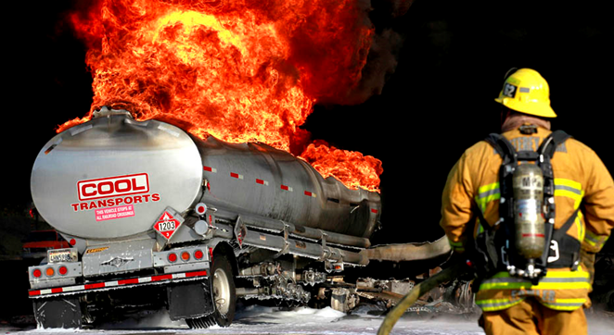
Objective
Upon the completion of this module, participants should be able to develop firefighting strategies & foam-use tactics for controlling & fighting fires associated with flammable liquid hazards of ethanol-blended fuels.
Notes:
Enabling Objectives
1. Describe the manner in which foam applications can be used to fight fuel fires.
2. List the ways in which foam applications suppress fire.
3. Predict when to fight fuel fires and when to simply protect surrounding areas.
4. State the generally accepted “rule of thumb” for the use of foam applications on ethanol-blended fuel fires.

Slide 3
Introduction
Emergency responders need to be prepared for
incidents associated with flammable liquids
Ethanol-blended fuels have similarities to other flammable liquids but also present unique burn characteristics
Hazards associated with production, storage, & transportation by cargo tank trucks & rail tank cars carrying these products require special considerations
Notes:
Show the video Emergency Response Considerations (12:14 to 15:41).
As discussed previously, we have seen a tremendous growth of the ethanol industry and it will continue to expand. As always, emergency responders should be ready for emergencies associated with flammable liquids. Ethanol-blended fuels are similar to other flammable liquids and their hazards. The predominate danger from ethanol emergencies is not from incidents involving cars and trucks running on ethanol-blended fuel, but instead from cargo tank trucks and rail tank cars carrying large amounts of ethanol, manufacturing facilities, and storage facilities. Responders need to anticipate large-scale emergencies and where appropriate engage in operational activities using the most effective techniques and extinguishing media. This module will focus on foam basics and then foam applied specifically to ethanol-related emergencies.
In this program it is recommend to us AR-AFFF foam. Please note that fire protection foams have changed composition in recent year due to health and environmental effects of the older fluorinated foams. A new formulation know as Fluorine Free Foams is now being manufactured. It is recommended that you consult the safety data sheet (SDS) for your current foam supply and use caution if using older foams. For more information on per and polyfluoroaklyl substance (PFAS) or perfluoroctane acid (PFOA) please visit https://www.epa.gov/pfas.

Slide 4
Basic Foam Principles
What is foam?
  “…foam a stable aggregation of bubbles of lower density than oil or water.” (NFPA 11 version 2016)
What is foam concentrate?
  “…a concentrated liquid foaming agent as received from the manufacturer.” (NFPA 11 version 2016)
What is alcohol resistant foam concentrate?
  “…a concentrate used for fighting fires on water soluble materials and other fuels destructive to regular….foams.” (NFPA 11 version 2016)
Notes:
Group Discussion:
Tell participants that this section covers basic principles of foam use. It is put here because not all participants will have this basic knowledge of foam. It also provides a bridge to the next section on specific foam use with ethanol and helps to broaden their understanding of why most foams are ineffective when used on ethanol emergencies.
The following section (from Basic Foam Principles through Rain-Down) is property of the Texas Engineering Extension Service (TEEX).
Reproduction of this section of the document, in whole or in part, requires written authorization from the Director, TEEX, The Texas A&M University System, unless such reproduction is authorized or executed by the United States Government.
To understand the basic foam principles, we must first understand - What is Foam?
As defined in National Fire Protection Association (NFPA) 11, low-expansion foam is:
“…an aggregate of air-filled bubbles formed from aqueous solutions which are lower in density than flammable liquids. It is used principally to form a cohesive floating blanket on flammable and combustible liquids and prevents or extinguishes fire by excluding air and cooling the fuel. It also prevents re-ignition by suppressing formation of flammable vapors. It has the property of adhering to surfaces, which provides a degree of exposure protection from adjacent fires.”
What is Foam Concentrate?
“…a concentrated liquid foaming agent as received from the manufacturer.” (NFPA 11 version 2016)
What is Alcohol Resistant Foam Concentrate?
“…a concentrate used for fighting fires on water soluble materials and other fuels destructive to regular….foams.” (NFPA 11 version 2016)

Slide 5
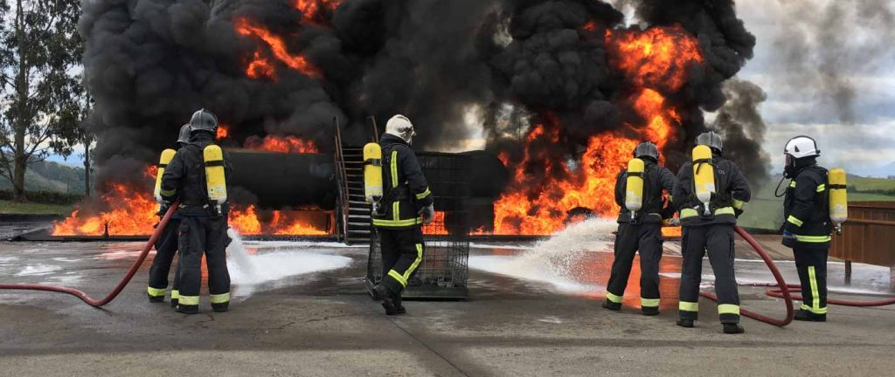
Basic Foam Principles
Why use foam?
  Can provide protection from flammable liquids for fire & rescue personnel during emergency operations
  Can provide post-fire security by protecting hazard until it can be secured/ removed
Notes:
Ethanol will continue to burn at five parts water to one-part ethanol (5:1 ratio/500% dilution). Many extinguishing agents are effective on flammable liquids. However, foam is the only agent capable of suppressing vapors and providing visible proof of security. Reasons to use foam include:
Foam can provide protection from flammable liquids for fire and rescue personnel during emergency operations when properly applied and maintained.
A foam blanket on an unignited spill can prevent a fire.
The suppression of vapors prevents them from finding an ignition source.
Foam can provide post-fire security by protecting the hazard until it can be secured or removed.

Slide 6
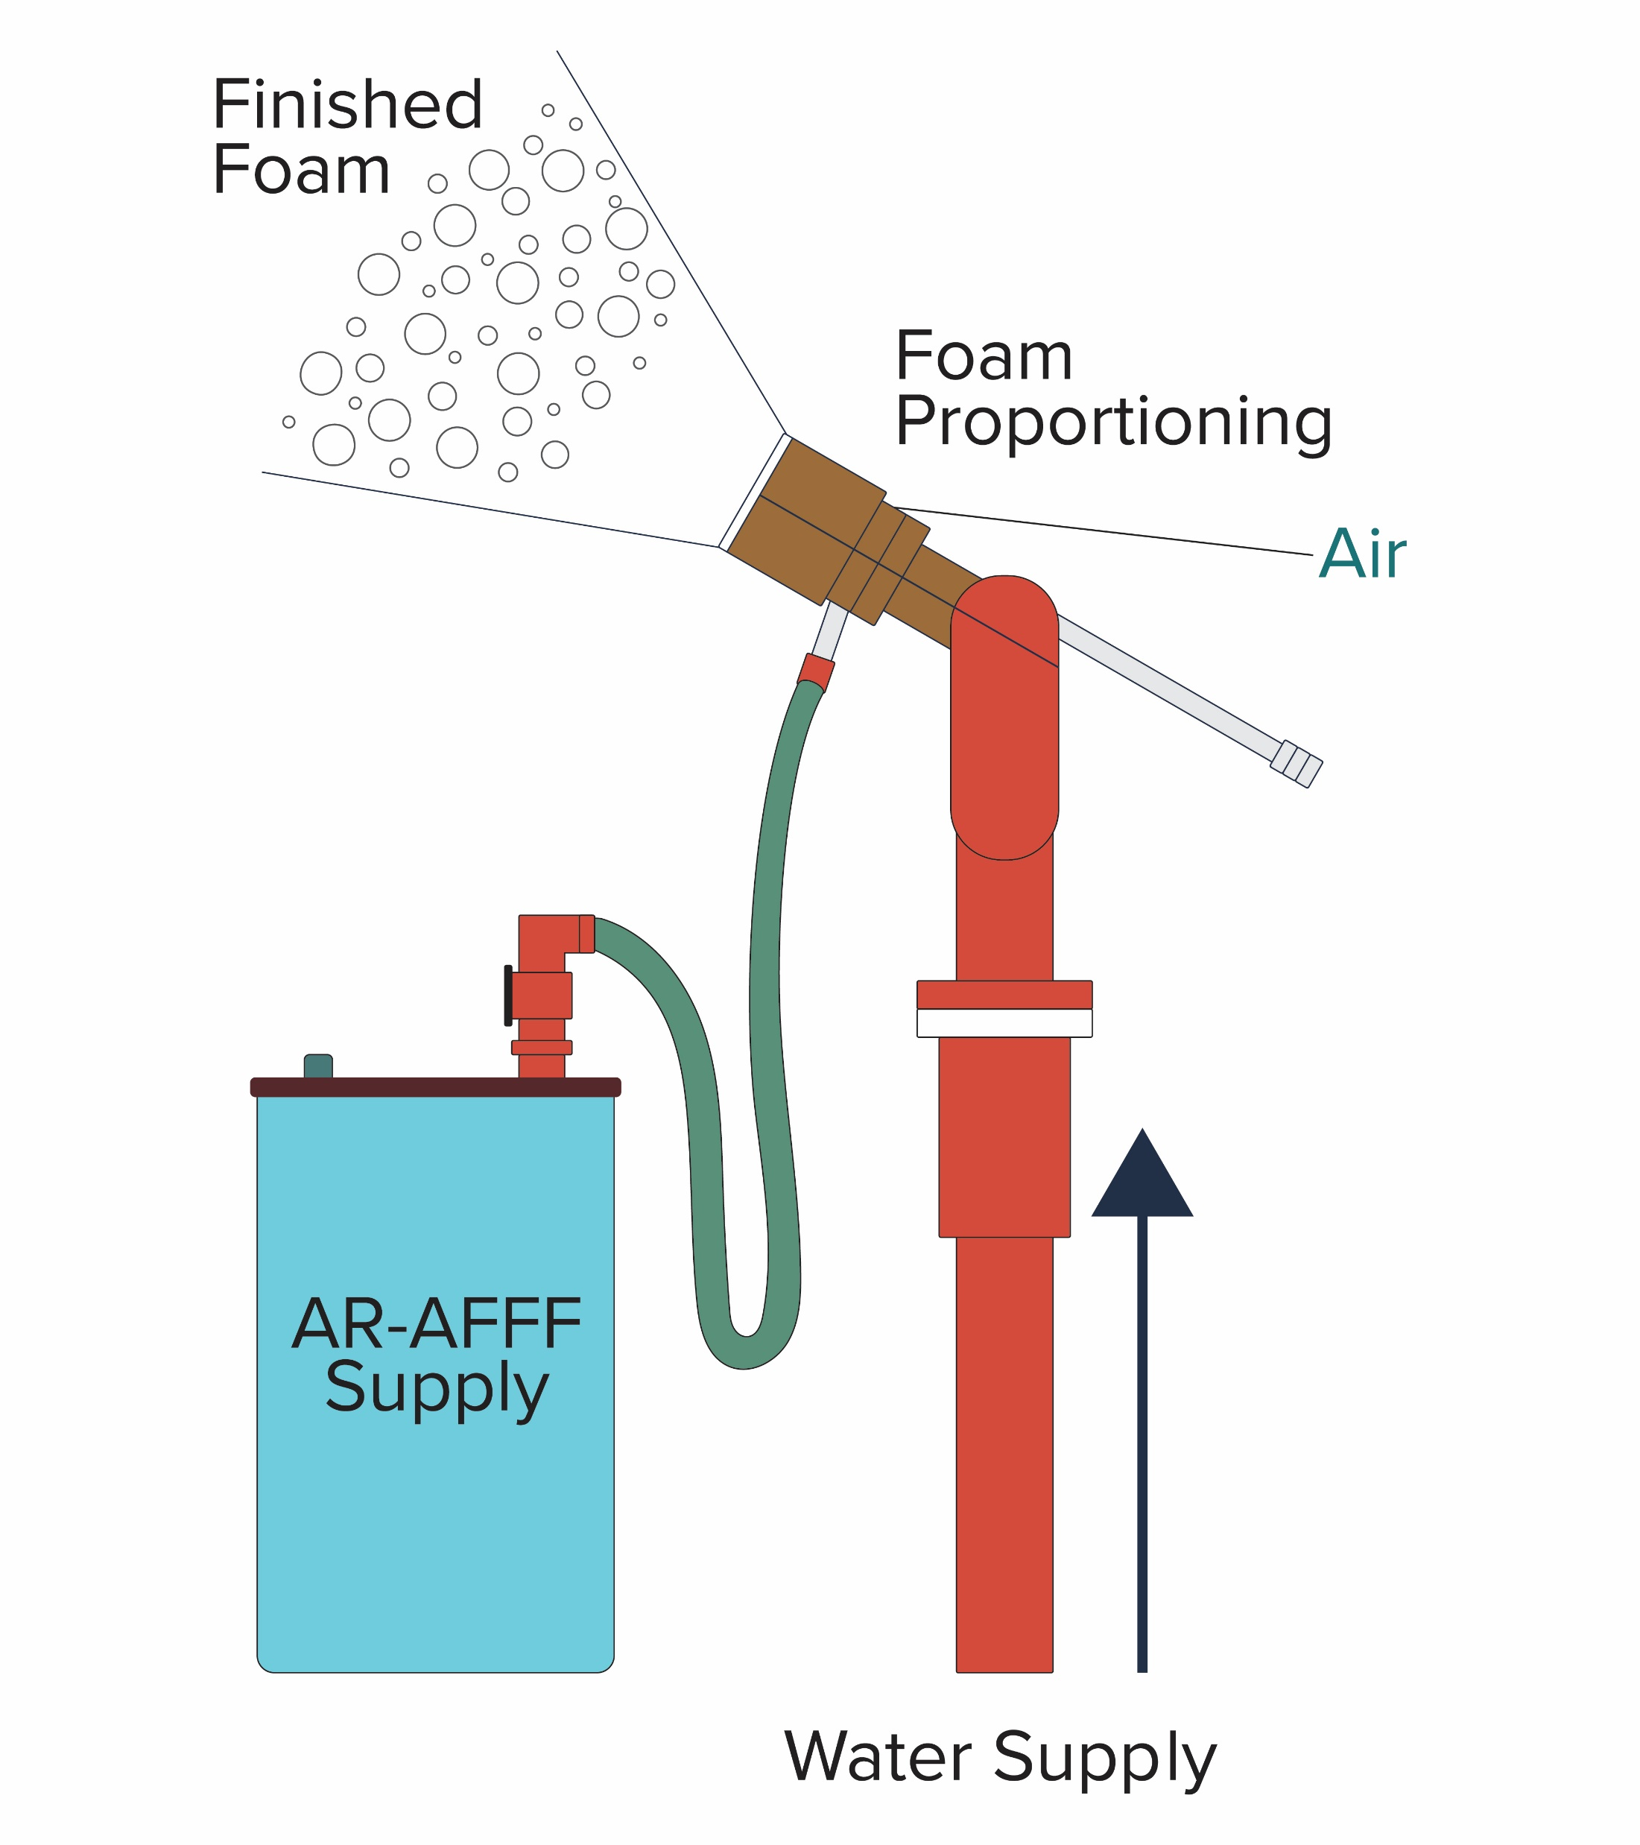
Basic Foam Principles
How foam works:
  Foam tetrahedron:
    Before being used must be proportioned & aerated
    4 elements:
      Foam concentrate
      Water
      Air
      Aeration
Notes:
How Foam Works
Foam can control and extinguish flammable liquid fires in a number of ways. Foam can:
Exclude oxygen from the fuel vapors and thus prevent a flammable mixture
Cool the fuel surface with the water content of the foam
Prevent the release of flammable vapors from the fuel surface
Emulsify the fuel (some environmental foams)
Foam Tetrahedron
Foams used today are primarily of the mechanical type. This means that before being used, they must be proportioned (mixed with water) and aerated (mixed with air).
Four elements are necessary to produce a quality foam blanket. These elements include:
Foam concentrate (AFFF, AR-AFFF, etc.)
Water
Air
Aeration (mechanical agitation)
All of these elements must be combined properly to produce a quality finished foam blanket. If any of these elements are missing or are not properly proportioned, the result is a poor-quality foam or no foam at all.
This training program is focused on ethanol-blended fuels and the foam of choice is AR-AFFF.

Slide 7
Basic Foam Principles
What is foam effective on?
  Effective at suppressing vapors & extinguishing Class B fires
    Not effective on pressurized flammable gases
    Not effective on combustible metals
  2 categories of Class B products:
    Hydrocarbons
      Foams listed such as AFFF
    Polar solvents
      AR-AFFF
Never mix foam concentrates from different manufactures together
Notes:
What is Foam Not Effective On?
Foam is not effective on all types of fires. Therefore, it is important to know the type of fire and the fuel involved in every incident. Foam is not effective on:
Class C (electrical) fires
Three-dimensional fires
Pressurized gases
Class D (combustible metal) fires.
Foam is Not Effective on Class C Electrical Fires
Class C fires involve energized electrical equipment; water conducts electricity. Since foam contains 94-97% water, it is not safe for use on this type of fire. In some cases, foam concentrate is even more conductive than water. Class C fires can be extinguished using nonconductive extinguishing agents such as a dry chemical, carbon dioxide (CO₂), or halon. The safest procedure for this type of situation is to de-energize the equipment if possible and treat it as a Class A (ordinary combustible material) or Class B (flammable/ combustible liquids) fire.
Foam is Not Effective on Three-Dimensional Fires
A three-dimensional fire is a liquid-fuel fire in which the fuel is being discharged from an elevated or pressurized source, creating a pool of fuel on a lower surface. Foam is not effective at controlling three-dimensional flowing fires. It is recommended that firefighters control a three-dimensional flowing fire by first controlling the spill fire; then they may extinguish the flowing fire using a dry chemical agent.
Foam is Not Effective on Pressurized Gases
Foam is not effective on fires involving pressurized gases. These materials are usually stored as liquids but are normally vapor at ambient temperature. The vapor pressure of these types of fuels is too high for foam to be effective. To be effective, foam must set up as a two-dimensional blanket on top of a pooled liquid. Examples of pressurized gases include:
Acetylene
Butane
Liquefied Petroleum Gas (LPG)
Propane
Vinyl chloride
Foam is Not Effective on Combustible Metals
Class D fires involve combustible metals such as aluminum, magnesium, titanium, sodium, and potassium. Combustible metals usually react with water; therefore, foam is not an effective extinguishing agent. Fires involving combustible metals require specialized techniques and extinguishing agents that have been developed to deal with these types of fires. A Class D extinguisher or a Class D powder is the recommended choice for fires involving combustible metals.
What is Foam Effective On?
Foam is effective at suppressing vapors and extinguishing Class B fires. Class B fires are defined as fires involving flammable or combustible liquids. For the purposes of this discussion, Class B products are divided into two categories: hydrocarbons and polar solvents.
Hydrocarbons
Most hydrocarbons are byproducts of crude oil or have been extracted from vegetable fiber. Hydrocarbons for liquid fuels have a specific gravity of less than 1.0 and therefore float on water. Examples of these include:
Gasoline
Diesel
Jet propellant (JP4)
Heptane
Kerosene
Naphtha
Polar Solvents
Polar solvent fuels will mix with water with varying degrees of attraction for the water. For example, acetone has a stronger affinity for water than does rubbing alcohol. Polar solvent fuels are usually destructive to foams designed for use on hydrocarbons. Specially formulated foams have been developed for use on polar solvents. Some examples of polar solvent fuels include:
Ketones
Esters
Alcohol including ethyl-alcohol (ethanol)
Amine
Methyl tertiary-butyl ether (MTBE)
Acetone
NEVER mix AR-AFFF foam concentrates from different manufacturers. These concentrates are proprietary blends and may counteract each other when mixed in concentrate form. Finished foam (foam concentrate properly proportioned with water and aerated to allow expansion to manufacturer’s recommendations) from different manufacturers being deployed into or adjacent to the same location is acceptable.

Slide 8
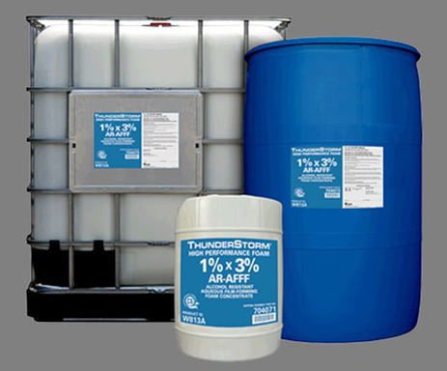
Basic Foam Principles
Types of foam:
  Protein foam
    Made of natural protein products such as
    soybeans, chicken beaks, fish bones, &
    animal hooves, along with some other
    stabilizing additives
  Fluoroprotein foam
    Combination of protein-based foam derived from protein foam concentrates & fluorochemical surfactants
Notes:
Foam Terminology
Before discussing the types of foam and the foam making process, it is important to understand the following terms:
Foam concentrate is the liquid substance purchased from a manufacturer in a container, pail, drum, or tote
Foam solution is the mixture obtained when foam concentrate is proportioned (mixed) with water prior to the addition of air
Finished foam is obtained by adding air to foam solution through either entrainment or mechanical agitation
Types of Foam
Several foam types have been developed over the years, each with particular qualities:
Protein foam, one of the earliest foams, is produced by the hydrolysis of protein material such as animal hoof and horn. Stabilizers and inhibitors are added to prevent corrosion, resist bacterial decomposition, and control viscosity.
Fluoroprotein foams are formed by the addition to protein foam of special fluorochemical surfactants that reduce the surface tension of the protein-based concentrate and allow more fluid movement.

Slide 9
Basic Foam Principles
Types of foam:
  Aqueous Film Forming Foam (AFFF)
    Synthetic foam consisting of fluorochemical & hydrocarbon surfactants combined with high boiling point solvents & water
  Film Forming Fluoroprotein Foam (FFFP)
    Based on fluoroprotein foam technology with AFFF capabilities
    Capabilities of AFFF with the heat resistance of fluoroprotein foam
  Alcohol-Resistant Aqueous Film-Forming Foam (AR-AFFF, ATC)
    When applied to a polar solvent fuel, AR foams will often create a polymeric membrane rather than a film over the fuel
Notes:
Types of Foam
Aqueous Film-Forming Foam (AFFF) replaces protein-based foams with synthetic foaming agents added to fluorochemical surfactants. Designed for rapid knockdown, AFFFs sacrifice heat resistance and long-term stability.
Film-Forming Fluoroprotein Foam (FFFP) is a protein-based foam with the more advanced fluorochemical surfactants of AFFF. FFFPs combine the burn back resistance of fluoroprotein foam with the knockdown power of AFFF.
Alcohol-Resistant (AR) foam is a combination of synthetic stabilizers, foaming agents, fluorochemicals, and synthetic polymers designed for use on polar solvents. The chemical makeup of these foams prevents the polar solvents from destroying them. Today’s more modern AR foams can be used on both polar solvents and hydrocarbons.
This link is a visual explanation of the value of AR-AFFF foam concentrate - https://www.youtube.com/watch?v=LMFkwovkWH8

Slide 10
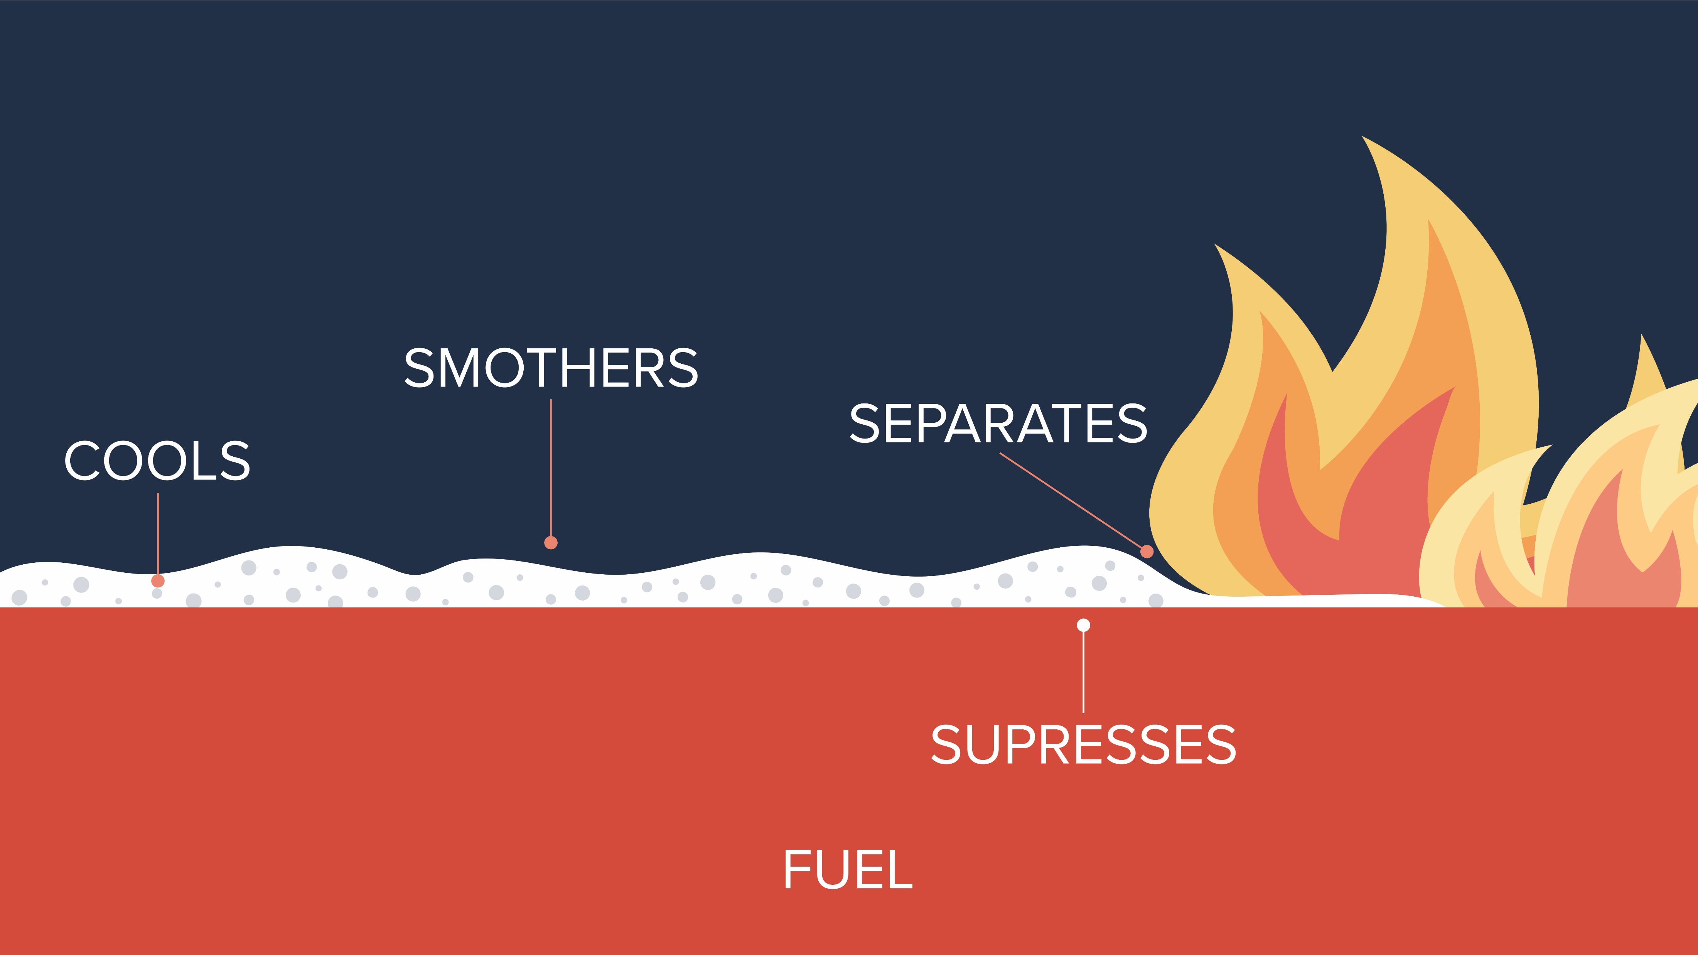
Basic Foam Principles
Remove heat at a faster rate than it is released
Separate the fuel from the oxidizing agent
Dilute the vapor-phase concentration of the fuel &/ or oxidizing agent below that necessary for combustion
Terminate the chemical chain-reaction sequence
Notes:
Foam will remove heat at a faster rate than it is released, separate the fuel from the oxidizing agent, dilute the vapor-phase concentration of the fuel and/ or oxidizing agent below that necessary for combustion, and terminate the chemical chain-reaction sequence.

Slide 11
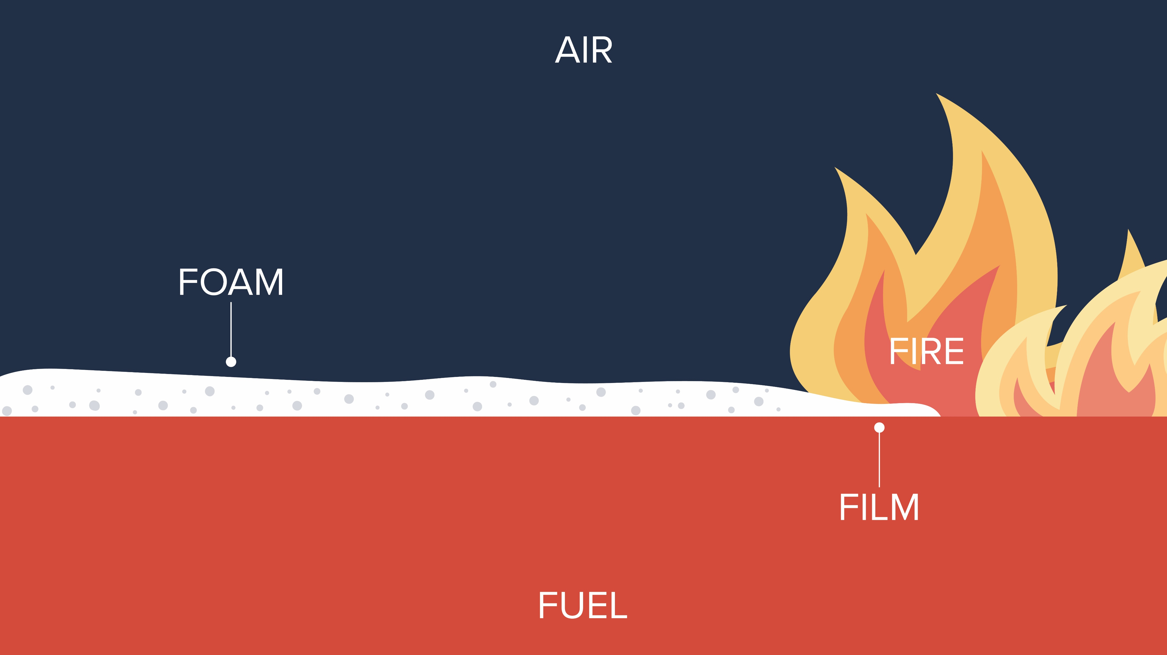
Basic Foam Principles
AFFF
  Low surface tension
  Rapidly spreads across surface
  High burn back resistance
  Quick knockdown
Notes:
AFFF type of foam lowers surface tension, will rapidly spread across the surface, has a high burn back resistance and has quick knockdown.

Slide 12
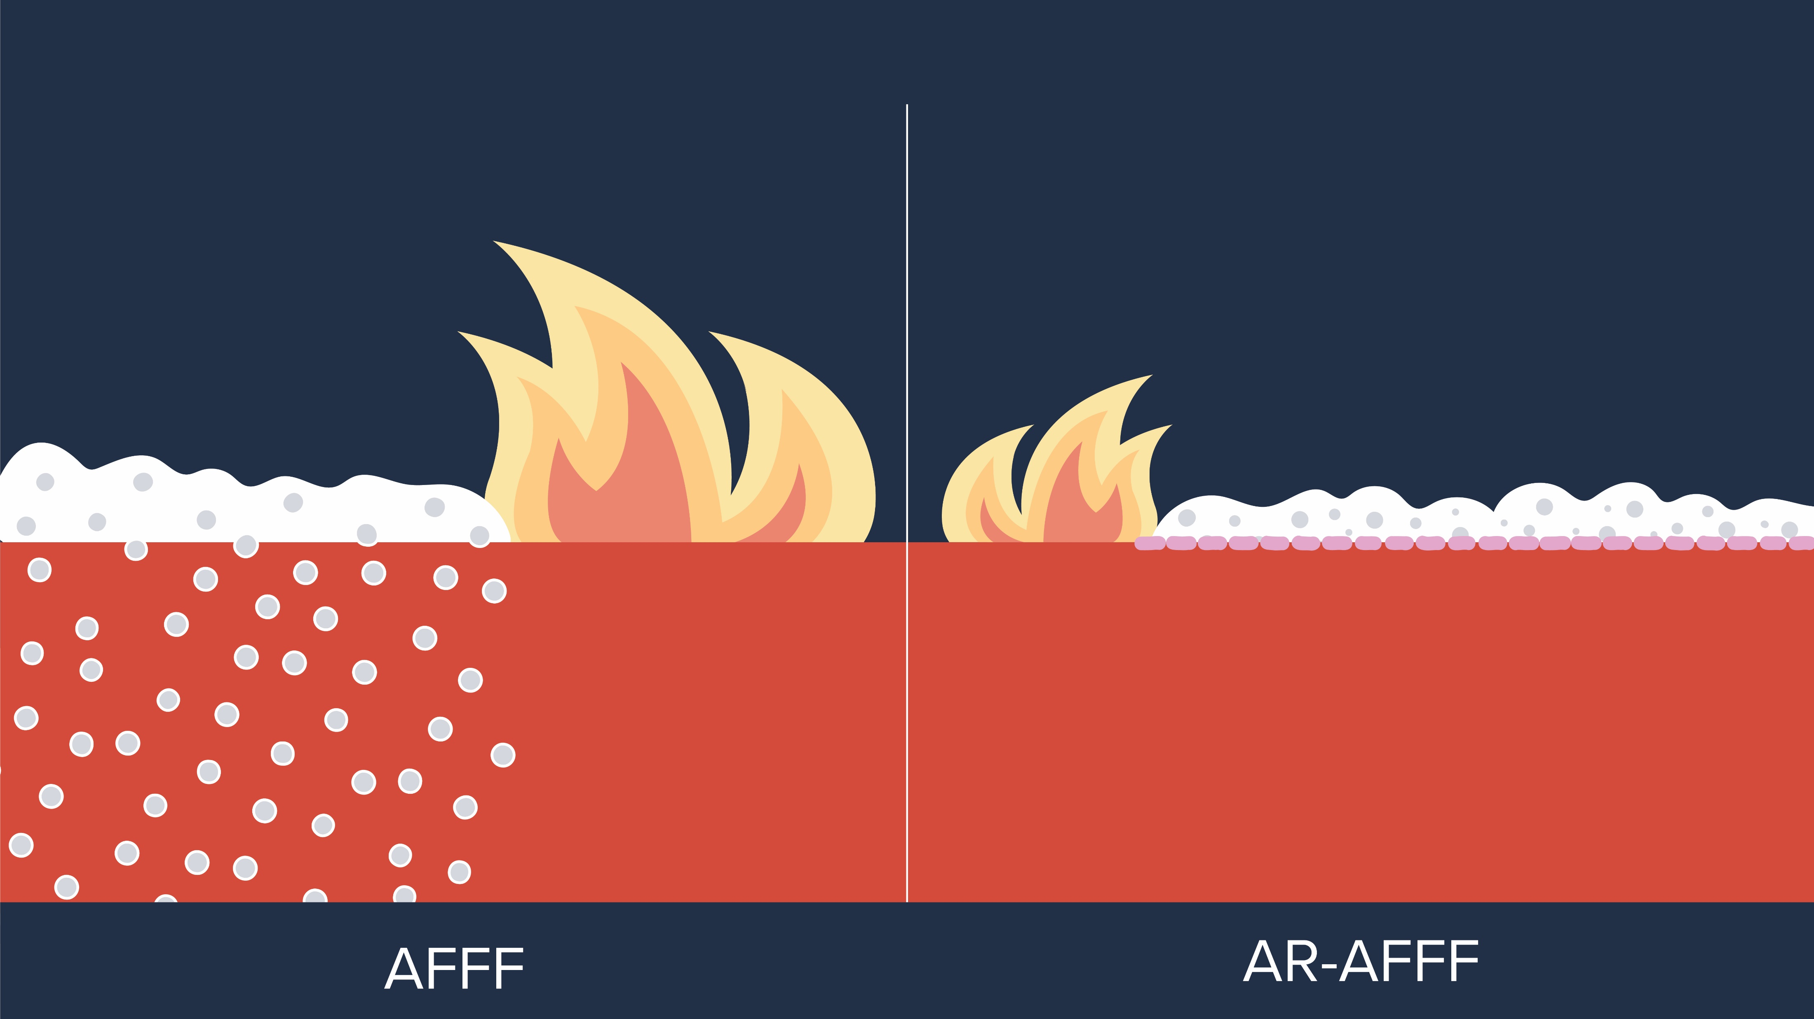
Basic Foam Principles
POLYMERIC MEMBRANE
FILM
Water miscible fuel
(alcohol, esters, ketones, etc.)
Notes:
AFFF finished foam when applied or exposed to a water miscible fuel such as ethanol and ethanol-blended fuels is immediately attacked. The ethanol, having a greater affinity for water than the hydrocarbon it may be blended with, will aggressively mix with the water present in the AFFF finished foam, effectively collapsing and destroying the foam’s capabilities suppress vapors and/or extinguish a fire. The left side of the graphic in this slide is visually representing this scenario.
AR-AFFF finished foam includes a polymeric membrane which is released when applied on ethanol and ethanol-blended fuel incidents. The initial application of the AR-AFFF finished foam is attacked and sacrificed by the ethanol as mentioned before, but as additional AR-AFFF finished foam is continuously applied the polymeric membrane develops a layer on the surface of the ethanol or ethanol-blended fuel and becomes impenetrable for further ethanol attack.
Continued application of the AR-AFFF finished foam will ultimately establish a satisfactory depth and complete coverage of the spilled or burning ethanol to suppress vapors, cool the fuel, break up the uncontrolled chain reaction of fire and stabilize the incident.
All this is possible because the polymeric membrane prevented further destruction of the AR-AFFF finished foam as depicted in the graphic on the right side of the slide.
https://www.youtube.com/watch?v=F_HMe-aOp7A is a video emphasizing the positive attributes of AR-AFFF associated with the graphic in this slide.

Slide 13
Basic Foam Principles
Why use alcohol resistant (AR) foam?
  Only agent capable of extinguishing a fire, suppressing vapors & providing visible proof of security
  Foam blanket on un-ignited spill can prevent fire
  Suppression of vapors prevents them from finding ignition source
  Polymeric membrane prevents the ethanol from mixing with the water element of finished foam
  AR foam provides protection from flammable liquids for fire & rescue personnel during emergency operations
Notes:
Alcohol Resistant (AR) foam is the only agent that can extinguish an ethanol or ethanol-blended fuel fire, suppressing vapors and providing visible proof of security. The foam blanket on an un-ignited spill can prevent the spill from catching fire. The AR foam suppresses the vapors and prevents them from finding an ignition source. The foams polymeric membrane will prevent the ethanol from mixing with the water element of finished foam. AR foam also provides protection from flammable liquids for fire and rescue personnel during emergency operations.
https://www.youtube.com/watch?v=iYEzHfEaH98&t=4s is a video emphasizing what a polymeric membrane looks like.

Slide 14
Foam Characteristics
Property | Protein | Fluoroprotein | AFFF | FFFP | AR-AFFF
Knockdown | Fair | Good | Excellent | Good | Excellent
Heat Resistance | Excellent | Excellent | Fair | Good | Good
Fuel Tolerance | Fair | Excellent | Moderate | Good | Good
Vapor Suppression | Excellent | Excellent | Good | Good | Good
Alcohol Tolerance | None | None | None | None | Excellent
Source: National Foam
Notes:
Foam Characteristics
No single foam product performs the same for all classes of fires. Each foam type excels at different functions; however, performance in other areas is often diminished. Knockdown, heat resistance, fuel tolerance, vapor suppression, and alcohol tolerance are all characteristics of various foam types. Each property is explained in the text that follows.
Knockdown
Knockdown is the speed at which foam spreads across the surface of a fuel. Quick knockdown is achieved by allowing the solution contained in the bubbles to spread rapidly across the fuel surface. Extremely quick knockdown sacrifices good post-fire security, which is required for a stable, long-lasting foam blanket.
Heat Resistance
Heat resistance is the ability of a foam bubble to withstand direct flame impingement or contact with elevated temperature surfaces, with little or no destruction to the foam bubble. The heat resistance of a foam blanket is often called “burn back resistance”.
Fuel Tolerance
Fuel tolerance is the ability of the foam to enter the fuel and resurface with little or no pick-up of fuel within the structure of the bubble. A foam bubble which picks up fuel while submerged would simply carry the fuel to the surface and feed the fire.
Vapor Suppression
Vapor suppression is the ability of the foam blanket to suppress flammable vapors and prevent their release. Vapor suppression is necessary to extinguish fires involving flammable liquids and to prevent ignition of unignited flammable liquid spills.
Alcohol Tolerance
Alcohol tolerance is the ability of the foam blanket to create a polymeric barrier between the fuel and the foam, thus preventing the absorption of the water from the foam bubbles. This absorption would result in the destruction of the foam blanket.

Slide 15
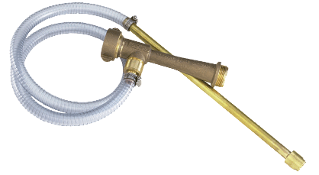
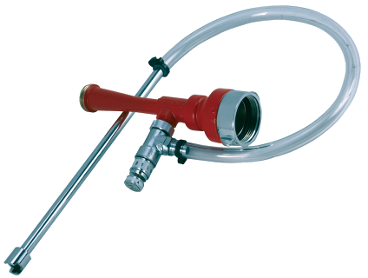
Basic Foam Principles
Foam proportioning & delivery systems
    Concentration levels:
      Hydrocarbons - 3%
      Polar solvents - 6%
    Foam proportioning systems:
      Eductors
        In-line eductors have advantages
Notes:
Foam Proportioning and Delivery Systems
The effectiveness of foam depends on proper proportioning and the ability to deliver finished foam to the spill or fire.
Concentration Levels
Foams are applied at various concentration levels depending on the fuel involved and the concentrate being used. Typically for hydrocarbons, foam is proportioned at 3%: that is three parts foam concentrate to ninety-seven parts water. For polar solvents, foam is usually proportioned at 6%: that is six parts foam concentrate to ninety-four parts water. Some concentrates allow for proportioning at 1% on hydrocarbons.
Foam Proportioning Systems
A number of ways exist to proportion foam. These include:
Line eductors
Self-educting nozzles
Pressure systems
Pump proportioning systems
This section will discuss the most common proportioning systems: line eductors and foam nozzle proportioners (foam nozzles with pickup tubes).
Eductors
Eductors use the Venturi Principle to pull foam into the water stream. The flow of water under pressure and velocity past an orifice or opening creates a vacuum or negative pressure that draws the concentrate through the metering valve. The metering valve controls the amount of concentrate allowed to flow into the water stream. The ball check valve prevents water from flowing back into the pickup tube and the concentrate container. Major elements of the eductor setup include foam concentrate supply, water supply, eductor arrangement, metering valve, pickup tube, and foam solution discharge. Two common types of eductors are in-line eductors and bypass eductors.
In-Line Eductors
In-line eductors are some of the least expensive and simplest pieces of proportioning equipment available (see Figures 6.1 and 6.2 in Participant Guide). For this reason, they are perhaps the most common type of foam proportioner used in the fire service. Some advantages include:
Low cost
Minimal maintenance
Simple operation

Slide 16
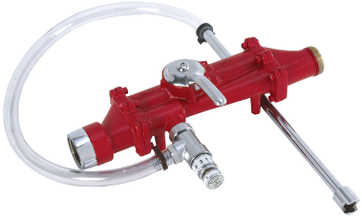
Basic Foam Principles
Foam proportioning & delivery systems:
  Foam proportioning systems:
    Eductors
      Bypass eductors
      Common eductor failures
Notes:
Bypass Eductors
Bypass eductors (see Figures 6.3 and 6.4 in the Participant Guide) differ in that they have a ball valve to divert flow from foam to just water, allowing time for cooling without wasting foam and with less flow restriction.
Common Eductor Failures
The most common causes for eductor failure include:
Mismatched eductor and nozzle
Air leaks in the pickup tube
Improper flushing after use
Kinked discharge hoseline
Improper nozzle elevation
Too much hose between eductor and nozzle
Incorrectly set nozzle flow
These may be eliminated by careful preparation, inspection, and use of the eductor, nozzle, and hose. Other eductor failures may be caused by:
Incorrect inlet pressure to educator
Partially closed nozzle shutoff
Collapsed or obstructed pickup tube
A pickup tube which is too long

Slide 17
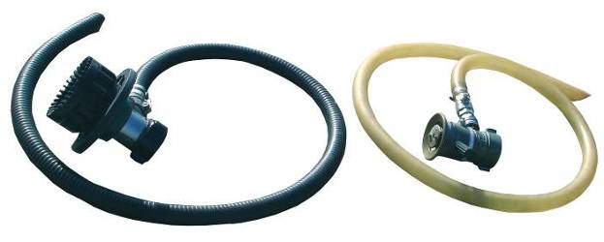
Basic Foam Principles
Foam proportioning & delivery systems:
  Foam nozzles
      Foam proportioning nozzles have advantages
Notes:
Foam Nozzles
Foam nozzles are either foam proportioning, air aspirating, or non-air aspirating.
Foam Proportioning Nozzles
Foam proportioning nozzles (see Figure 6.5 in the Participant Guide) have built-in orifice plates and utilize the Venturi Principle of operation, producing a very effective foam. These monitor nozzles have the ability to deliver significant volumes of finished foam. Due to the insignificant pressure drop across the eductor, they are able to project foam over long distances.
Advantages of foam proportioning nozzles include:
They are easy to operate
They are easy to clean
There are no moving parts
There is no additional foam equipment needed

Slide 18
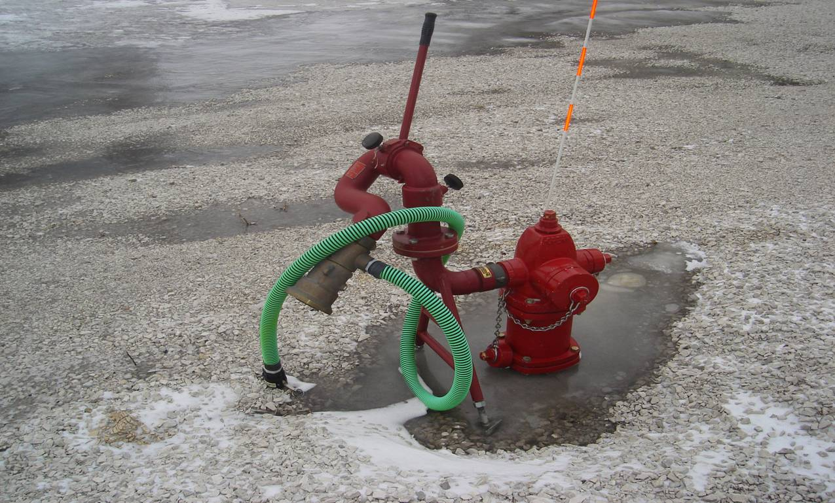
Hydrant with Foam Nozzle
Notes:
Some bulk storage and ethanol production facilities have engineered, and professionally designed fire protection systems installed. As depicted by the graphic in this slide, by the flip of a switch in the “foam pump house” or when activated by a detection device this nozzle is automatically provided the appropriate amount of water at the required pressure.
It is incumbent upon emergency responders, facility owners and operators to understand the design, capabilities, and limitations of these specific systems.
In this instance, this may be a self-proportioning master stream foam nozzle that has a foam concentrate pick-up tube directly attached. Note that the coupling on the pick-up tube is specifically designed to be attached to a foam concentrate tote or similar container which has a quick coupling connection.
As part of the pre-planning process, emergency responders, facility owners and operators need to understand the resource needs to support a long-term foam operation for this foam nozzle and all others present at the bulk storage or production facility.
For example, if we assume this nozzle has a flow capacity of 1,000 gallons per minute (gpm) and the AR-AFFF foam concentrate we are using requires a 3% proportioning for ethanol-blended fuels, then this nozzle consumes 30 gallons of foam concentrate every minute.
A long-term foam operation could easily last for 2 hours and well beyond. The AR-AFFF foam concentrate needed to support the use of this nozzle just for 2 hours is 3,600 gallons.

Slide 19
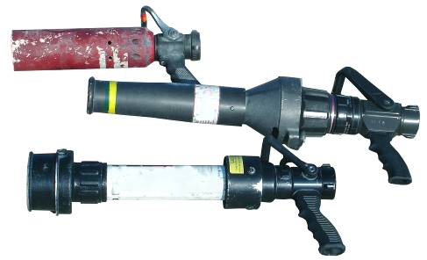
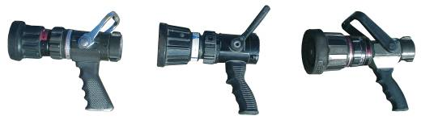
Basic Foam Principles
Foam proportioning & delivery systems:
  Foam nozzles
    Air aspirating
    Non-air aspirating
Notes:
Air Aspirating Nozzles
Air aspirating nozzles are foam generating nozzles that mix air and atmospheric pressure with foam solution (see Figure 6.6 in the Participant Guide). These nozzles produce an expansion ratio of between 8:1 and 10:1 and produce a good-quality, low-expansion foam.
Non-Air Aspirating Nozzles
Fog nozzles are an example of non-air aspirating nozzles (see Figure 6.7 in the Participant Guide). Non-air aspirating nozzles produce an expansion ratio of between 3:1 and 5:1. This expansion ratio is not as good as that of air aspirating nozzles, but these nozzles often add some versatility which can be beneficial in various fire attack situations. Versatility includes the ability to switch from a foam solution to water in order to protect personnel and provide area cooling. Air aspirating nozzles do not offer this advantage.
A disadvantage of aspirating and non-air aspirating nozzles is that you must have additional equipment in order to generate foam. In addition, the gallonage setting on the nozzle must match the set flow for the eductor. It is important to understand the benefits of both types of nozzles in order to select the most appropriate one for the specific encounter.

Slide 20
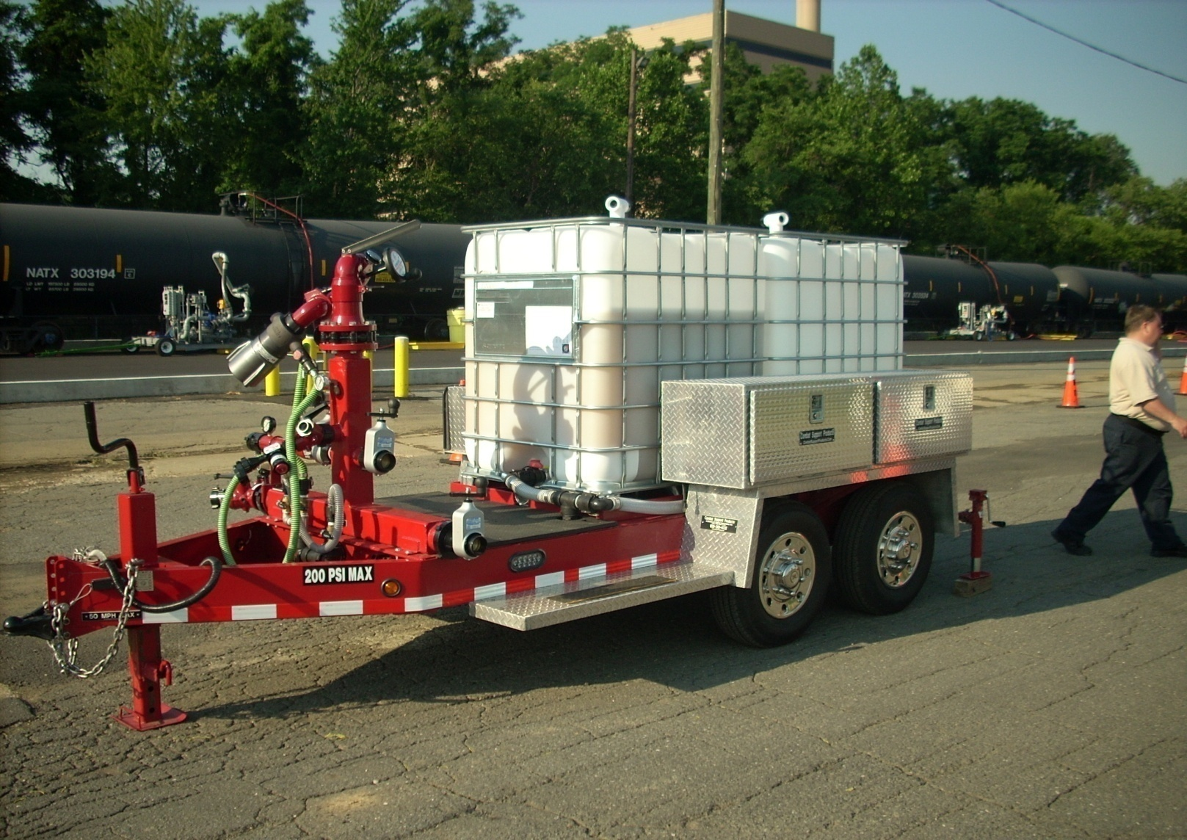
Foam Trailer
Notes:
This portable foam trailer is equipped with:
1,000 gpm self educting foam nozzle
Air aspirated and non-air aspirated
Two totes of AR-AFFF
Portable foam trailers may be found at certain fire departments, local facilities for example airports and also stationed at major railroad facilities along principle routes.

Slide 21
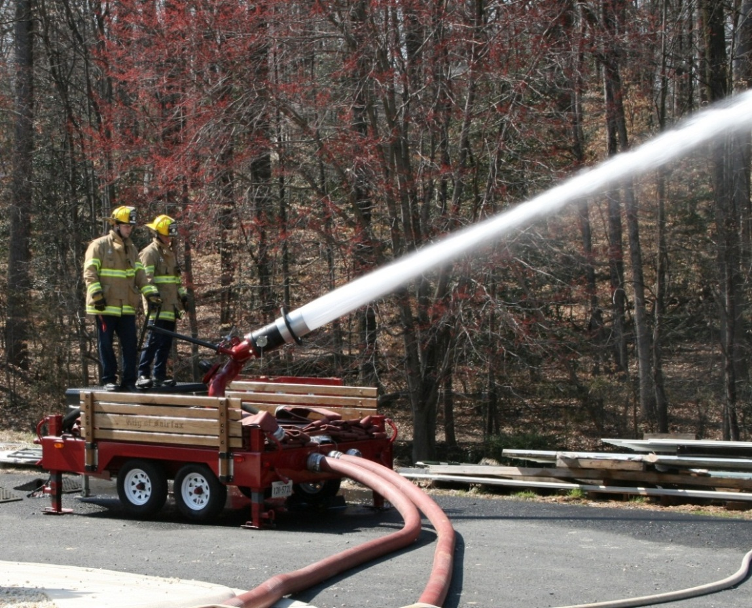
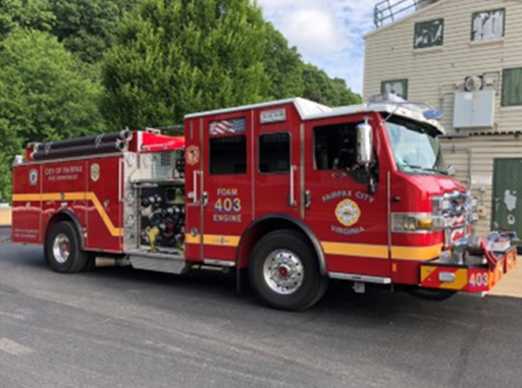
Specialized Foam Equipment
4,000 GPM – 475’ reach
300 gal. AR-AFFF & 600 gal. water
Notes:
These pictures represent typical specialized foam firefighting equipment that may be in use by emergency service providers, bulk storage and/ or ethanol production facilities with their own fire brigades. In addition, private contractors who specialize in flammable and combustible liquid firefighting may have larger capacity and inventory available to them based on the scope and magnitude of any given ethanol-blended fuel incident.

Slide 22
Basic Foam Principles
Application techniques:
  Never plunge foam directly into the fuel
  Bounce-off:
    Effective if there is an object in/ behind spill area
  Bank-in:
    Particularly effective with non-air aspirating fog nozzles
  Rain-down:
    An alternative application technique is the rain-down method. The nozzle is elevated and the foam is allowed to fall over the spill as gently as possible
Notes:
Application Techniques
Proper application is critical for foam. The key to foam application is to apply the foam as gently as possible to minimize agitation of the fuel and creation of additional vapors. The most important thing to remember is to never plunge the foam directly into the fuel.
Bounce-Off
The bounce-off method is effective if there is an object in or behind the spill area. The foam stream can be directed at the object, which will break the force of the stream, allowing the foam to gently flow onto the fuel surface.
Bank-In
When no obstacles exist to bounce the foam off, firefighters should attempt to roll the foam onto the fire. By hitting the ground in front of the fire, the foam will pile up increasing in depth and as the angle of nozzle in relation to the ground is decreased the velocity and direction of the foam stream will push or roll the blanket of foam into the spill area as firefighters move forward.
Rain-Down
An alternative application technique is the rain-down method. The nozzle is elevated and falls over or rained onto the spill as gently as possible.
Remember! Never plunge a stream of foam directly into fuel!
This is the end of the section that is the property of TEEX.

Slide 23
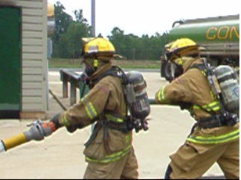
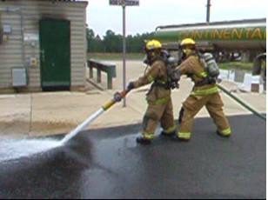
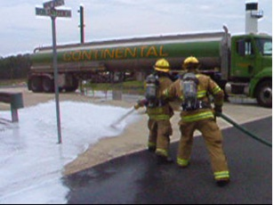
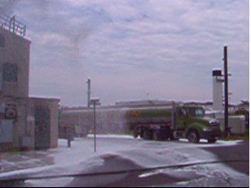
Basic Foam Principles
Notes:
Pictures of actual application methods and approach as explained in the previous slide. The first three images are showing the bank-in or roll-on method. The picture in the lower right corner depicts the rain-down method of foam application.
The most important factor to consider when using AR-AFFF finished foam on an ethanol-blended fuel incident is to apply the foam AS GENTLY AS POSSIBLE to your spill or fire. Proper application choice and technique will minimize AR-AFFF finished foam degradation, reduce risk to operational personnel and increase potential for successful management of the incident.

Slide 24
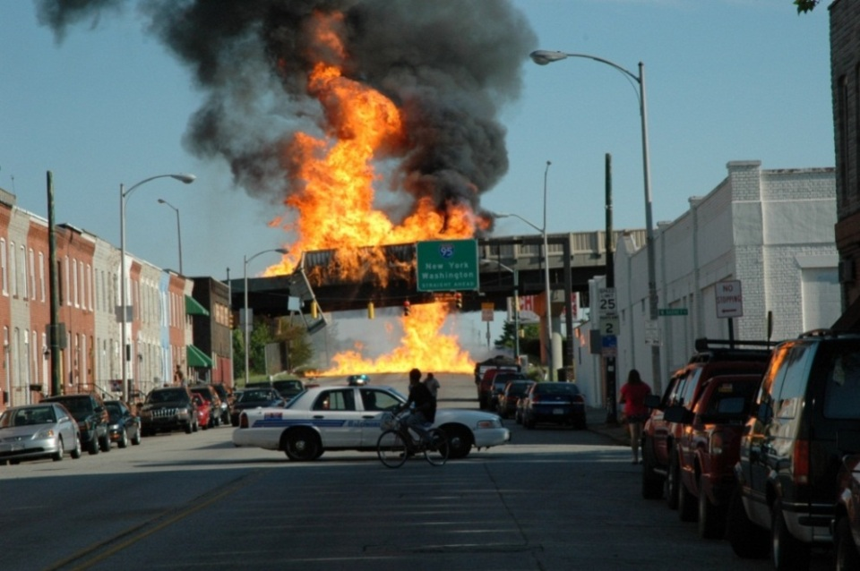
Foam for Ethanol and Ethanol--Blended Fuels
Principles for dealing with ethanol-blended fuels
  Only AR-AFFF or equivalent foams
  Gentle application methods
  Increased foam application rates
Notes:
Some of the foams mentioned in the previous sections have been around for over fifty years and have proven to be very effective on hydrocarbon fuels. However, these foams were not developed for application on ethanol-blended fuels and are simply ineffective.
This is because the alcohol or ethanol content of the blended fuel literally attacks the foam solution, absorbing the water component of the foam solution into the ethanol-blended fuel. Foam that is designed to be alcohol resistant forms a non-permeable membrane between the foam blanket and the alcohol-type fuel. It is crucial that these AR foams are used in combating ethanol-blended fuel fires, including E10. This is an important point.
Additionally, to be effective, these foams must be applied gently to the surface of the alcohol- or ethanol-blended fuels. Otherwise, the foam is absorbed into the fuel and will not resurface to form an encapsulating blanket.
Extensive testing done at the Ansul Fire Technology Center indicated that even at low-level blends of ethanol with gasoline, such as E10, there is a major effect on foam performance. The testing also indicated that with high-level blends of ethanol with gasoline, even AR foams required careful application methodology and techniques to control fires, suppress vapors, and stabilize the incident.
Using the proper foam and application technique will also reduce the risk to emergency responders and possibly increase the time before re-application of the finished foam is required to maintain incident stabilization.

Slide 25
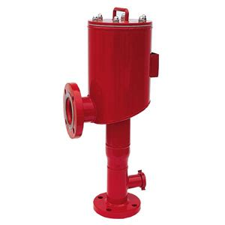
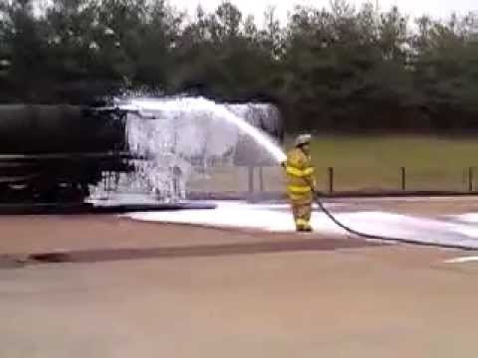
Foam for Ethanol and Ethanol-Blended Fuels
AR foams
  Use of Type II application techniques:
    Foam is applied indirectly to fire through fixed or semi-fixed foam chambers
  Use of Type III application techniques:
    Portable monitors & hand lines
    Effective only when deflected off surfaces
    Best option may be to protect surrounding exposures
Notes:
AR-type foams must be applied to ethanol fires using Type II gentle application techniques. For responding emergency services, this will mean directing the foam stream onto a vertical surface and allowing it to run down onto the fuel. Direct application to the fuel surface will likely be ineffective unless the fuel depth is very shallow (i.e., 0.25 inches or less).
Type III application (fixed and handline nozzle application) is prone to failure in ethanol-blended fuels of any substantial depth. The only time it is effective is when it is deflected off surfaces, such as tank walls, to create a gentle style application.
It has also been determined that even with indirect foam application techniques it may require substantial increases in flow rates to accomplish extinguishments.
Therefore, in situations where AR foam cannot be applied indirectly by deflection of the foam off tank walls or other surfaces or there is no built-in application device to provide gentle application, the best option may be to protect surrounding exposures.

Slide 26
Foam Recommendations for Fire Departments
Consider converting to AR foam concentrates
  Ensure foam is UL certified to meet NFPA standards
Develop means of having cache of AR foam readily available:
  Mutual aid resources maybe available
Notes:
Departments that are subject to incidents involving the various ethanol-blended fuels found on highway incidents or at storage facilities should strongly consider converting to AR-AFFF foam concentrates or develop a means of having a cache of AR-AFFF foam readily available. When purchasing foam, ensure it is Underwriters Laboratory (UL) certified to remain compliant with NFPA standards.
Significant amounts of AR foam may be required for successful incident management. If your emergency response plan involves relying on mutual aid, and mutual aid assets, be sure to confirm what type of aid will be provided, what firefighting resources are available and what type of foam concentrate is being used.
The mixing of different brands of foam can potentially hinder the desired outcome and efficiency anticipated in which to be performed. It is imperative that departments verify the compatibility of the foams with their mutual aid partners. Also be sure to train emergency responders to use these assets.

Slide 27
Foam Application Rates
Foam application with portable application devices may require higher rates
  Application device types whether portable or stationary have operational set points
Foam application rates vary by manufacturer
  Ethanol-blended fuels require higher flow rate of foam to extinguish fires, suppress vapors & increase emergency responder safety
  Flow rates start at 2 gpm foam/ 10 sqft of AR type foam (0.2 gpm/ sqft) for any ethanol-blended fuel incident
Notes:
AFFF-type foams require approximately 1 gallon per minute (gpm) foam solution flow for every 10 square feet of burning surface on a hydrocarbon-type fuel. Ethanol-blended fuels require approximately double that flow (2 gpm/ 10 square feet) of an AR-type foam solution.
As with all types of foam, mixing percentage, application rate and flow rate are dependent upon the type and design of the foam concentrate. It is important to refer to the foam manufacturers recommendations.

Slide 28
Alcohol Resistant Foam Facts
Ensure all AR-AFFF foam supplies meet UL-162 testing certifications & so indicated in documentation & stamped on containers
Effective on both alcohol & hydrocarbon fires
Some have quicker knockdown abilities & longer foam retention times than protein-based hydrocarbon foams
Foam can stratify; must have maintenance program for re-agitation
Foam delivery systems such as foam tanks & totes cannot be shaken & remixed easily
Notes:
There are quite a few new foam concentrates on the market that are challenging the fire protection standards for flammable and combustible liquids to include ethanol-blended fuels. As new testing and certification methods are adopted and approved by organizations such as NFPA (National Fire Protection Association) and UL (Underwriters Laboratories) it is absolutely critical that organizations and agencies purchase foam concentrates from reputable manufacturers.
These globally recognized foam concentrate manufacturers have tested their foam products to these industry standards and the foam concentrates PASSED these tests. UL-162 is currently an industry standard relating to foam concentrate performance on ethanol and ethanol-blended fuels. Foam concentrate manufacturers will more than likely include their UL-162 certification within the product documentation and be visible on the foam concentrate container.
Keep in mind that alcohol resistant (AR) foams are effective on both alcohol and hydrocarbon fires. AR foams have a special polymer that forms a protective membrane between the fuel and the foam as it contacts the polar fuel, making fire extinguishment possible. AR foams also make the foam more stable and heat tolerant, resulting in better burn back resistance when compared to conventional foams.
As a matter of fact, some of the AR foams have quicker knockdown abilities and longer foam retention times than some of the traditional protein-based hydrocarbon foams. It is recommended that a thermal imaging camera be used to more accurately determine if a fire is completely extinguished, especially during daylight hours.
All foam concentrates have a shelf life and will deteriorate over time. Shelf life can exceed 20 years if the foam concentrates are properly managed and maintained in a suitable storage environment according to manufacturer’s requirements.
In addition, to keep the particulates or critical ingredients of the foam in suspension and mixed, a maintenance program must be developed whereby the foam concentrate is re-agitated and rotated periodically. Foam concentrate manufacturers typically require a concentrate sample to be taken and tested on an annual basis to ensure the integrity of their product.
If a department has a specific hazard that only involves non-alcohol or non-ethanol-blended fuels, they may want to consider non-AR foam for that specific hazard. For ethanol production, transportation and retail fuel station related incidents emergency response agencies should have AR foam readily available.

Slide 29
Ethanol Scene Evaluation
Proper scene evaluation will assist in making the right choices for successful incident mitigation:
Size-up
Situation report to include addressing life safety issues and/or
Evacuate impacted areas
Establish Unified Command
Establish hot, warm and cold zones
Notes:
Proper scene evaluation will assist in making the right choices for successful incident management and mitigation. Benchmarks that need to be considered are:
Size-up
Situation report to include addressing life safety issues and/or
Evacuate impacted areas
Establish Unified Command
Establish hot, warm and cold zones
Continued on next slide.

Slide 30
Ethanol Scene Evaluation
Continued - Proper scene evaluation will assist in making the right choices for a successful incident mitigation:
Protect exposures
Deny entry
Assemble resources to engage in mitigation activities in staging area
Be sure to use the application rate recommended for ethanol
AR-AFFF is the foam of choice
Notes:
Continued -
Protect exposures
Deny entry
Assemble resources to engage in mitigation activities in staging area
Be sure to use the application rate recommended for ethanol
AR-AFFF is the foam of choice
Keep in mind that AR foams are effective on both alcohol fires and hydrocarbon fires. Regardless of the type of incident, scope or magnitude, emergency responders adhere to the universal professional benchmarks of Life Safety, Incident Stabilization and Property Conservation (LIP) which ultimately lead to recovery activities.
At every incident, some type of management process must be initiated to “organize the chaos.” This incident management system (ICS) becomes even more important when the nature of these incidents increases in complexity, geography and as mentioned before scope, magnitude and involving multiple response organizations with statutory responsibility and/ or functional capabilities.
Within the concept of the incident management system, standardized benchmarks need to be addressed at every single ethanol-blended fuel incident. This will ensure the health, safety and welfare of the emergency responders and impacted community. Additionally, the benchmarks noted above ensures that the incident management process is initiated and that objectives are developed.
Strategies or solutions to achieve the objectives are identified, and resources (human and equipment) with the appropriate knowledge, skills and abilities are assigned to perform the work necessary to achieve the specific incident objectives and universal benchmarks previously discussed.
Finally, the intent of this information is to assist emergency responders following the ICS management process to arrive at an educated conclusion on whether their specific incident is going to become offensive or defensive in nature.
*Please note that offensive operations involving the use AR-AFFF foam, specialized foam fire firefighting equipment and personnel may not always be the best strategy or solutions for every ethanol-blended fuel incident.

Slide 31
Application Formula
To determine the amount of foam concentrate required, you must find out the type of fuel & the area of involvement
The square footage multiplied by the application rate will give the recommended gpm
The whole formula will give the concentrate total
This includes the time duration for the attack & percentage rate for the concentrate to be used
Time duration depends on the nature of the incident
  Typical times are:
    60 minutes for tanks
    20 minutes for ground spills
Reference: Williams Fire & Hazard Control
Notes:
To determine the amount of foam concentrate required, you must find out the type of fuel and the area of involvement. The square footage multiplied by the application rate will give the recommended gpm. The whole formula will give the concentrate total, this includes the time duration for the attack and percentage rate for the concentrate to be used. As a note, double the amount of foam concentrate on hand prior to initiating fire attack (covers fire attack and maintaining foam blanket following knockdown). Time duration depends on the nature of the incident. Typical times are 60 minutes for tanks and 20 minutes for ground spills for hydrocarbon only based incidents.
*Foam calculations courtesy of Williams Fire and Hazard Control.

Slide 32
Application Rates
The application rates for spill fires of shallow depth are recommended by NFPA 11
Increasing the foam application rate over the minimum recommendation will generally reduce the time required for extinguishment
NFPA recommended application rate for film forming type foams equals 0.1 gpm (foam solution) per square foot of fire with a minimum run time of 15 minutes for hydrocarbon only based incidents
Due to the characteristics of ethanol-blended fuels the application rate and flow time is based on the manufacturers recommendations. The application rate will be at least doubled to 0.2gpm/ sqft
Notes:
Application rates recommended for ethanol spill fires of shallow depth follow NFPA 11. Increasing the foam application rate over the minimum recommendation will generally reduce the time required for extinguishment.
NFPA recommended application rate for hydrocarbon only based incidents with film-forming type foams equals 0.1 gpm (foam solution) per square foot of identified surface area with a minimum finished foam flow time of 15 minutes.
For ethanol-blended fuel incidents of any kind, flow times are based on specific manufacturer recommendations as well as the application rate which will be at least doubled to 0.2 gpm/ sqft of surface area identified within the incident.

Slide 33
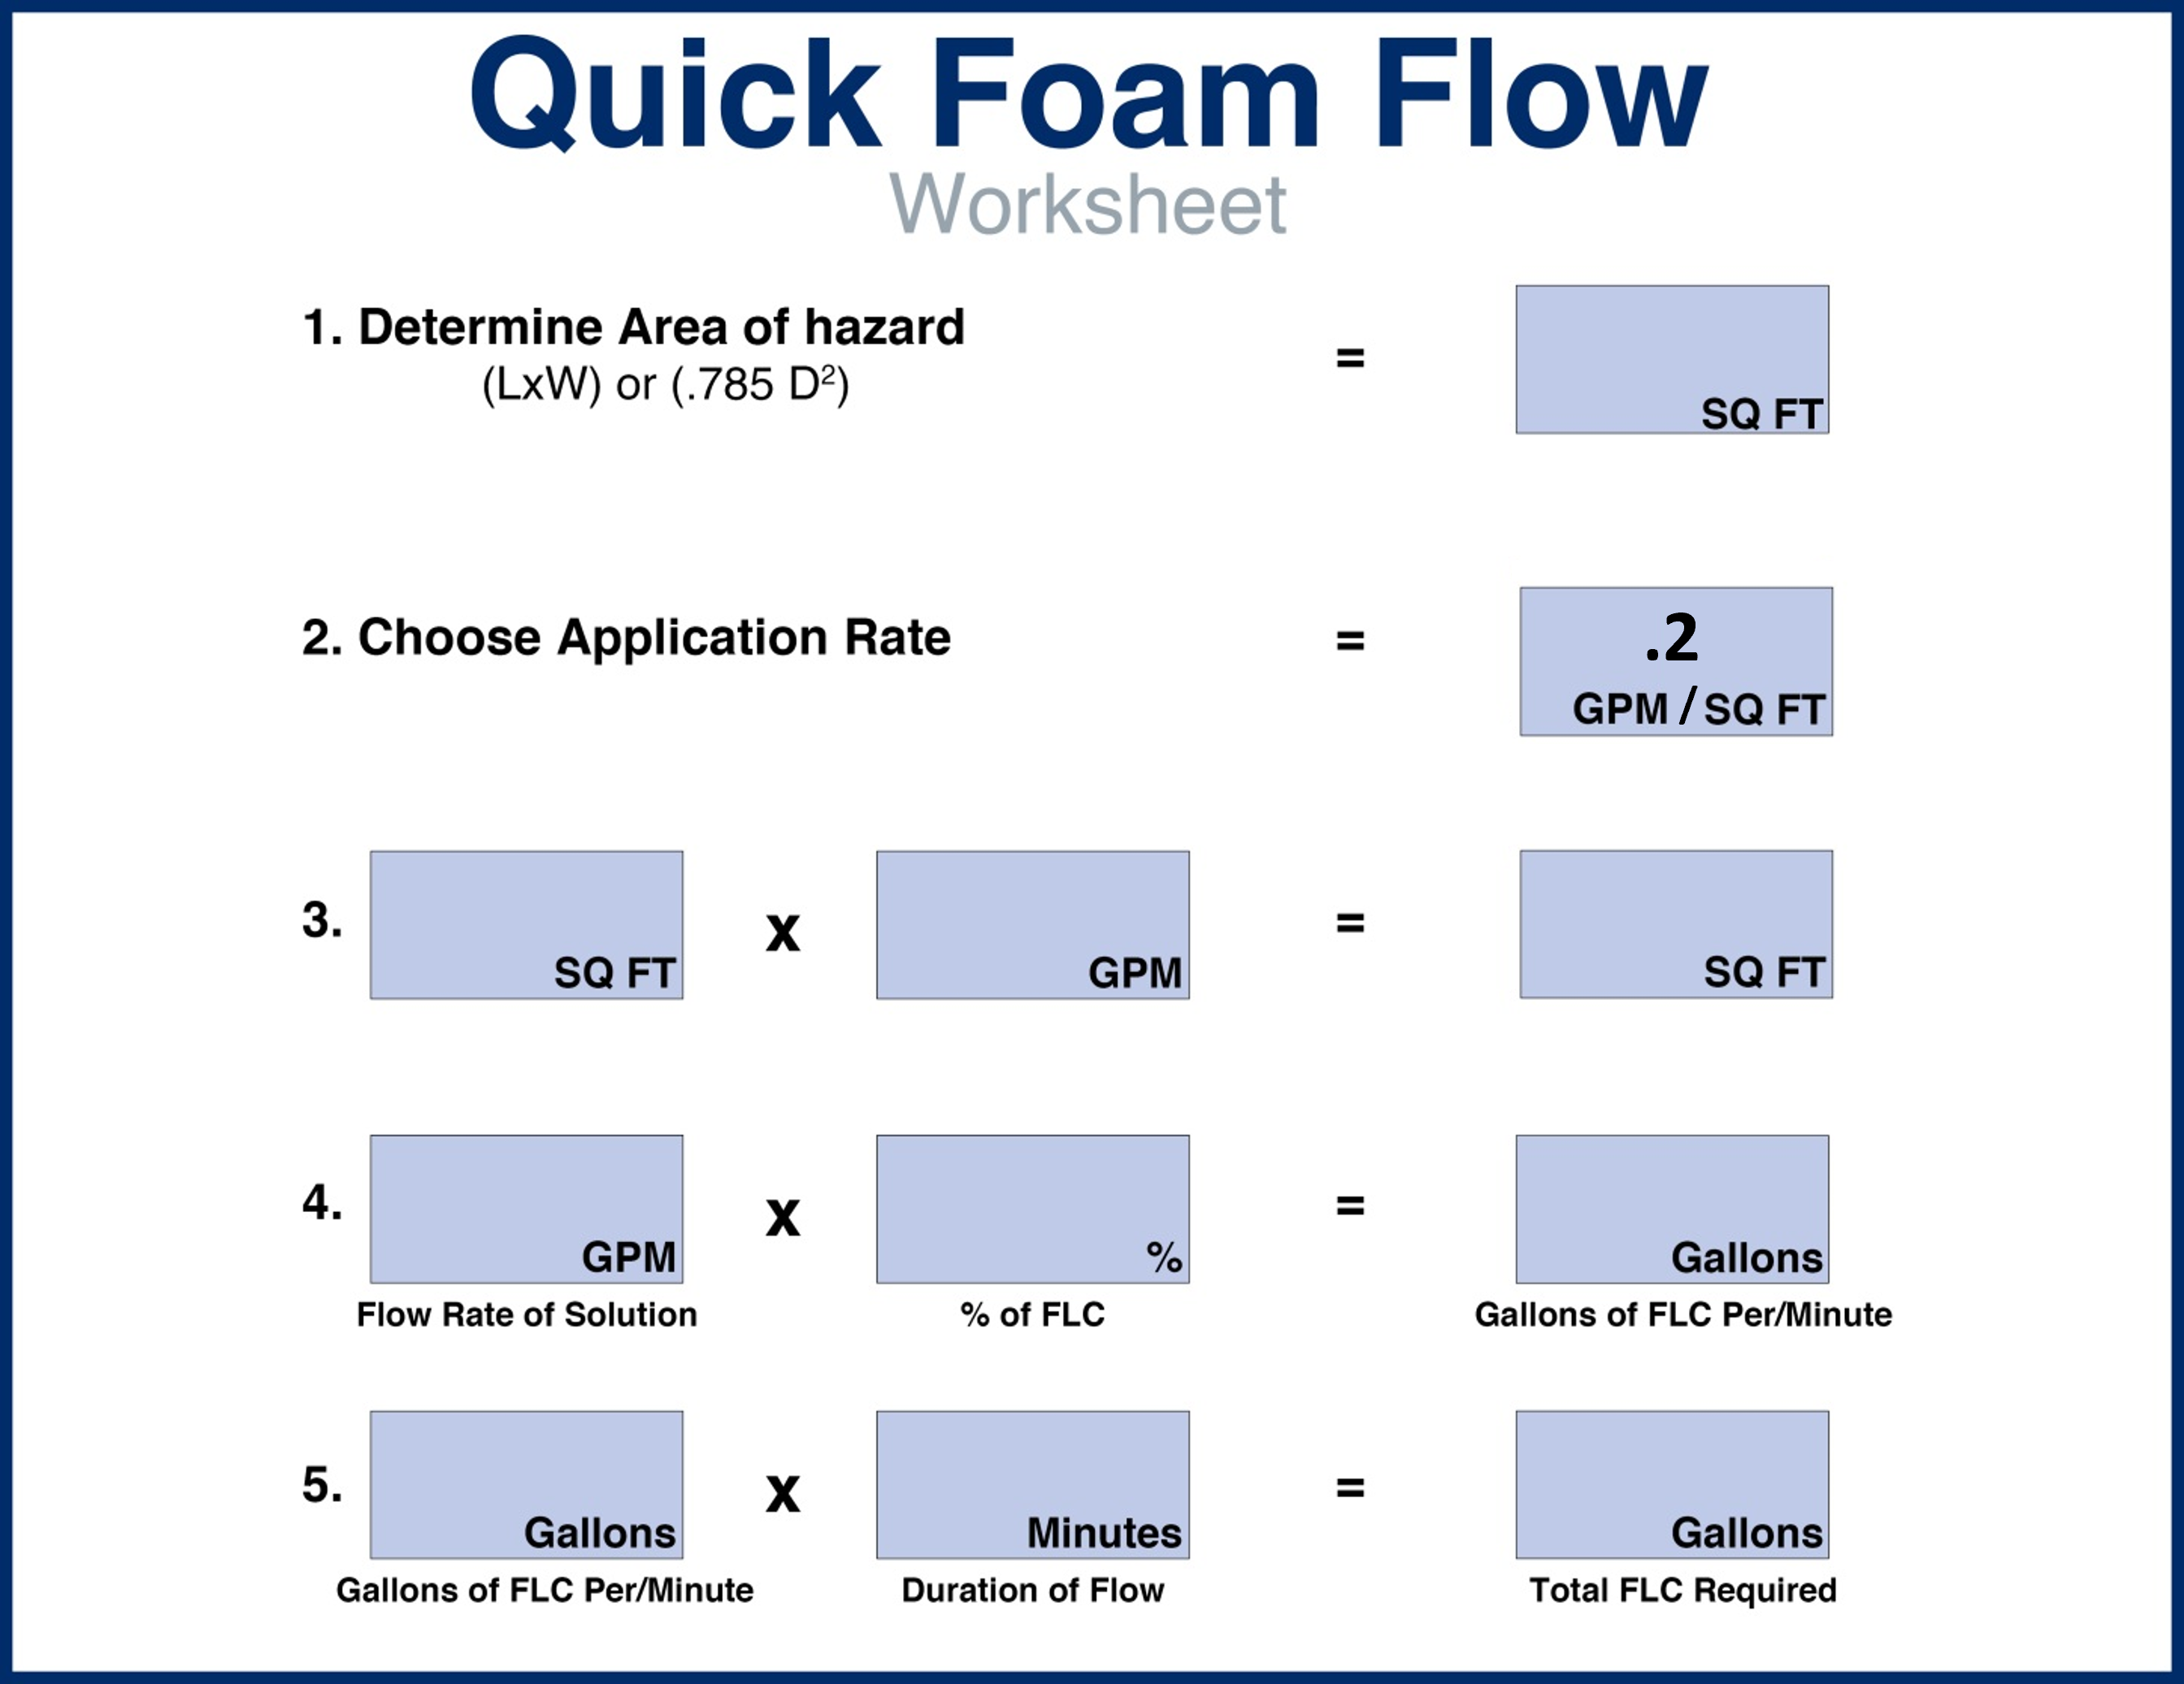
Application Rates
.2
PRINT, LAMINATE and PLACE ON RESPONSE VEHICLES
Notes:
For ethanol-blended fuel incidents the application time is based on the recommendations from the manufacturer of the foam and the type of foam that will be used.
Examples of application rates for ethanol-blended fuels:
An area of 2,000 square feet of ethanol-blended fuel is burning. You have universal plus 3%/ 6% foam available for securing the flame.
• 0.20 gpm/ sqft X 2,000 sqft = 400 gpm of foam solution required.
• 0.03 X 400 gpm = 12 gallons of 3% concentrate required per minute.
• 12 gallon X 30 minutes = 360 gallons of 3% AFFF concentrate required to control, extinguish and initially secure a 2,000 sqft ethanol-blended fuel fire.
Application rate calculations tell you more than just “How much foam do I need?”; they also tell you what hardware, tools, appliances and even possibly what application technique may prove most effective based on the incident specifics such as weather and terrain.

Slide 34
Application Rates
GPM requirements
Area (Square Feet) | X | Minimum Application Rate | = | GPM Solution
 | X | 0.10 Hydrocarbon Liquid Spill/ Fire | =
 | X | 0.16 Tank Dia.<150’ | =
 | X | 0.18 Tank Dia.<200’ | =
 | X | 0.20 Tank Dia.<250’ | =
 | X | 0.20 Polar Solvent Spill/ Fire | =
Notes:
This specific form provides resource need guidance as part of a detailed pre-plan for any flammable/ combustible liquid bulk storage facility, ethanol or hydrocarbon production facility bulk storage and large scale above ground storage tanks at a retail facility.
NOTE that the recommended application rates or densities indicated are for hydrocarbon fuels. The RED highlighted information is a starting point for ethanol-blended fuels. Current methodology indicates that greater application rates or densities are required as tank diameter increases.
Emergency response organizations with statutory responsibilities or functional capabilities should work closely with owners and operators of these facilities during pre-plan development. It is highly encouraged to tank advantage of fire protection engineers and other nationally recognized private contractors who engage in ethanol-blended fuel incidents of scope and magnitude when calculating resource needs to include AR-AFFF foam concentrate needs, water supply and specialized foam firefighting equipment.

Slide 35
Concentrate requirements
Application Rates
GPM Solution | X | % of Foam Concentrate | = | Foam Concentrate GPM | X (Time) | Total Concentrate (Gal)
 | X |  | = |  | 30 Min. (Spill/fire) 40 Min. (Bulk Storage Ancillary spill/fire)
 | X |  | = |  | 120 Min. (Tank Fire)
Notes:
Remember that due to the characteristics of ethanol and ethanol-blended fuels, additional foam concentrate needs and increased finished foam flow times may be required or doubled to achieve incident objectives and scene safety.

Slide 36
Application Rates
Incident foam needs rule of thumb:
  Double the amount of foam concentrate on hand prior to initiating fire attack (covers fire attack & maintaining foam blanket following knockdown)
Total Concentrate (Gallons) | X 2 | Incident Foam Needs Prior to Initiating Fire Attack
 | X2 (Spill/fire or bulk storage ancillary spill/fire)
 | X2 (Bulk storage tank)
Notes:
Incident foam needs rule of thumb is to double the amount of foam concentrate on hand prior to initiating fire attack (covers fire attack and maintaining foam blanket following knockdown).

Slide 37
Example: Spill Calculation
Determine Area of Hazard
Choose Appropriate Application Rate
Rate x Area = GPM of Foam Solution
Solution GPM x % Used = Concentrate GPM
Concentrate GPM x Time = Total Concentrate
Spills - 30 Minutes Minimum Flow Time for Ethanol-Blended Fuels
(The incident flow time will be based on the recommendations from the foam manufacturer and the type of foam.)
Flow rates will dictate what nozzles or combination of nozzles will be required…
Notes:
Group Discussion:
Walk participants through Example: Spill Calculation, which shows the calculations to determine the appropriate amount of foam needed for a mock transportation incident involving ethanol.

Slide 38
Example: Ethanol-Blended Fuel
Spill Calculation
Determine Area of Hazard
80’x 50’ = 4000 sqft
Choose Appropriate Application Rate
.20 GPM for product not in depth
Rate x Area = GPM of Foam Solution
800 GPM
Solution GPM x % Used = Concentrate GPM
800 GPM x 3% (.03) = 24 GPM
Concentrate GPM x Time = Total Concentrate
Spills - 30 Minutes Flow Time
30 minutes x 24 GPM = 720 gallons of concentrate

Slide 39
Summary
AR-AFFF foam is the best choice for incidents
AR-AFFF foam is recommended for all incidents involving ethanol-blended fuels
AR-AFFF foam performs well on hydrocarbon incidents
Notes:
AR foam is accepted as the best fire suppression/ firefighting agent for use in incidents involving hydrocarbons and ethanol-blended fuels.
Because of its ability to develop a protective polymeric membrane layer when applied on ethanol-blended fuels, AR-AFFF foam turned out to be the best choice for incidents involving these types of fuel.
Because AR-AFFF foam also works well on gasoline fires, it is the recommended choice for all fuel fires involving either gasoline or ethanol-blended fuels.
If it is unclear the chemical nature of the burning fuel, AR-AFFF is the preferred choice from a response standpoint. Refer to the foam manufacturer for the recommended application rate.
Group Discussion:
To reinforce what was discussed in this module, show the segment from 6:12 to 10:45 from the video Responding to Ethanol Incidents. This segment deals with the use of Type II and Type III foam application.
After the video ask and discuss the following:
What is the purpose of the burn back test?
Answer: To evaluate a foam’s resistance to fire
In Type II application with 95% ethanol, which foam was most effective?
Answer: AR-AFFF
How did the AR-AFFF perform in the Type II test with 95% ethanol?
Answer: It extinguished the fire but failed the burn back test.
Which was the only foam to pass the sprinkler test in a 95% ethanol fire?
Answer: AR-AFFF
In the Type III test with 10% ethanol, did the AR-AFFF pass the test at the normal usage rate?
Answer: No, only at an increased usage rate
Based on what we discussed in the module and what we saw in the video, what would be the best foam application method for Type III applications? Why?
Answer: Banking, because this method directs the foam stream toward a structure or object adjacent to the burning fuel to create a cascading effect that introduces the foam into the burning surface more gently then plunging or direct application.
Why should direct application or plunging be avoided in ethanol or ethanol-fuel blend fires?
Answer: Plunging disturbs the polymers in the foam and prevent proper mixing with the polar solvent.

