Slide 1
Module 1:
An Introduction to Ethanol
Notes:
Module Time: 10 minutes/ 25 minutes
During this portion of the course, you should facilitate the following activities:
Introduction of instructors
Introduction of course participants
-(Tell who they are, experience, expectations)
Overview of participant manual and other resources
You will need the following materials to teach this course:
Training Guide to Ethanol Emergency Response Program (downloadable or available online)
-Includes videos
Computer and projector/ screen
Paper chart or dry erase board

Slide 2
Administrative Information
Facility safety briefing
Exits
Restroom facilities
Refreshments
Available resources
Notes:
Facility Safety Briefing - familiarize participants with the venue/ facility.

Slide 3
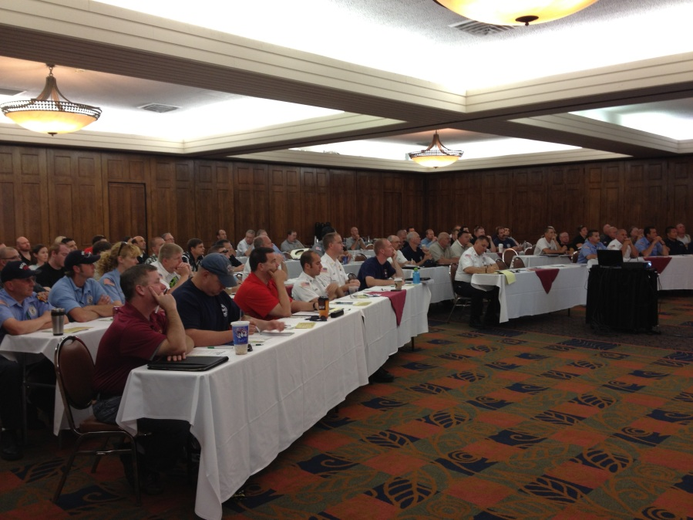
Administrative Information
Target audience
Delivery method
Course prerequisites
Course length
Notes:
Target Audience
This course is designed for individuals who will respond to ethanol-related emergencies as well as those who work at fixed-facilities and with transport fuel.
Delivery Method
Course delivery method consists of:
Lecture with PowerPoint presentations
Videos
Hyperlinks
Exercises
Participant discussions
Course Prerequisites
None
Course Length
4 hours - Lecture with PowerPoint presentations
6 hours - Lecture with PowerPoint presentations and student activities

Slide 4
Course Goal
Upon the completion of this course, participants will have knowledge related to ethanol & ethanol-blended fuels. The course provides participants with an understanding of:
Chemical & physical characteristics
Transportation modes
Transfer operations
Basics of foam
Suggested responder tactics & strategies
Environmental issues

Slide 5
Introduction
Increasing production, storage, & transportation of ethanol-blended fuels
Differing views on effectiveness of various firefighting foam concentrates
Emergency responders’ unfamiliarity with industrial processes of ethanol-blended fuels
Determining if ethanol-blended fuels represent a unique hazard for emergency responders
Notes:
Over 16 billion gallons of ethanol is transported across our country by railroad tank cars, highway cargo tank trucks, freighter ships/ barges and pipeline. Ethanol is one of the top hazardous materials shipped by rail today. It is important that the emergency responder community throughout the country is well prepared and trained for ethanol and ethanol-blended fuel-related emergencies.

Slide 6
Course Overview
Module 1: An Introduction to Ethanol
Module 2: Ethanol & Ethanol-Blended Fuels
Module 3: Chemical & Physical Characteristics of Ethanol & Hydrocarbon Fuels
Module 4: Transportation & Transfer
Module 5: Storage & Dispensing Locations
Module 6: Fire Fighting Foam Principles
Module 7: General Health & Safety Considerations
Module 8: Storage & Pre-planning Considerations

Slide 7
Training Package
PowerPoint presentations
Instructor manual
Participant guide
Videos
Extras
Rail Tank Car 101 PowerPoint & video
U.S. DOT Emergency Response Guide
Additional hazmat resources
Notes:
Included with this training program are:
Training program with PowerPoint & video presentations
Module PowerPoints embedded with instructor notes
Instructors manual
Participants guide
Emergency Response Considerations video
Responding to Ethanol Incidents video
Rail Tank Car 101 PowerPoint
Rail Tank Car 101 video
U.S. DOT ERG
TRANSCAER® and CHEMTREC® information
RFA Fuel Ethanol: Guideline for Release Prevention & Impact Mitigation
DOT Chart 16
AAR Pamphlet 34
Association of American Railroads Loading and Unloading video
RFA Guidelines for Hinged and Bolted Manway Assembly
RFA How to Properly Close a Tank Car Manway poster and brochure
2017 Field Guide for Tank Cars

Slide 8
Resources
Renewable Fuels Association: www.EthanolRFA.org
Ethanol Emergency Response: www.EthanolResponse.com
TRANSCAER: www.transcaer.com
Notes:
For additional information please visit the following web sites:
Renewable Fuels Association: www.EthanolRFA.org
Ethanol Emergency Response: www.EthanolResponse.com
TRANSCAER: www.transcaer.com

